Slide 1
οὔπω ἔχετε πίστιν
By Joseph Peters

Slide 2
The Author of Mark
…we shall now of necessity add to his words already quoted a tradition about Mark who wrote the Gospel, which he gives in these words: “This also the Presbyter used to say, ‘When Mark became Peter’s interpreter, he wrote down accurately, although not in order, all that he remembered of what was said or done by the Lord’” (Eus., Hist. eccl. 3.39).

Slide 3
The Author of Mark P2
And when he had considered the thing, he came to the house of Mary the mother of John, whose surname was Mark; where many were gathered together praying (Acts 12:12)
The church that is at Babylon, elected together with you, saluteth you; and so doth Marcus my son (1 Pe 5:13).

Slide 4
The Purpose of Mark
Matthew: The Promised Messiah
Mark: The Suffering Messiah
Luke: The Savior of the World
John: The Son of God
Strauss, Mark L. Four Portraits, One Jesus: A Survey of Jesus and the Gospels. Second Edition. Grand Rapids, MI: Zondervan Academic, 2020.

Slide 5
Objective
Everyone should have confidence in Jesus’ care and ability to save
For these two reasons

Slide 6
Rationale
The peace of Jesus during the chaos was evidence of his faith
The fear of the disciples during the chaos was evidence against their faith

Slide 7
Jesus and the Crowd
And he began again to teach by the sea side: and there was gathered unto him a great multitude, so that he entered into a ship, and sat in the sea; and the whole multitude was by the sea on the land. And he taught them many things by parables, and said unto them in his doctrine (Mark 4:1-2)
And the same day, when the even was come, he saith unto them, Let us pass over unto the other side. And when they had sent away the multitude, they took him even as he was in the ship. And there were also with him other little ships (Mark 4:35)

Slide 8
Jesus and the Crowd P2
Perceiving then that they were about to come and take him by force to make him king, Jesus withdrew again to the mountain by himself. When evening came, his disciples went down to the sea, got into a boat, and started across the sea to Capernaum. It was now dark, and Jesus had not yet come to them. The sea became rough because a strong wind was blowing (John 6:15–18).
And rising very early in the morning, while it was still dark, he departed and went out to a desolate place, and there he prayed (Mark 1:35).

Slide 9
The Chaos
And there arose a great storm of wind, and the waves beat into the ship, so that it was now full (Mark 4:37)
But the LORD sent out a great wind into the sea, and there was a mighty tempest in the sea, so that the ship was like to be broken (Jonah 1:4)

Slide 10
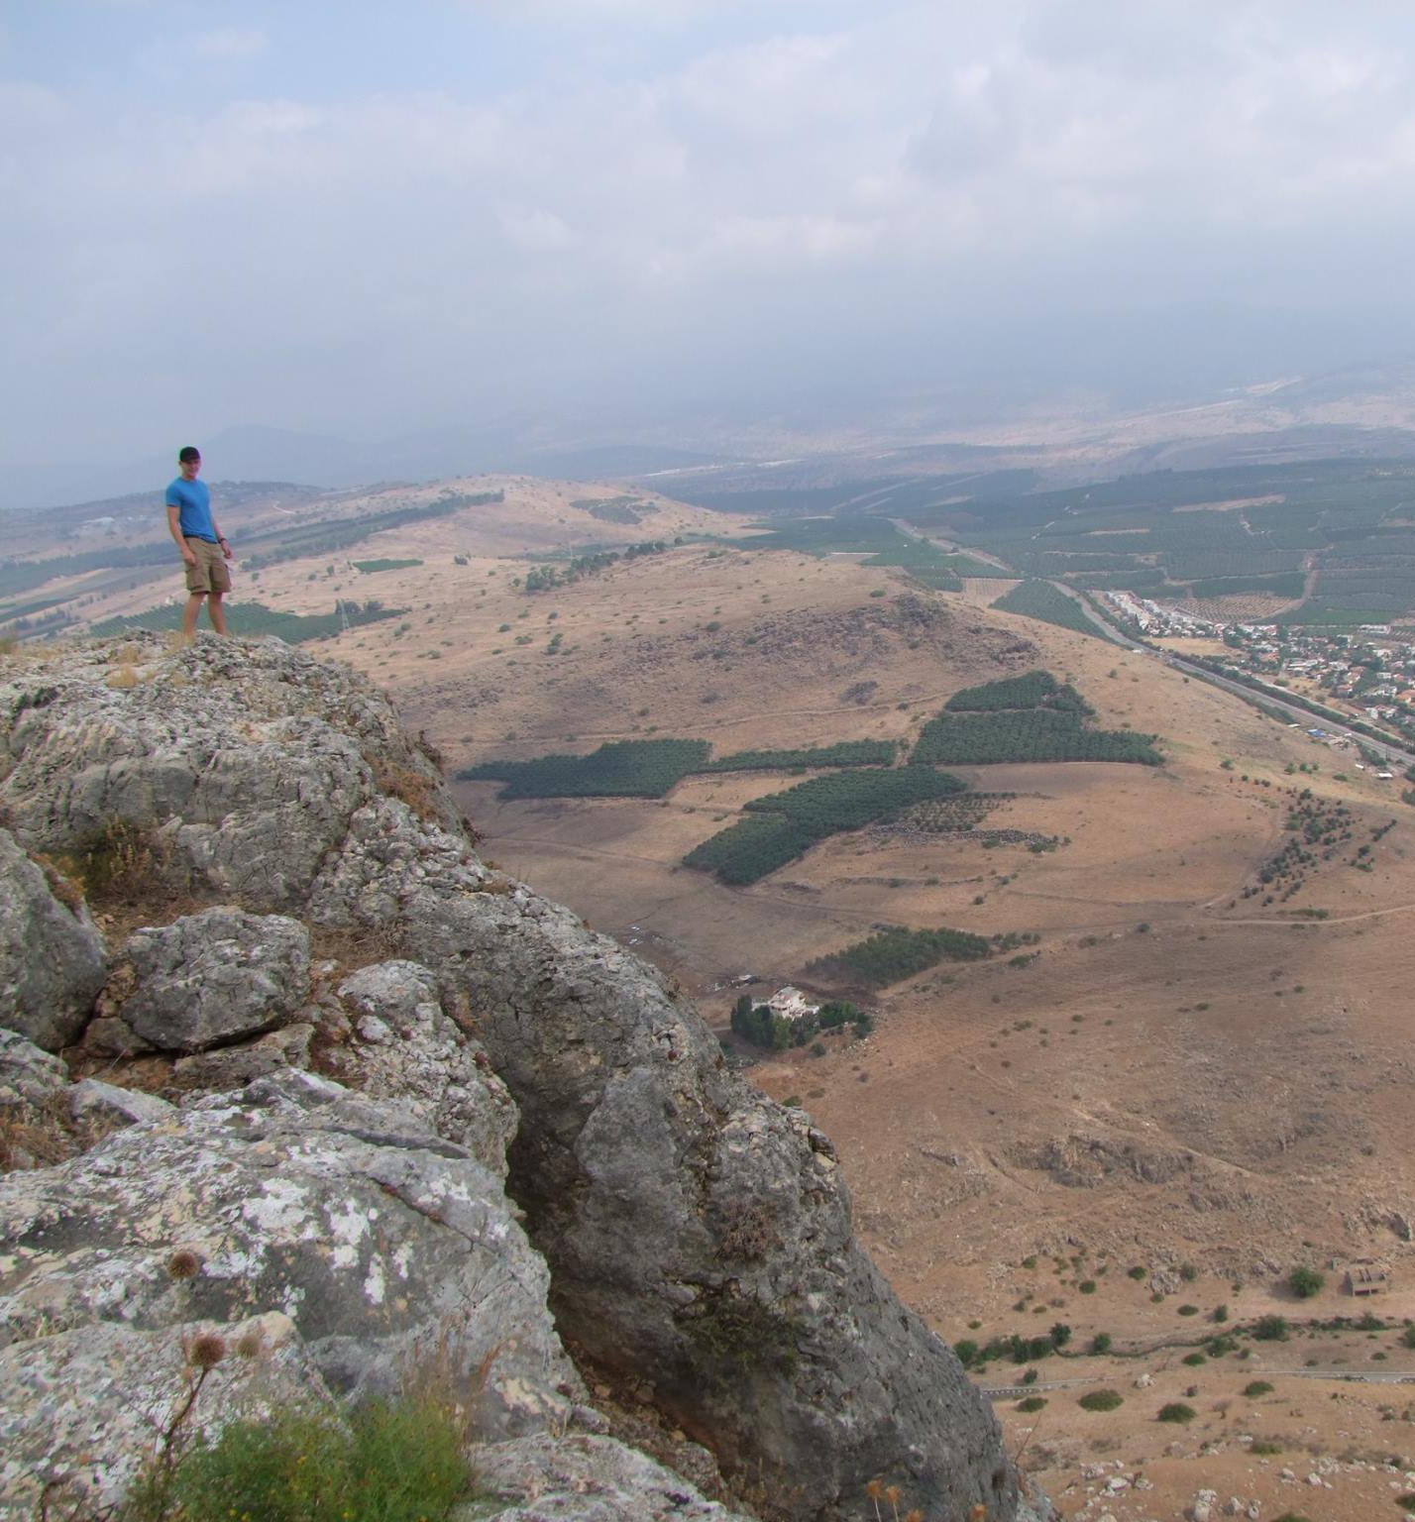
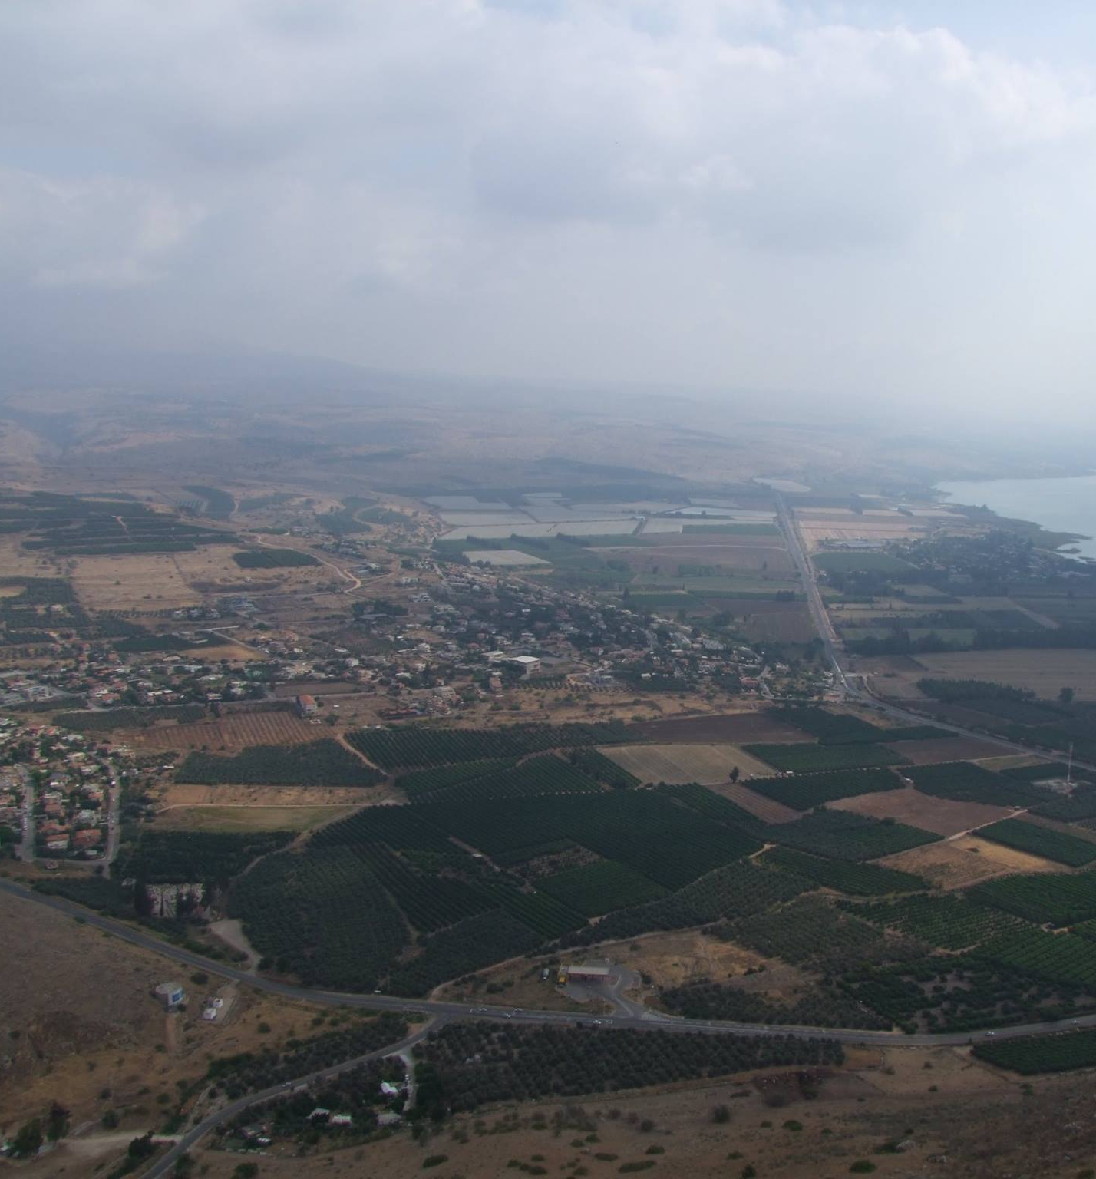

Slide 11
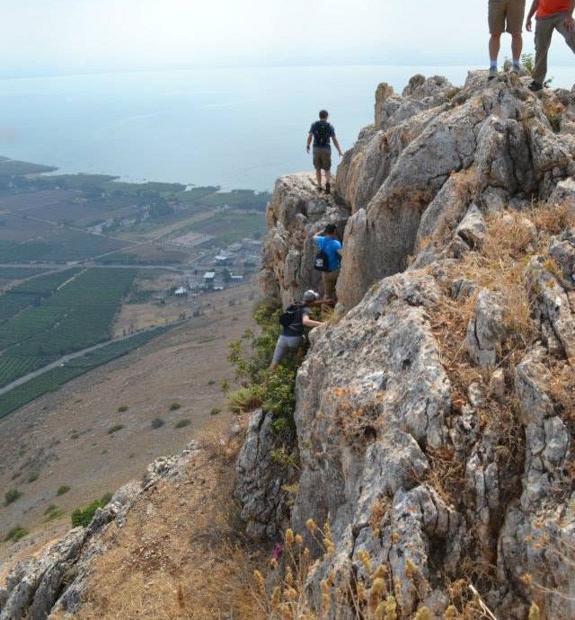
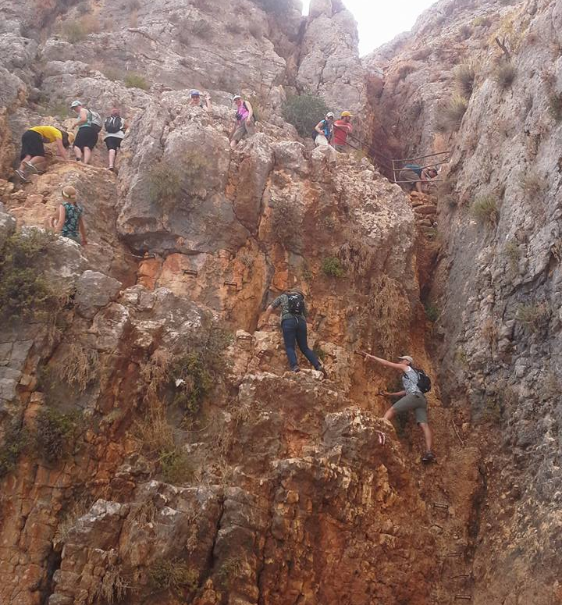

Slide 12
The Fear of the Disciples
Then the mariners were afraid, and cried every man unto his god, and cast forth the wares that were in the ship into the sea, to lighten it of them. But Jonah was gone down into the sides of the ship; and he lay, and was fast asleep. So the shipmaster came to him, and said unto him, What meanest thou, O sleeper? arise, call upon thy God, if so be that God will think upon us, that we perish not (Jon 1:5–6).
And he was in the hinder part of the ship, asleep on a pillow: and they awake him, and say unto him, Master, carest thou not that we perish (Mark 4:38)

Slide 13
Jesus Calms the Sea
And he arose, and rebuked [ἐπιτιμάω] the wind, and said unto the sea, Peace, be still [φιμόω]. And the wind ceased, and there was a great calm (Mark 4:39)
And Jesus rebuked [ἐπιτιμάω] him, saying, Hold thy peace [φιμόω], and come out of him (Mark 1:25).

Slide 14
The Power of God
They that go down to the sea in ships, That do business in great waters; These see the works of the LORD, And his wonders in the deep. For he commandeth, and raiseth the stormy wind, Which lifteth up the waves thereof. They mount up to the heaven, they go down again to the depths: Their soul is melted because of trouble. They reel to and fro, and stagger like a drunken man, And are at their wits’ end. Then they cry unto the LORD in their trouble, And he bringeth them out of their distresses. He maketh the storm a calm, So that the waves thereof are still. (Psalms 107:23-29)

Slide 15
Fear in Contrast to Faith
And he said unto them, Why are ye so fearful? how is it that ye have no faith? And they feared exceedingly, and said one to another, What manner of man is this, that even the wind and the sea obey him (Mark 4:40-41)
Then the men feared the LORD exceedingly, and offered a sacrifice unto the LORD, and made vows (Jonah 1:16)

Slide 16
Conclusion
The peace of Jesus during the chaos was evidence of his faith
The fear of the disciples during the chaos was evidence against their faith

