Slide 2
God is relational!
Gen. 1:26 “Let us make man in our image”
Ṣelem: resemblance, representative!
In Mt 6:9 Jesus introduced us to God as
“our Father which art in heaven”
The NT goes on to use this image 266 more times!

Slide 3
God’s very nature is Love! (1 Jn. 4:16)
Relationships are difficult because they involve specific “responsibilities” and expectations.
We tend to think others in our relationships “owe us”.
(Happiness, cooperation, respect, attention, etc.)
God brings us into relationships
In order to “GROW US!”

Slide 4
“The Heavenly Father”
has charged Human Fathers to accurately
represent Him to their children. Ps 127:3; Dt. 6:5-7
“thou shalt love the LORD thy God with all thine heart, and with all thy soul, and with all thy might.
And these words, which I command thee this day,
shall be in thine heart:
7 And thou shalt teach them diligently unto thy children…”

Slide 5
“The Heavenly Father”
has called men (earthly Fathers) to be:
“The Goodman of the house”
Pr 7:19, Mt 20:11; 24:43; Mk 14:14; Lk 12:39; 22:11
OT (ʾîsh) Man, Champion
NT (oikodespotēs) Head, master
“The Strongman of the house” Mt 12:29; Mk 3:27
ischyros’: forceful, mighty, able
(OT: Gibbor)

Slide 6
Speaking of Satan’s intention/nature to
“steal, kill, and destroy” (from Jn 10:10)
Jesus warned in Mk 3:27:
“No one can enter into a strong man's house, and spoil his goods,
except he will first bind the strong man;
and then he will spoil (diarpazo: Plunder)
his house.”

Slide 7
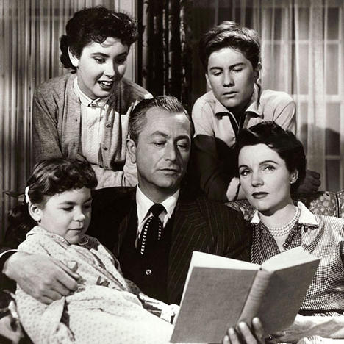
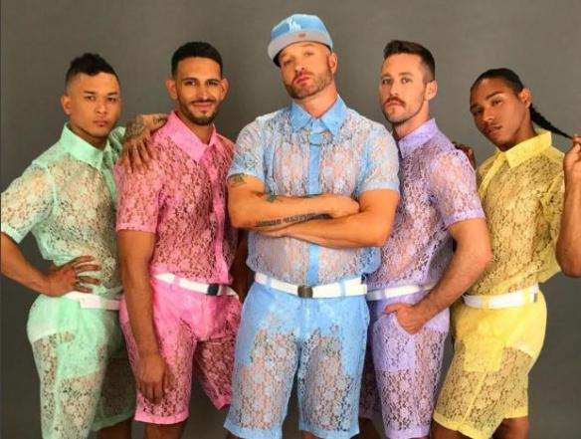
Strong men are becoming “bound men!”
Ps 12:1 “Help, LORD; for the godly man ceaseth;
for the faithful fail from among the children of men. “
“Father knows best” 1960
“Daddy’s Confused” 2022

Slide 8
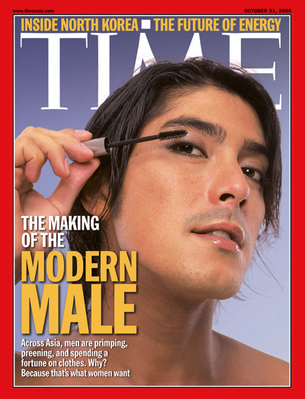
Masculinity is under attack!

Slide 9
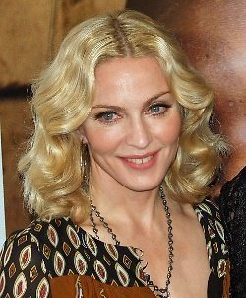
Masculinity is under attack!
“Straight men need to be emasculated.
They all need to be slapped around.
Women have been kept down
for too long.”
Madonna; Newsweek, 27 May 1991.

Slide 10
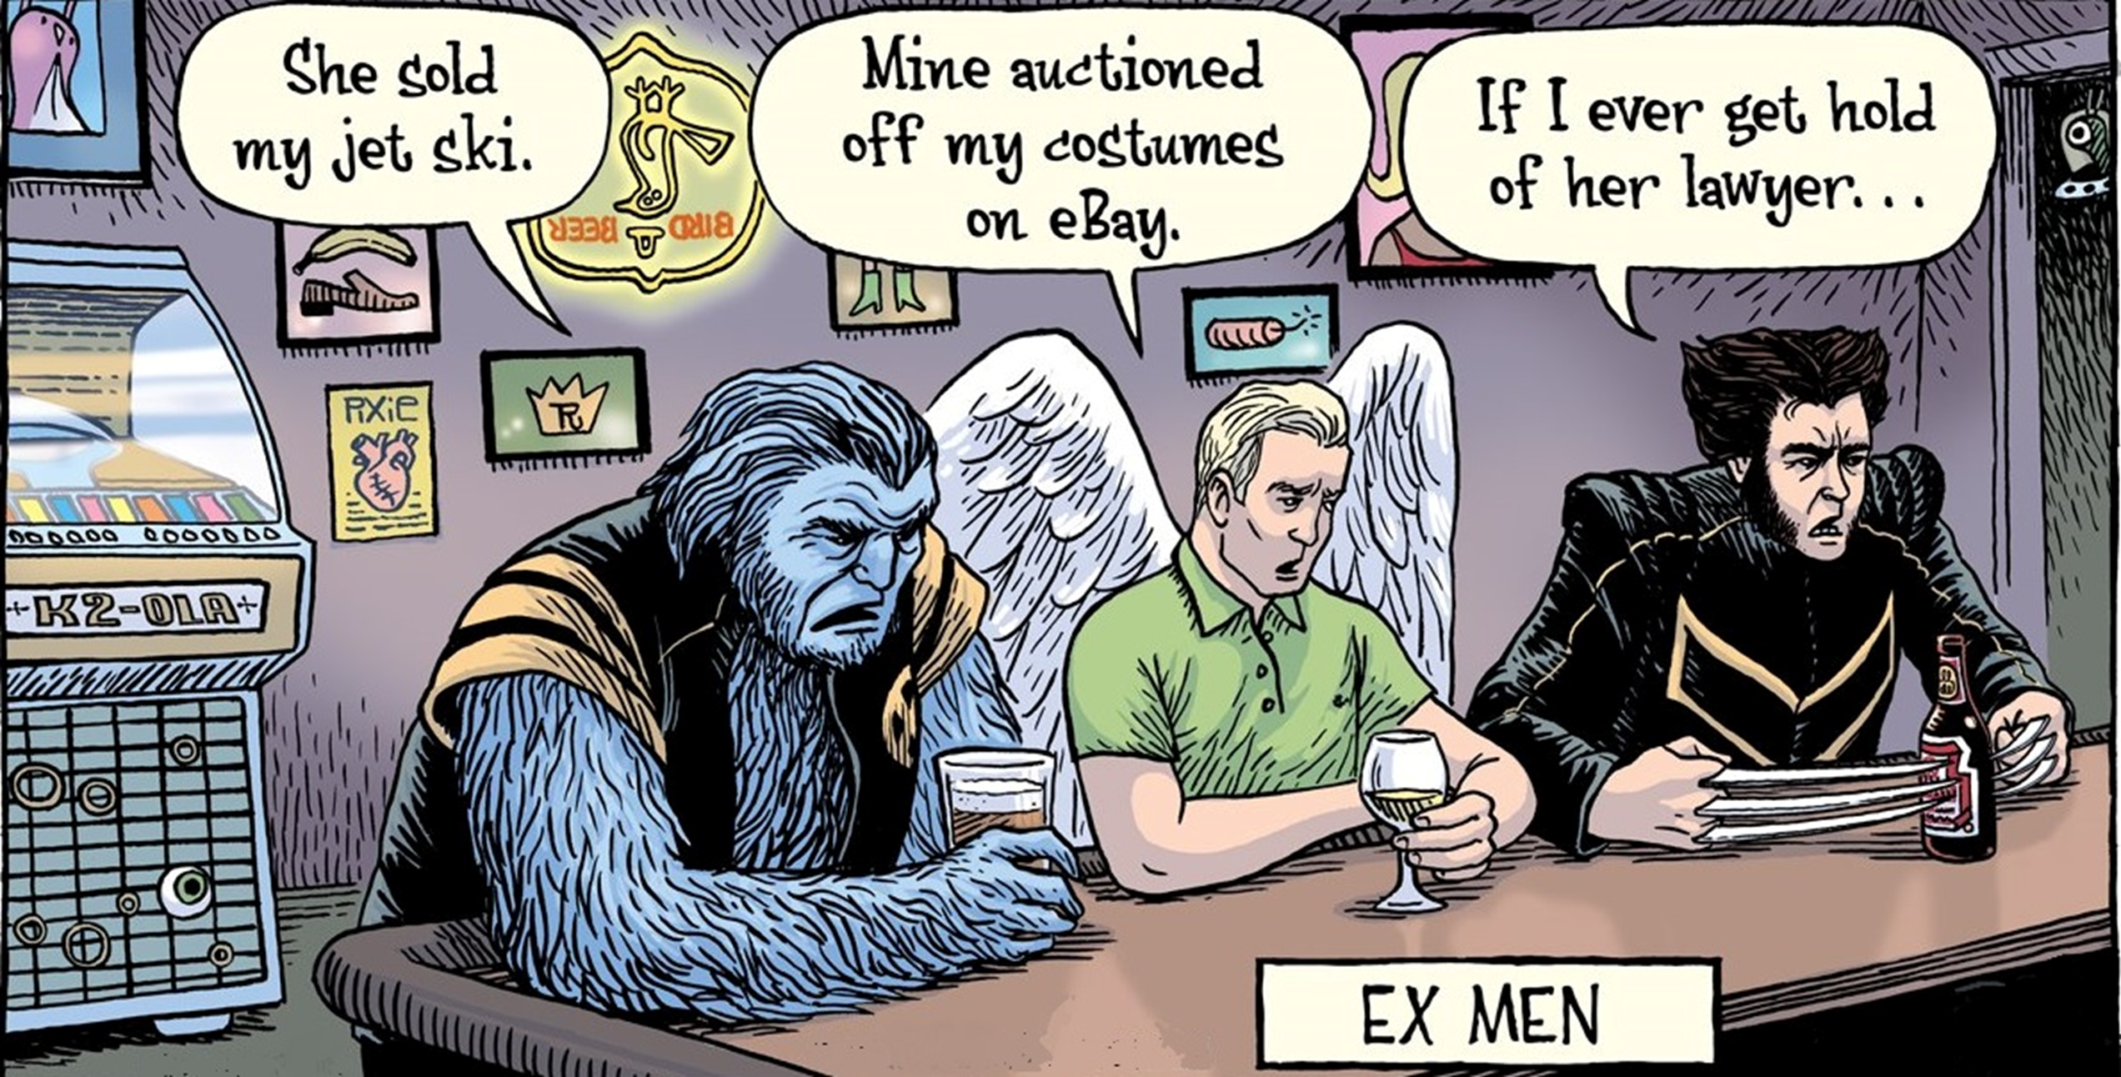
“Goodmen” and “Strongmen” have become:

Slide 11
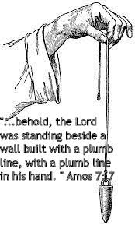
Amos 7 describe a series of Divine Judgments on Israel because of their sin.
In vs 7,8 God is seen measuring them with a plumbline,
Revealing how far they’d moved
away from His Standard.
God’s word used to be the “Plumbline” (standard)
with which our Nation’s laws and values
were built and measured.

Slide 12
This standard (by which we measure
masculinity and even “reality”)
has been rejected
and replaced by deceit and vanity.
This is clearly seen in the “Devaluation”
of Men in general,
and Fathers in particular.

Slide 13
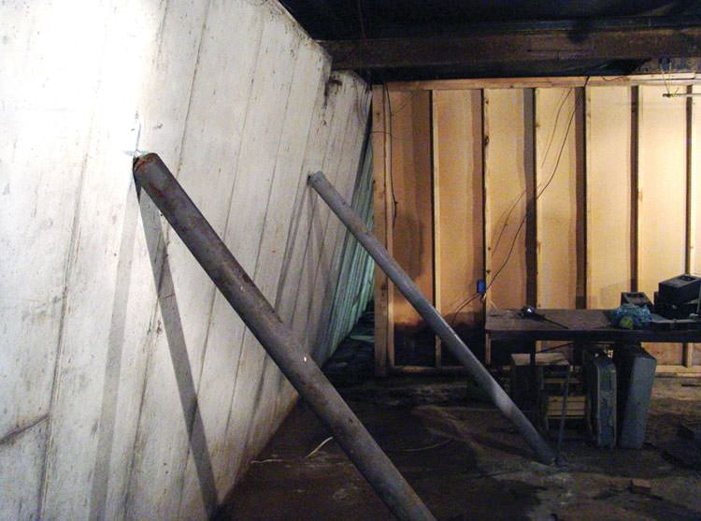
We, like Israel, have rejected God’s Standard and have bowed (moved)
so far off center
that we’re in danger of collapsing from the pressure.

Slide 14
Ez 22:30 “I sought for a man among them, that should make up the hedge, and stand in the gap before me for the land,
that I should not destroy it:
but I found none.”
God’s still looking for “Men” who will stand in the gap in this war of “misrepresentation”.

Slide 15
Psalm 128 is known as the Marriage Psalm.
(Sung at Jewish Weddings)
It’s one of the 15 “Songs of Degrees” sung by pilgrims
en route to Jerusalem for the three annual feasts.
“Degrees” (maʿalâ) means a journey of priority, elevation
Ps. 126: The need for Patience during crisis.
Ps. 127: Our need of God’s Providential care…
Particularly when it comes to our families.
Ps. 128: The need for solid families led by godly men.
Biblical “masculinity” is under attack…
and men are retreating!

Slide 16
God calls men in every generation to be:
“the sons of God… in the midst of a crooked and perverse nation, among whom ye shine as lights in the world;
Holding forth the word of life” Phil. 2:15,16
We can’t “stay straight” and “Shine” in a crooked and dark world without “holding the word of life.”
(checking the “plumb” of our beliefs and behaviors)
Ps. 128 provide several principles to help us to stay “straight” in a crooked world!

Slide 17
Walking Straight in a Crooked World Requires the right:
FEAR. (Motivation!) 128:1
“Blessed is every one that feareth the Lord“
A. “Blessed” ‏אֶשֶׁר‎: ʾesh’er (Supremely content)
Comes from ʾāshar’: to be straight
1) It’s God’s nature to bless His children! Lk 12:30-32
“For all these things do the nations of the world seek after: and your Father knoweth that ye have need of these things.
But rather seek ye the kingdom of God;
and all these things shall be added unto you.

Slide 18
1) It’s God’s nature to bless His children! Lk 12:30-32
Lk 12:31-32 “But rather seek ye the kingdom of God;
and all these things shall be added unto you.
Fear not, little flock;
for it is your Father's good pleasure
to give you the kingdom.”
a) Seeking God comes before “giving us the kingdom.”
b) Most are too busy seeking / building their own “Kingdom!”

Slide 19
A. “Blessed is every one that feareth the Lord“ 2) God’s “blessing” is related to our “walk”.
vs 1 “that walketh (shaqad’: watches, remains) in His ways”
a) God’s word (Plumb line) reveals where things
(Priorities) are “misaligned”. Ps 119:9-10
“Wherewithal shall a young man cleanse his way?
by taking heed thereto according to thy word.
With my whole heart have I sought thee:
O let me not wander from thy commandments.”

Slide 20
2) God’s “blessing” is related to our “walk”.
“that walketh (shaqad’: watches, remains) in His ways”
b) Little “misalignments” can eventually
produce major “messes”.
Pr. 3:5,6 “Trust in the Lord with all thine heart…
In all thy ways acknowledge Him,
And He shall direct (Yashar: straight) thy paths.”
Pro. 4:26-27 “Ponder the path of thy feet,
and let all thy ways be established.” (kun: prepared)

Slide 21
FEAR. (Motivation!) 128:1 “everyone that:
B. “Feareth The Lord.” Blessing is Related to our:
‏ 1) Accountability ‎ “feareth” Yareh (awe/ fear / revere)
2 Cor 5:9-11 “we labor, that we may be accepted of him.
For we must all appear before the judgment seat of Christ;
that every one may receive the things done in his body, …
whether it be good or bad.
Knowing therefore the terror (phobos: fear or alarm)
of the Lord, (kurios: supreme master!) we persuade men…”
(vs 14-20) “Be reconciled to God”

Slide 22
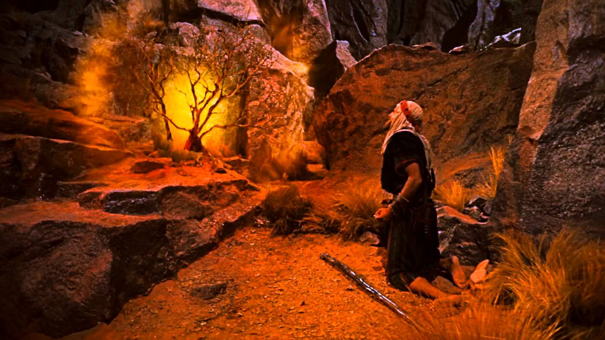
B. “Feareth The Lord” Related to our:
1) Accountability “fear” יָרֵא‎ Yareh (awe / revere)
2) Worship “The Lord” (‏יהוה‎ yhwh) 6519 X
Ex 3:2 “the LORD appeared unto him in a flame of fire out of the midst of a bush…
5 …put off thy shoes from off thy feet,
for the place whereon thou standest
is holy ground.”
Ex. 3:14
“I AM that I AM”

Slide 23
1. “Blessed is everyone that feareth the Lord”
C. Giving God Preeminence in our lives is the
rational response! (Col. 1:18; Mt. 6:33; Pr. 3:5,6)
Pr. 9:10 “The fear of the LORD
is the beginning of wisdom.”
Luke 6:46 “why call ye me, Lord, Lord,
and do not the things which I say?”
1 Kgs 18:21 “How long halt ye between two opinions?
if the LORD be God,
follow him:…”

Slide 24
Walking Straight in a Crooked World Requires the right:
FOCUS. (Concentration!) “walketh in His ways.”
(Begin with an End In View!)
A. God Has Certain Paths That He Can Bless.
Ps. 16:11 “Thou wilt show me the path of life…”
Ps 119:105 “Thy word is a lamp unto my feet,
and a light unto my path.”
Pr 4:18 “But the path of the just is as the shining light,
that shineth more and more unto the perfect day.”
Pr. 22:6 “Train up a child in the way he should go…”
Derek: road, path, course or manner of life

Slide 25
Walking Straight in a Crooked World Requires the right:
FOCUS. (Concentration!) “that walketh in His ways.”
(Begin with an End In View!)
A. God Has Certain Paths That He Can Bless.
B. Satan Seeks To Pull Us Off these paths Jms 1:14
“every man is tempted when he’s drawn away...”
Pr. 4:14-15 “Enter not into the path of the wicked, go not in the way
of evil men. Avoid it, pass not by it, turn from it, and pass away. “
Ps 119:104 “Through thy precepts I get understanding:
therefore I hate every false (she’qer: deceitful) way.”

Slide 26
Walking Straight in a Crooked World Requires the right:
FOCUS. (Concentration!) “that walketh in His ways.”
(Begin with an End In View!)
C. The Right Worship Leads To The Right Walk.
1) Worship involves giving God the “worth” He’s due. Rev. 4:11 “Thou art worthy…thou has created all things,
for thy pleasure (thelēma: purpose) they are created”
2) Obedience is the natural result of a genuine fear
(honor) of the Lord. See Ecc. 12:13,14
“The conclusion of the whole matter…”

Slide 27
Walking Straight in a Crooked World Requires the right:
FOCUS. (Concentration!) “that walketh in His ways.”
(Begin with an End In View!)
D. The basis of our Authority (as Human Fathers)
is our obedience to our Heavenly Father.
(1 Cor 11:1-3; Mt. 8:9,10)
1) If you’re not willing to honor & submit to God,
why should others to do so to you?
Remember Gal. 6:7

Slide 28
Walking Straight in a Crooked World Requires the right:
1. FEAR (Motivation) 2. FOCUS (Concentration!)
3. FAMILY Relationships (Expectation)
2 “thou shalt eat the labor of thy hands”
A. Husband comes from “Husbandman”.
1) Norse (Noun) (husbondi) “Master of the house”
2) Old (1290) English Verb from Husbandry:
To “Manage” (care for) a household
(instead of just animals or crops)

Slide 29
3. FAMILY (Expectation) 2 “eat the labor of thy hands”
B. Notice The Gardening References Vs 3
1) “Thy wife shall be as a fruitful vine”
(Jewish symbol of prosperity and abundance.)
a) She’s to be Fruitful (practical),
“I will make a help meet (‏עֵזֶר‎: ʿēzer: aid) for him.” Gen 2:18
b) The vine is a pliable and tender plant, and needs to
be supported and protected. (Eph. 5:29; 1 Pt 3:7)
“Giving honor unto her as unto the weaker vessel”
not just beautiful.

Slide 30
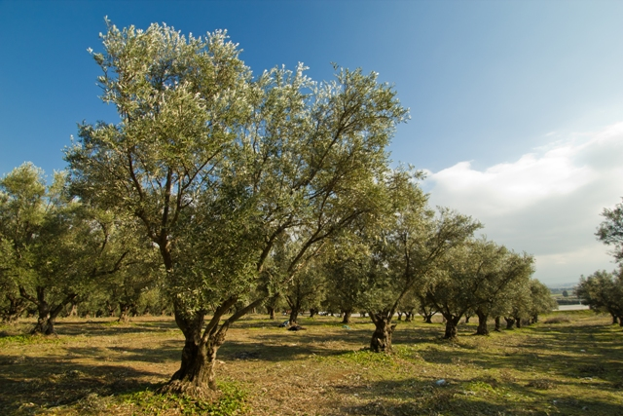
Walking Straight in a Crooked World Requires the right:
3. FAMILY (Expectation) 2 “eat the labor of thy hands”
B. Notice The Gardening References Vs 3
2) “Thy Children as olive plants...”
a) Olive Plants Had Great Value.
They provided fruit
and income
for many generations.

Slide 31
2) “Thy Children as olive plants...”
b) Implies Investing / reproducing a godly
influence generationally! (Mal. 2:15; Is. 58:12)
“And they that shall be of thee
shall build the old waste places:
thou shalt raise up the foundations of many generations;
and thou shalt be called,
The repairer of the breach,
The restorer of paths to dwell in.”

Slide 32
B. Notice The Gardening References Vs 3
2) “Thy Children as olive plants...”
c) Olive Plants Required Pruning
in order to be Productive!
Pr. 22:6 “train up a child in the way he should go…”
‏חָנַךְ‎: ḥānak: to dedicate or narrow. (limit)
Jn 15:1 “My father is the husbandman.”
That’s every father’s job description!

Slide 33
Conclusion:
Ps 128:4-6 “Behold, that thus shall the man be blessed that feareth the LORD.
5 The LORD shall bless thee out of Zion: and thou shalt see the good of Jerusalem all the days of thy life.
Yea, thou shalt see thy children's children,
and peace upon Israel”
The nation will be blessed in direct proportion to the commitment of godly fathers to walk with God and influence their families. (Ps. 78:5-7)

Slide 34
Ps. 78:5-7 "He established a testimony in Jacob
and appointed a law in Israel,
which He commanded our Fathers,
that they should make them known to their children:
that the generation to come might know them,
even the children which should be born;
who should arise and declare them to their children:
that they might set their hope in God,
and not forget the works of God,
but keep (nāṣar: guard) His commandments."

Slide 35
APPLICATION
The word used in Pr. 22:6 for “Train up a child”
(ḥānak) has an interesting “history.”
It comes from the name “Enoch” (ḥanôk’) in Gen. 5.
Adam lived 930 years. (Gen. 5:5)
Enoch was born 622 years after God created Adam.
Noah was born 1056 years after Creation.
That means that within 1 generation of Adam’s death…
“all flesh had corrupted his way upon the earth.” Gen. 6:12
This corrupting process was underway during Enoch’s life,
but something happened to change Enoch!

Slide 36
Gen 5:22 “And Enoch walked with God
after he begat Methuselah”
It appears that becoming a father changed Enoch!
He began to “see things” differently.
Have you had a “Methuselah” Moment?

Slide 37
Heb 11:5 “By faith Enoch was translated” (metatith’ēmi)
meta: To accompany (aka: he “walked with God”)
tithemi: to transfer, exchange, change sides!
After the birth of his son,
It appears he began to take God seriously.
He literally “Changed Sides!”

Slide 38
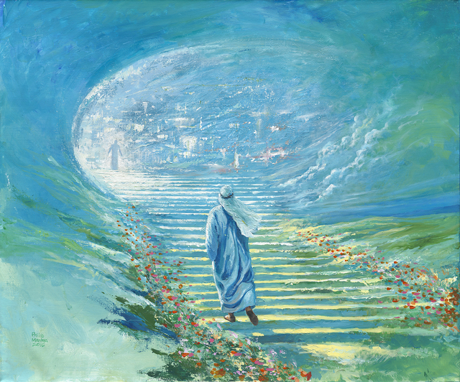
He literally “Changed Sides!”
He began to “exchange” his societies values for God’s.
Eventually there was more of His heart in heaven
than on Earth.
Mt. 6:20 “Lay up for yourselves treasures in heaven…
21 For where your treasure is,
there will your heart be also.”

Slide 39
Heb 11:5 “By faith Enoch was translated” (metatith’ēmi)
For before his translation, He had this testimony,
that he pleased God.”
“Pleased”: euaresteo: to gratify entirely.
Men, Is God Pleased with our:
Worship? “Blessed is the man that fears the Lord”
Walk? “That walks in His ways” Ps. 128:1
With our “worth” (investment/commitment)
in and to our Families?

Slide 40
Perhaps it’s time we all had our own “Methuselah Moment”
“Blessed is every one that feareth the LORD, that walketh in
His ways.”
Ps. 138:1

