Slide 1

Faithful

Slide 2
Pr. 20:6 “Most men will proclaim their own goodness,
but a faithful Man (ʾēmûn: trustworthy)
who can find?
⁷ The just man walketh in his integrity: his children are blessed
Ešer: happy, fortunate
after him.”
(from 'āšar’: guided, straight)
aḥar’: by following behind him

Slide 3
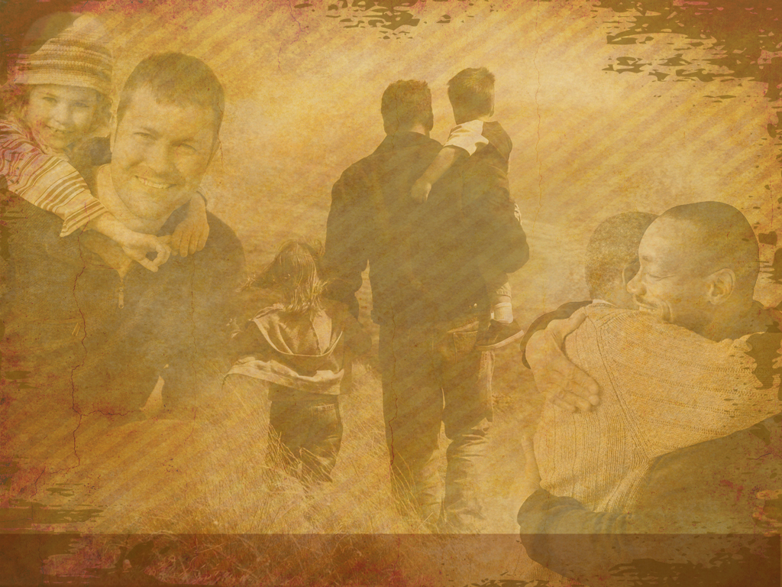

“Father” is used 352 times in the New Testament.
266 times it is used to describe God!
Last week we discussed the awesome responsibility God has given Fathers to represent Him to their families.
The Bible often refers to the Father’s Role as a type of “Partner” with God in the growing/guiding of his family.

Slide 4
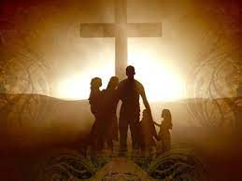
God the models the qualities of a loving Father to us, and challenges us to:
“Take my yoke upon you and learn of me”
(Mt 11:28,29)
so we can cultivate those qualities in our own hearts
and reflect them through our own lives.
(Phil. 2:13; Ro. 12:1,2)

Slide 5
Deut. 6 gives us some important directions on how to accomplish this in our hearts and homes.
I began to summarize the principles of this chapter using an Acronym for Father.
F: Faithful to…
1) Obediently Listen to God (vs 3),
2) Sincerely Love God (vs 5),
3) Intentionally Learn about God (vs 6),
4) Diligently Lead our Families to a vibrant and
intimate relationship with God! (Vs 7)

Slide 6
F: Faithful
A: AVAILABLE Dt 6:7
“thou… shalt talk of them
(God and His word and ways)
when thou sittest in thine house,
And when thou walkest by the way,
and when thou liest down,
and when thou risest up."

Slide 7
A: AVAILABLE
1) Many fathers are “unavailable” to their families.
a) According to Dr. James Dobson, the average amount
of time middle-class fathers spent with their small
children was 37 seconds per day!
b) Their direct interaction was limited to 3 encounters
daily, lasting ten to fifteen seconds each!
2) Aren’t you glad our Heavenly Father is available to us?
Heb. 13:5 “I will never leave thee nor forsake thee…”
Jer 33:3 “Call upon me and I will answer thee….”

Slide 8
2) Aren’t you glad our Heavenly Father is available?
(Often giving us “Father Figures”)
1 Thes. 2:11,12 "As ye know how we exhorted
(parakaleo: to call near, or invite; walk beside)
and comforted (paramythe’omai: to relate near,
encourage, console:--comfort) and charged (martyreō: to be a witness, testify) every one of you,
as a father doth his children,
That ye would walk worthy of God,
who hath called you unto his kingdom and glory."

Slide 9
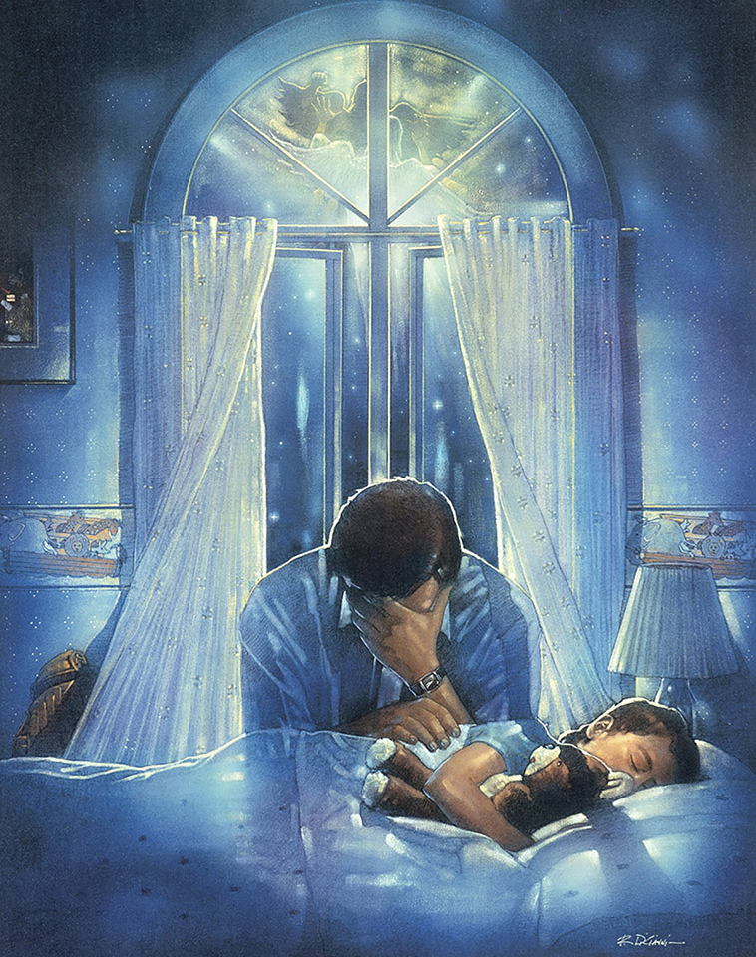
God doesn’t come asking about our ability;
But our availability!
If we give him our availability, and demonstrate our dependability,
He will increase our Capacity!
Phil. 2:13 “It’s God which worketh in you…”
3:13,14 “this one thing I do…
I press toward the mark…”
4:13 “I can do all things through Christ..”

Slide 10
T: Teachable
F: Faithful A: Available
vs 6“these words shall be in thine heart,
and thou shalt teach them to thy children…”
1) We Can Only Be Effective Teachers If We purpose to Remain Humble, growing Students! 2 Pt 1:
4 “Whereby are given unto us exceeding great and precious promises: that by these ye might be partakers of the divine nature, having escaped the corruption that is in the world through lust.
5 And beside this, giving all diligence, add to your faith virtue; … knowledge; 6 …temperance; …. patience; …. godliness;
7 … brotherly kindness; and to brotherly kindness charity.”

Slide 11
T: Teachable
F: Faithful A: Available
2) We Can’t Learn Unless We Can really Listen.
“Seek first to understand,
a) Communication Is The Key To Cultivating and
Conserving healthy Relationships.
b) Ways To Listen More Effectively:
➔ Remove the distractions that COMPETE.
Pr 17:1 "Better is a dry morsel, and quietness therewith,
than an house full of sacrifices with strife."
This is necessary of our communication with God.
Ps 46:10 "Be still, and know that I am God: "
then to be understood!” S. Covey

Slide 12
b) Ways To Listen More Effectively:
➔ Remove the distractions that COMPETE.
➔ Relinquish the desire to COMPARE or CONTROL.
2 Cor 10:12 "measuring themselves by themselves, and comparing
themselves among themselves, are not wise."
➔ Renew the decision to COMPREHEND.
Counsel before comprehension is folly. Pr 18:13
"He that answereth a matter before he heareth it,
it is folly and shame unto him.“
➔ Recognize the Responsibility to COUNSEL. Prov 4:1
"Hear, ye children, the instruction of a father, and attend to know understanding. For I give you good counsel…"

Slide 13
3) Being teachable (so we can teach others)
requires Tenacity.
2 Tim. 2:15 “Study (Spoudazō: be diligent, make effort)
to shew thyself approved unto God,
a workman that needeth not to be ashamed,
rightly dividing the word of truth.”
Dt 6:7 “Thou shalt teach them diligently unto thy children…”

Slide 14
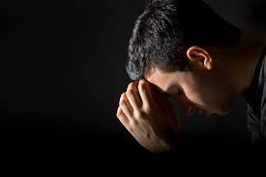
2Pt 3:18 "grow in grace, and in the knowledge
Lord, who am I to teach the way,
To my children, day by day,
So prone myself to go astray.
I teach them knowledge, but I know,
How faint they flicker and how low
The candles of my knowledge glow.
I teach them power to will and do, But only now to learn anew,
my own great weakness through and through.
Lord if their guide I still must be, Oh, let my precious children see
Their Father leaning hard on thee!
of our Lord
and Savior
Jesus Christ. "

Slide 15
F: Faithful A: Available T: Teachable
H: HUMBLE Vs 2, 10,11,12
“beware lest thou forget the LORD, which brought thee forth out of the land of Egypt, from the house of bondage.”
1) True humility is related to genuine Honesty!
Ps 15:2 “he that walks uprightly and works righteousness, and speaketh truth in his heart…”
Pr 20:7 “The just man walketh in his integrity:
his children are blessed after him. “

Slide 16
H: HUMBLE Vs 2, 10,11,12
2) It’s too easy to forget who we are, whose we are,
and where we’ve come from. Dt 8:11
“Beware that thou forget not the LORD thy God, …
14 Then thine heart be lifted up, and thou forget the LORD …God,
which brought thee forth .. from the house of bondage…”
Jms 4:6,10 "He giveth more grace. …God resisteth the proud,
but giveth grace unto the humble.
Humble yourselves in the sight of the Lord,
and he shall lift you up."

Slide 17
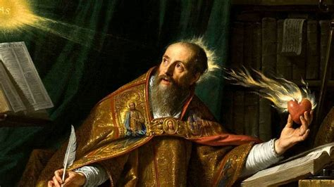
“Do you wish to be great? Then begin by being humble.
Do you desire to construct a vast and lofty building?
Think first about the foundations of humility.
The higher your structure
is to be,
the deeper must be its foundation.”
Augustine (354-430)
1Pt 5:5,6 "be subject one to another, and be clothed with humility: for God resisteth the proud, and giveth
grace to the humble. Humble yourselves therefore under the mighty hand of God, that he may exalt you…”

Slide 18
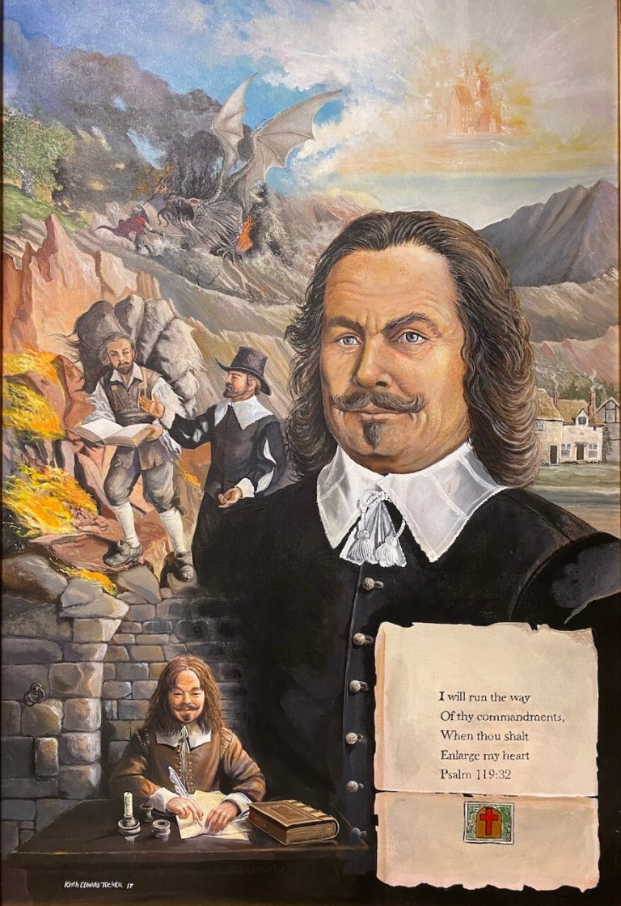
John Bunyan (1628-1688)
“He that is down needs fear no fall,
He that is low,
no pride.
He that is humble shall ever have
God to be his guide.”

Slide 19
F: Faithful A: Available T: Teachable H: Humble
E: EXPERIENCED Dt 6:6
“These words…shall be in thine heart…
You cannot teach what you do not know
or lead where you’ve never been. Mt 15:14
“Let them alone, for they be blind leaders of the blind.
And if the blind lead the blind,
both shall fall into the ditch.”

Slide 20
Daddy had a little boy, His soul was white as snow.
He never went to Sunday School
Cause Daddy wouldn't go.
He never heard the Word of God.
That thrills the childish mind,
While other children went to class,
This child was left behind.
As he grew from babe to youth, Dad saw to his dismay,
A soul that once was snowy white,
Became a dingy grey.

Slide 21
When he realized his son was lost,
Dad tried to win him back.
But now the soul that once was white,
Had turned an ugly black.
Dad started going back to church, and Bible study too;
He often asked the preacher,
“Isn’t there anything you can do?”
The preacher tried, failed, and said
“We're just too far behind;
I tried to tell you years ago,
But you paid me no mind."

Slide 22

And so, another soul was lost,
That once was white as snow;
Sunday School could have helped,
But Daddy
wouldn't go!

Slide 23
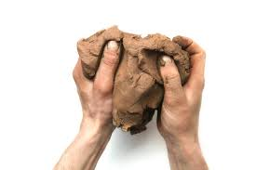
“I took a piece of plastic clay,
And idly fashioned it one day.
And as my fingers pressed it still,
It moved and yielded to my will.
I came again when the days were passed,
And the bit of clay was hard at last.
The form I gave it still it bore,
But I could change that form no more.

Slide 24
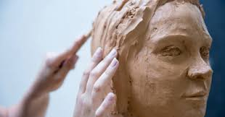
I took a piece of living clay,
And gently formed it day by day;
and molded with my power and art,
A young child's soft and yielding heart.
I came again when the days were gone,
It was a man I looked upon.
He still that early impress wore,
But I could change that form no more.”
-- Dave Stone

Slide 25
F: Faithful A: Available T: Teachable H: Humble E: Experienced
R: REVERENT Vs 13,14
“Thou shalt fear the LORD thy God,
and serve him,
…Ye shall not go after other gods, …”
Ps 15:4 "he honoreth them that fear the LORD."
Pr 9:10 “The fear of the LORD
is the beginning of wisdom:
and the knowledge of the holy is understanding.”

Slide 26
Every map must have a reference point to be useable.
That point must be unmovable in order to give meaning to the rest of the map.
Ps. 15:1 asks: “LORD, who shall abide in thy tabernacle?”
And goes on to answer: “He that walketh uprightly, and worketh righteousness, and speaketh the truth in his heart.
He that backbiteth not with his tongue, nor doeth evil to his neighbor…In whose eyes a vile person is contemned;
but he honoreth them that fear the LORD.
He that sweareth to his own hurt, and changeth not…
He that doeth these things shall never be moved.”

Slide 27
Our relationship to the Lord should be the solid “Reference Point” in our lives and one from which our children can navigate their own lives.
1 Th 2:10-12 “Ye are witnesses, and God also, how holily and justly and unblameably we behaved ourselves among …:
As ye know how we exhorted and comforted and charged every one of you,
as a father doth his children,
That ye would walk worthy of God,
who hath called you unto his kingdom and glory.”

Slide 28
APPLICATION:
What (who) is your “reference point” as a Father?
If your kids follow your life’s “map”,
will you be content with where it leads them?
Pr. 20:7 “The just man walks in his integrity:
his children are blessed (from 'āšar’: guided straight) after him.” (aḥar’: by following behind him)
Will your children be “Blessed”
by following “after” you?

Slide 29

2 Tim 2:1 “Thou therefore,
my son,
be strong in the grace that is in Christ Jesus.
3 Thou therefore endure hardness, as a good soldier of Jesus Christ.
4 No man that warreth entangleth himself with the affairs of this life;
that he may please him who hath chosen him to be a soldier.”
(and Father)

Slide 30
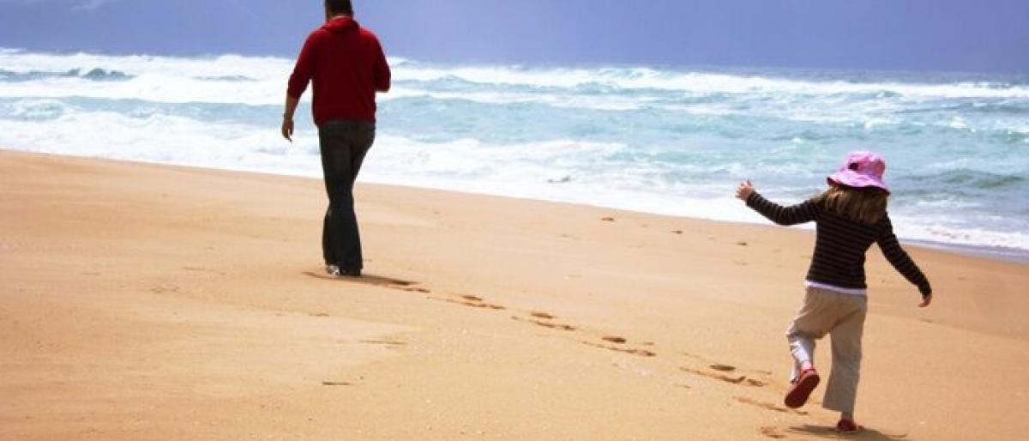
Walk a little slower Daddy,
said a child so small
I’m following in your footsteps,
and I don’t want to fall!
Sometimes your steps are very fast,
sometimes they’re hard to see.
So walk a little slower daddy,
for you are leading me.

Slide 31
Someday when I am all grown up, you’re what I want to be.
Then I will have a little child,
Who’ll want to follow me!

Slide 32
And I would want to lead just right,
And know that I was true.
So walk a little slower, Daddy,
For I must follow you!
Author Unknown

