Slide 1
Failing
Forward!
Mt 26:31-56

Slide 2
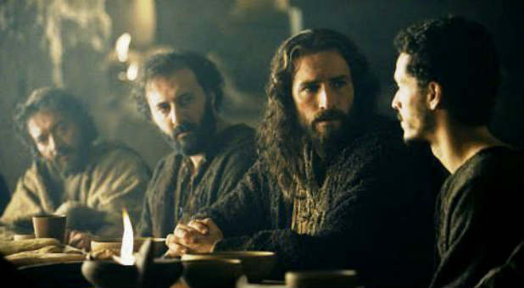
Mt 26:31 “All ye shall be offended because of me…”

Slide 3
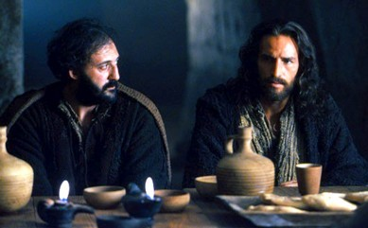
33 “Peter said,
Though all men shall be offended
because of thee,
yet will I never be offended.
35 Though I should die with thee,
yet will I not deny thee.
Likewise also said all the disciples.”

Slide 4
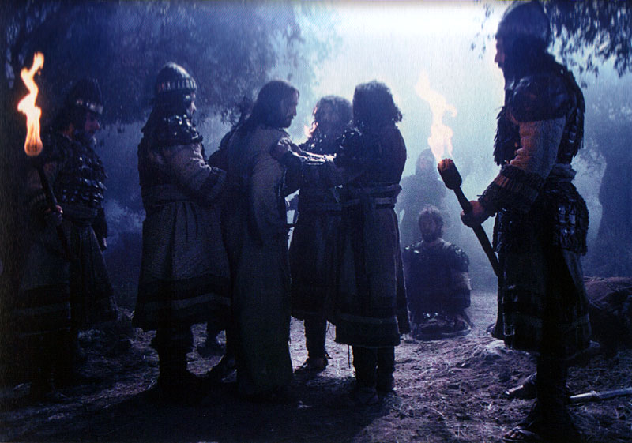
“Then all the disciples forsook him, and fled.”
Mt 26:56

Slide 5
Failure is a common denominator.
It’s also like a two edged sword;
Carrying with it seeds of blessing & bane.
The very “humiliation” that failure brings can produce humility,
Which can result in God’s Grace!
(Jms 4:6)

Slide 6
It’s possible to “Fail Forward”,
using the pain and disappointment of our failures to draw us closer to God.
(Mt 11:29,30)
God specializes in bringing
“Beauty out of Ashes”. (Is. 61:1-3)
See also Ro. 8:28,29; Phil. 1:12
Our stumbling blocks can become stepping stones! (Gen. 50:20)

Slide 7
1. Understanding Failure
A. Failure Is Universal Ro. 3:23
“all have sinned and come short…”
(hamartanō: to miss the mark)
Eccl 7:20 “there is not a just man upon earth, that doeth good, and sinneth not.”

Slide 9
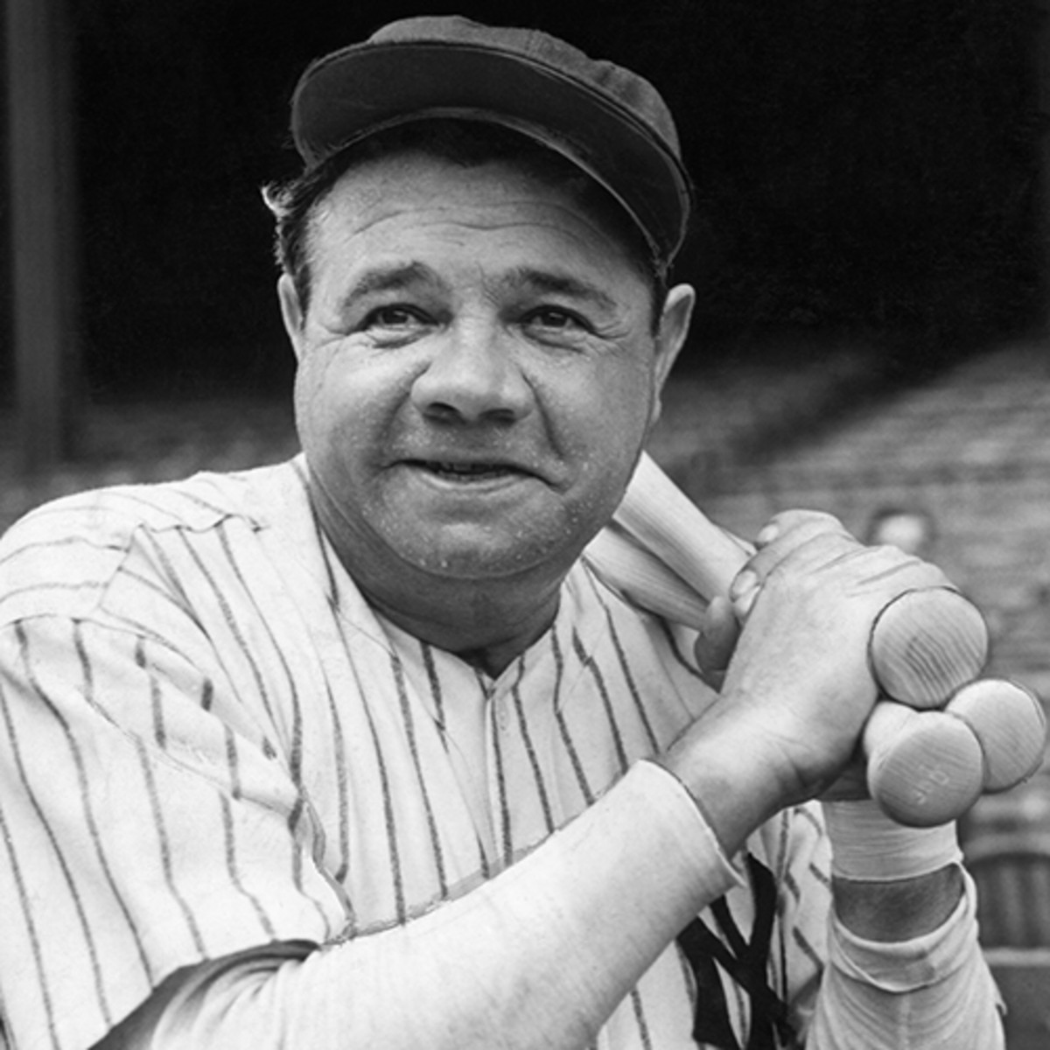
We all have a history of failure.
You fell down the first time you tried to walk.
You almost drowned the first time
you tried to swim!
Did you get a home run the with the first swing of the baseball bat?
Babe Ruth struck out 1,330 times,
but he also hit 714 home runs.

Slide 10
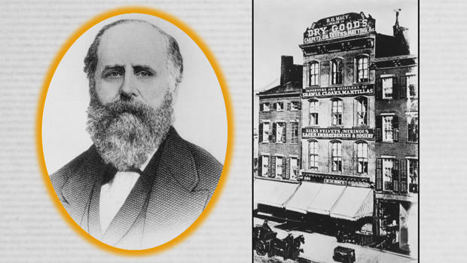
R. H. Macy failed four times before his store in New York caught on.

Slide 11
1. Understanding Failure
B. Failure Is An Indicator.
1) A failing grade on a test reveals something!
a) You didn’t just fail “The test”, but the test
revealed a failure to comprehend the material.
b) It wasn’t a failure to take the test,
but to adequately prepare for the test.

Slide 12
1. Understanding Failure
B. Failure Is An Indicator.
The Apostles Failure began before the garden.
(Pride, Preoccupation with self)
Mt 26:40-41 “could ye not watch with me one hour?
Watch and pray, that ye enter not into temptation:
the spirit indeed is willing,
but the flesh is weak.”

Slide 13
C. Failure Is Subjective.
1) We tend to evaluate the significance of
a failure on some inconsistent things.
(Embarrassment, cost, criticism, etc)
2) What some consider failure
might be (or lead to) success to others!
Edison held 1,093 patents, including the phonograph, the motion picture camera…

Slide 14
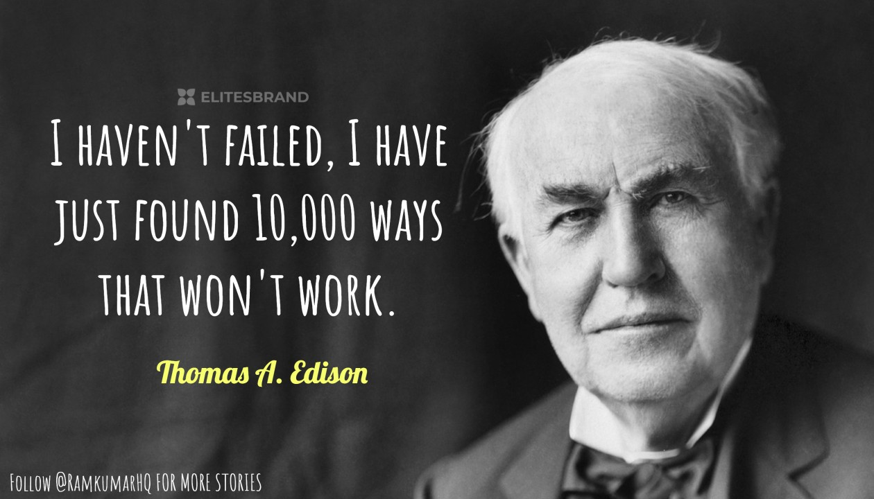
and of course, the light bulb.
(after years of failed attempts)
“I haven’t Failed!
I’ve just discovered 10,000 ways that won’t work.”

Slide 15
C. Failure Is Subjective.
3) Your perception of and response to mistakes determine whether they’re failures.
a) Three steps forward and two steps back
still means progress!
b) Business professor Lisa Amos observed: “entrepreneurs fail in an average of 3.8 business ventures before they finally make it.”

Slide 16
C. Failure Is Subjective.
“The Life of Jesus seemed like an absolute failure from every standpoint,
but God’s.”

Slide 17
D. Failure Can Be A Friend.
1) Most try to avoid failure at all cost,
But it takes adversity to create success.
Rick Pitino (only coach to lead 3 schools to final 4):
"Failure is fertilizer.
Everything I've learned about coaching
I've learned from making mistakes."

Slide 18
Winston Churchill was asked what he felt best prepared him to lead Britain in WW2.
“The time I repeated a class in grade school."
"You actually flunked grade school?"
"I never flunked in my life!
I was simply given a second
opportunity to get it right."

Slide 19
E. Failure Doesn’t Have To Be Final.
(Peter came back!!!)
1) Most “mistakes” are not “Earthquakes”
19th Century author Washington Irving:
(Rip Van Winkle, Sleepy Hollow, etc)
"Great minds have purposes;
others have wishes.
Little minds are subdued by misfortunes;
but great minds rise above them."

Slide 20
2. HOW TO “FAIL FORWARD”
Anyone can make failure their friend by:
Maintaining a teachable spirit
Purposing to learn from their mistakes by asking/ determining:
A. What Caused The Failure?
1) Unless / until you learn this,
you’re bound to repeat the failure.

Slide 21
2. To “Fail Forward” we must Ask:
A. What Caused The Failure?
2) What “set up” the apostles to fail?
“Satan hath desired to have you,
that he may sift you as wheat:
But I’ve prayed for thee, that thy faith fail not:
and when thou art converted,
strengthen thy brethren.”
Lk 22:31,32

Slide 22
2. To “Fail Forward” we must Ask:
B. How Can I Learn From The Failure?
Warren Wiersbe "A realist is an idealist who has gone through the fire and been purified.
A skeptic is an idealist who has gone through the fire and been burned."
1) Some are so distracted/disgusted by the failure,
that they can’t find the lesson
and thus learn from it.

Slide 23
B. How Can I Learn From The Failure?
After building a sand castle at the beach, Charlie Brown stood up to admire his work when
a large wave demolished his castle.
Staring at the smooth mound he says,
"There must be a lesson here,
but I don't know what it is."

Slide 24
To “Fail Forward” we must Ask:
C. Who Can Help Me With This Problem?
Peter went back to the Apostles.
1) Who can help me “live” through the
mistake? (Comfort)
2) Who can help me “Learn” through the
mistake? (Counsel)
Those who have survived failure are the best comforters and counselors.

Slide 25
C. Who Can Help Me With This Problem. Admiral Hyman Rickover: “We all need to learn from others' mistakes. We’ll not live long enough to make them all ourselves.“
"A winner knows how much he still has to learn, even when he is considered an expert by others.
A loser wants to be considered an expert by others
before he has learned enough to know
how little he really knows."

Slide 26
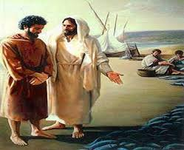
2. To “Fail Forward” we must Ask:
D. Where Do I Go From Here?
1) In Jn 21 Jesus repeated the miracle he
used to “attract” Peter’s attention. (Lk 5:1-11)
After lunch Jesus asked 3 times:
“Lovest thou me more than these?
…Feed my lambs…feed my sheep”
Jn 21:15, 16, 17

Slide 27
2. To “Fail Forward” we must Ask:
D. Where Do I Go From Here?
2) In their book “Everyone’s a Coach”
Don Shula & Ken Blanchard observe that:
“Learning involves a change in behavior.
You haven’t really learned a thing
until you can take action and use it."

Slide 28
Conclusion:
Without some conscious changes,
we won’t really benefit from our failures.
Lasting Change usually requires that we:
1) Hurt enough we’re motivated to change.
2) Learn enough we’re able to change.
3) Love enough we’re willing to change.
“Lovest thou me more than these?” Jn 21:15

Slide 29
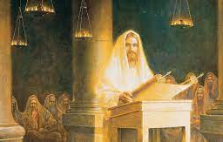
Jesus came to redeem our failures!
Is 61:1-3 “the LORD hath anointed me to preach good tidings unto the meek;
he hath sent me to bind up the brokenhearted, to proclaim liberty to the captives, and the opening of the prison to them that are bound;
To proclaim the acceptable year of the LORD, …
to comfort all that mourn”;

Slide 30
3 “to give unto them beauty for ashes,
the oil of joy for mourning, the garment of praise for the spirit of heaviness;
that they might be called trees of righteousness,
the planting of the LORD,
that he might be glorified.”
(See Luke 4:14-22)

Slide 31
God can redeem our failures if we’re willing to partner with him (Mt 11:28,29)
and humbly and honestly:
Seek to understand what caused them.
(James 1:2-5)
Be willing to learn from them.
(Ro. 8:28,29)

Slide 32
God can redeem our failures if we’re willing to partner with him (Mt 11:28,29) &
Learn to lean on (and learn from)
others. (Gal. 6:1-2)
Listen to God’s voice and direction
for the next steps in your faith journey.
(Pr. 3:5,6)

Slide 33
What Satan did to Peter (& the Apostles),
Lk. 22:31,32 “Satan hath desired to have you, that he may sift you as wheat:
he will seek to do to us!
But I’ve prayed for thee,
that thy faith fail not:
and when thou art converted,
strengthen thy brethren.”

Slide 34
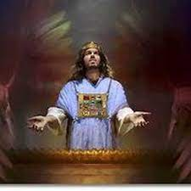
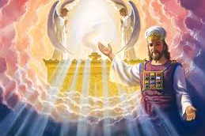
Thankfully, what Jesus did for them,
He does for us! Heb. 4:14-16

Slide 35
Will you partner with God
And Fail Forward?
Mt 26:31-56

