Slide 1
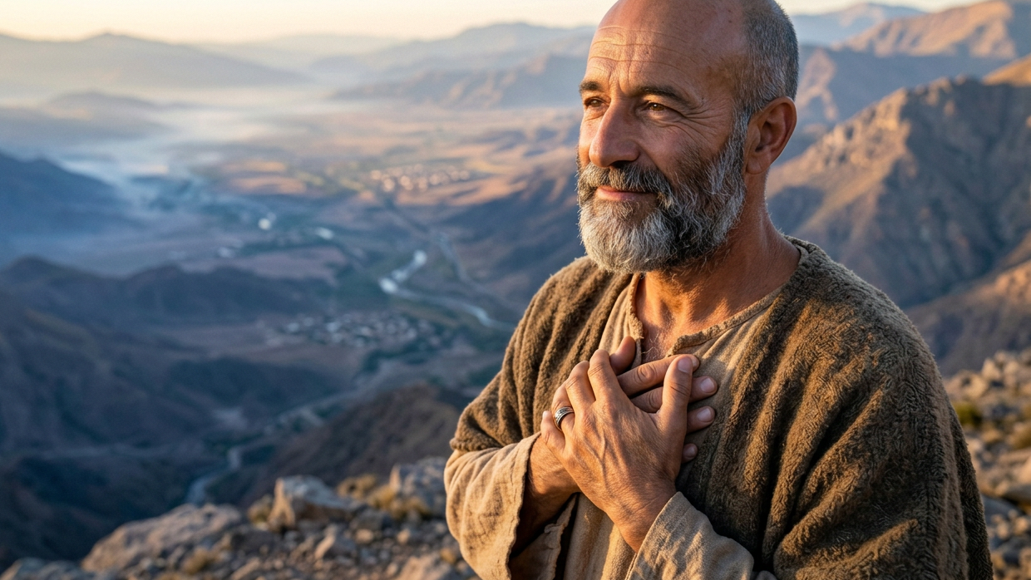
Elisha’s Confidence
By Joseph Peters

Slide 2

Goal
Everyone Should Have the Confidence in God that Elisha Had
For these Three Reasons

Slide 3
Reasons
Elisha knew that God could/would protect him
Elisha knew that God is in complete control
Elisha knew that God would provide in a miraculous way

Slide 4
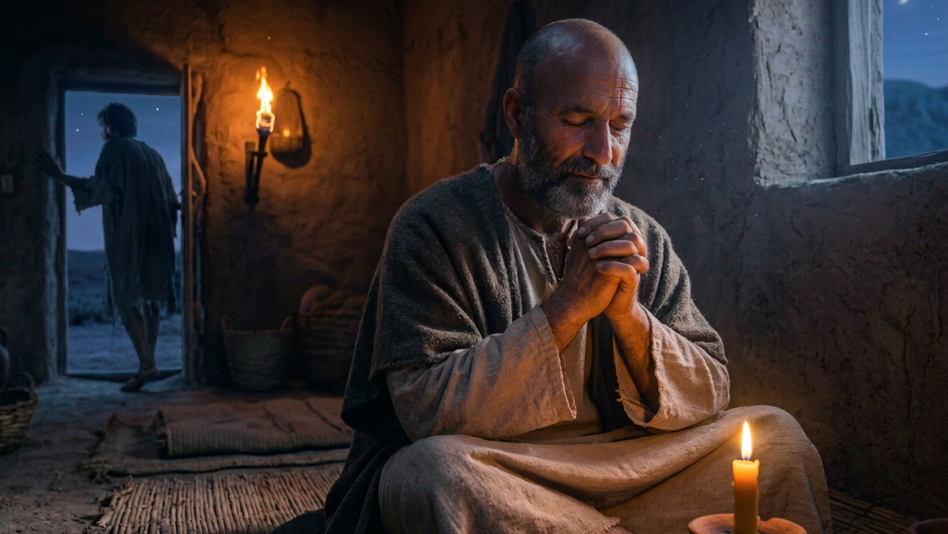
Elisha Knew that God Could/Would Protect Him

Slide 5
Foiling the Ambushes of Syria
Then the king of Syria warred against Israel, and took counsel with his servants, saying, In such and such a place shall be my camp. And the man of God sent unto the king of Israel, saying, Beware that thou pass not such a place; for thither the Syrians are come down. And the king of Israel sent to the place which the man of God told him and warned him of, and saved himself there, not once nor twice (2 Kings 6:8–10).

Slide 6
Syria Discovers Elisha is Helping Israel
Therefore the heart of the king of Syria was sore troubled for this thing; and he called his servants, and said unto them, Will ye not shew me which of us is for the king of Israel? And one of his servants said, None, my lord, O king: but Elisha, the prophet that is in Israel, telleth the king of Israel the words that thou speakest in thy bedchamber (2 Kings 6:11–12).

Slide 7
Syria Seeks to Take Elisha Out of the Equation
And he said, Go and spy where he is, that I may send and fetch him. And it was told him, saying, Behold, he is in Dothan. Therefore sent he thither horses, and chariots, and a great host: and they came by night, and compassed the city about. And when the servant of the man of God was risen early, and gone forth, behold, an host compassed the city both with horses and chariots. And his servant said unto him, Alas, my master! how shall we do (2 Kings 6:13–15)?

Slide 8
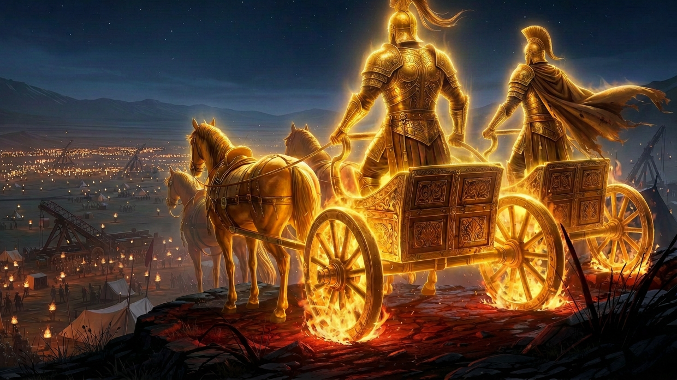
Elisha Knew that God Is in Complete Control

Slide 9
The Servant Sees a Glimpse of God’s Protection
And he answered, Fear not: for they that be with us are more than they that be with them. And Elisha prayed, and said, LORD, I pray thee, open his eyes, that he may see. And the LORD opened the eyes of the young man; and he saw: and, behold, the mountain was full of horses and chariots of fire round about Elisha (2 Kings 6:16–17).

Slide 10
God Foils Their Plan
And when they came down to him, Elisha prayed unto the LORD, and said, Smite this people, I pray thee, with blindness. And he smote them with blindness according to the word of Elisha. And Elisha said unto them, This is not the way, neither is this the city: follow me, and I will bring you to the man whom ye seek. But he led them to Samaria (2 Kings 6:18–19).

Slide 11
Showing Kindness to Israel’s Enemies
And the king of Israel said unto Elisha, when he saw them, My father, shall I smite them? shall I smite them? And he answered, Thou shalt not smite them: wouldest thou smite those whom thou hast taken captive with thy sword and with thy bow? set bread and water before them, that they may eat and drink, and go to their master. And he prepared great provision for them: and when they had eaten and drunk, he sent them away, and they went to their master. So the bands of Syria came no more into the land of Israel (2 Kings 6:21–23).

Slide 12
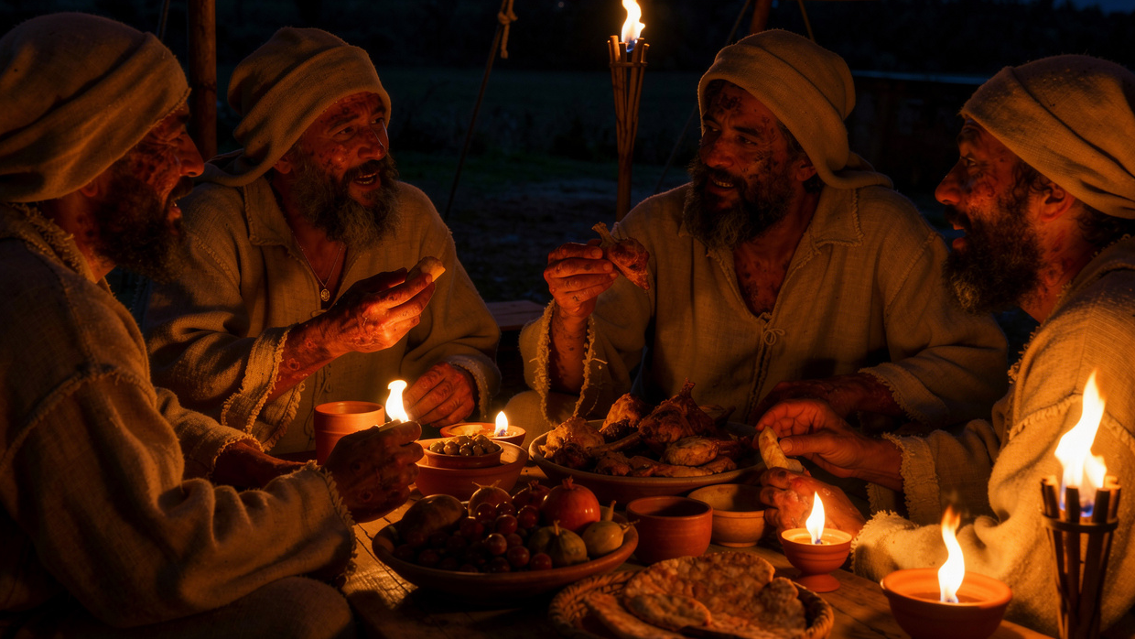
Elisha Knew that God Would Provide in a Miraculous Way

Slide 13
Syria Returns with a Vengeance
And it came to pass after this, that Ben-hadad king of Syria gathered all his host, and went up, and besieged Samaria. And there was a great famine in Samaria: and, behold, they besieged it, until an ass’s head was sold for fourscore pieces of silver, and the fourth part of a cab of dove’s dung for five pieces of silver (2 Kings 6:24–25).

Slide 14
The Dire Condition of Israel
So we boiled my son, and did eat him: and I said unto her on the next day, Give thy son, that we may eat him: and she hath hid her son. And it came to pass, when the king heard the words of the woman, that he rent his clothes; and he passed by upon the wall, and the people looked, and, behold, he had sackcloth within upon his flesh (2 Kings 6:29–30).

Slide 15
The King Wants Elisha Dead
Then he said, God do so and more also to me, if the head of Elisha the son of Shaphat shall stand on him this day. But Elisha sat in his house, and the elders sat with him; and the king sent a man from before him: but ere the messenger came to him, he said to the elders, See ye how this son of a murderer hath sent to take away mine head? look, when the messenger cometh, shut the door, and hold him fast at the door: is not the sound of his master’s feet behind him (2 Kings 6:31–32)?

Slide 16
Elisha Tells the King that the Lord Will Provide
Then Elisha said, Hear ye the word of the LORD; Thus saith the LORD, To morrow about this time shall a measure of fine flour be sold for a shekel, and two measures of barley for a shekel, in the gate of Samaria. Then a lord on whose hand the king leaned answered the man of God, and said, Behold, if the LORD would make windows in heaven, might this thing be? And he said, Behold, thou shalt see it with thine eyes, but shalt not eat thereof (2 Kings 7:1–2).

Slide 17
God Uses the Desperate Plan of Lepers
And there were four leprous men at the entering in of the gate: and they said one to another, Why sit we here until we die? If we say, We will enter into the city, then the famine is in the city, and we shall die there: and if we sit still here, we die also. Now therefore come, and let us fall unto the host of the Syrians: if they save us alive, we shall live; and if they kill us, we shall but die (2 Kings 7:3–4).

Slide 18
Israel Did Not Even Know that God Had Already Won the Battle
And they rose up in the twilight, to go unto the camp of the Syrians: and when they were come to the uttermost part of the camp of Syria, behold, there was no man there. For the Lord had made the host of the Syrians to hear a noise of chariots, and a noise of horses, even the noise of a great host: and they said one to another, Lo, the king of Israel hath hired against us the kings of the Hittites, and the kings of the Egyptians, to come upon us. Wherefore they arose and fled in the twilight, and left their tents, and their horses, and their asses, even the camp as it was, and fled for their life (2 Kings 7:5–7).

Slide 19
Evangelistic Lepers
And when these lepers came to the uttermost part of the camp, they went into one tent, and did eat and drink, and carried thence silver, and gold, and raiment, and went and hid it; and came again, and entered into another tent, and carried thence also, and went and hid it. Then they said one to another, We do not well: this day is a day of good tidings, and we hold our peace: if we tarry till the morning light, some mischief will come upon us: now therefore come, that we may go and tell the king’s household (2 Kings 7:8–9).

Slide 20
The Final Aspect of the Prophecy Fulfilled
And the people went out, and spoiled the tents of the Syrians. So a measure of fine flour was sold for a shekel, and two measures of barley for a shekel, according to the word of the LORD. And the king appointed the lord on whose hand he leaned to have the charge of the gate: and the people trode upon him in the gate, and he died, as the man of God had said, who spake when the king came down to him (2 Kings 7:16–17).

Slide 21
Conclusion
Everyone Should Have the Confidence in God that Elisha Had
For these Three Reasons

Slide 22
Reasons
Elisha knew that God could/would protect him
Elisha knew that God is in complete control
Elisha knew that God would provide in a miraculous way

