Slide 1
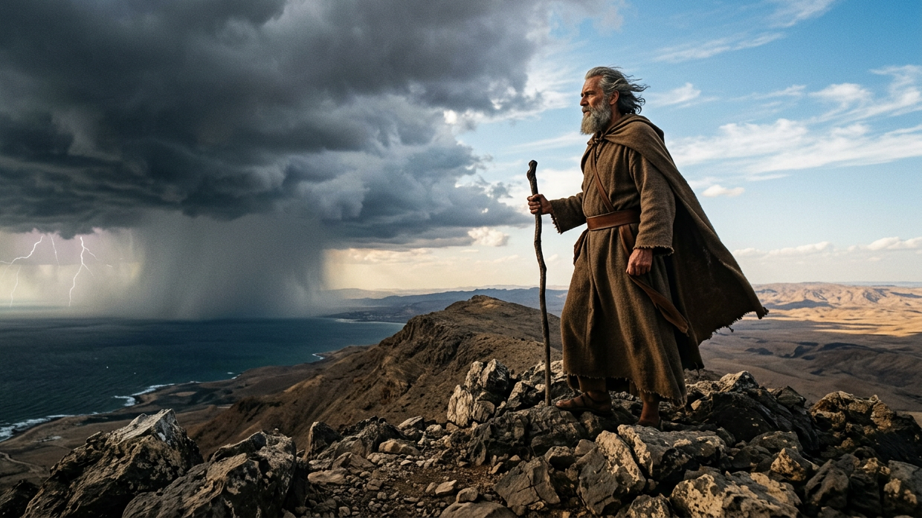
Elijah: Boldly Spoke While Others Hid
By Joseph Peters

Slide 2

Goal
Everyone of God’s people can boldly follow God’s Will
For these three reasons

Slide 3
Reasons
God Can Take Care of His People
God is Ever-present with His People
God Is Working in the Lives of Others

Slide 4
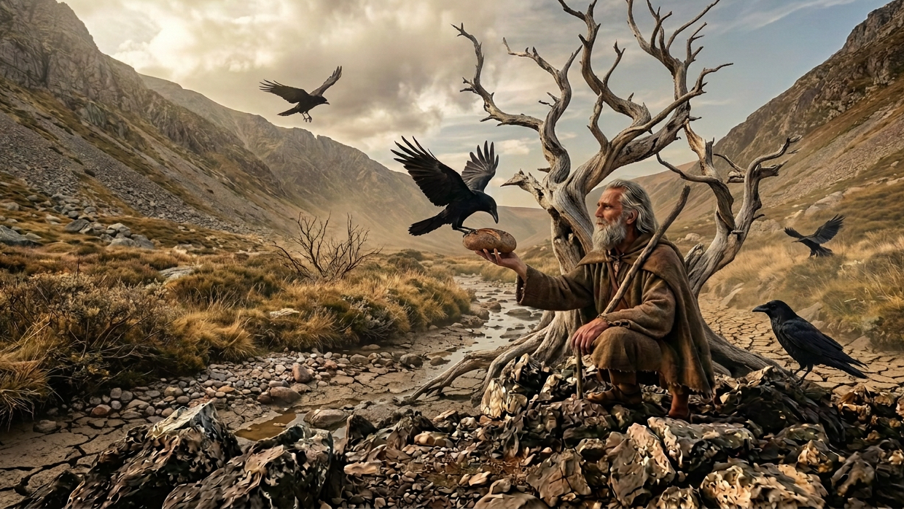
God Can Take Care of His People

Slide 5
Pronouncing Judgment on Israel
And Elijah the Tishbite, who was of the inhabitants of Gilead, said unto Ahab, As the LORD God of Israel liveth, before whom I stand, there shall not be dew nor rain these years, but according to my word (1 Kings 17:1).

Slide 6
Miraculous Provision for Elijah in Israel
And the word of the LORD came unto him, saying, Get thee hence, and turn thee eastward, and hide thyself by the brook Cherith, that is before Jordan. And it shall be, that thou shalt drink of the brook; and I have commanded the ravens to feed thee there. So he went and did according unto the word of the LORD: for he went and dwelt by the brook Cherith, that is before Jordan. And the ravens brought him bread and flesh in the morning, and bread and flesh in the evening; and he drank of the brook (1 Kings 17:2–6).

Slide 7
Miraculous Provision for Elijah in Phoenicia
And it came to pass after a while, that the brook dried up, because there had been no rain in the land. And the word of the LORD came unto him, saying, Arise, get thee to Zarephath, which belongeth to Zidon, and dwell there: behold, I have commanded a widow woman there to sustain thee…
And she went and did according to the saying of Elijah: and she, and he, and her house, did eat many days. And the barrel of meal wasted not, neither did the cruse of oil fail, according to the word of the LORD, which he spake by Elijah (1 Kings 17:7–9, 15-16).

Slide 8
The Widows Family Received the Same Provision
He that receiveth a prophet in the name of a prophet shall receive a prophet’s reward; and he that receiveth a righteous man in the name of a righteous man shall receive a righteous man’s reward (Matt 10:41).

Slide 9
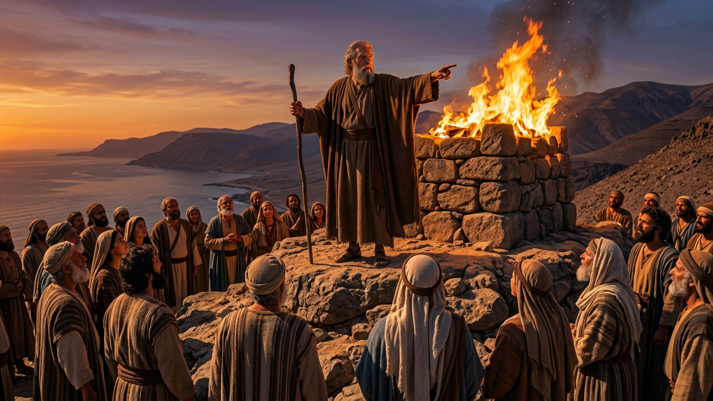
God is Ever-present with His People

Slide 10
Elijah Speaks to King Ahab
And it came to pass after many days, that the word of the LORD came to Elijah in the third year, saying, Go, shew thyself unto Ahab; and I will send rain upon the earth. And Elijah went to shew himself unto Ahab. And there was a sore famine in Samaria… Now therefore send, and gather to me all Israel unto mount Carmel, and the prophets of Baal four hundred and fifty, and the prophets of the groves four hundred, which eat at Jezebel’s table. So Ahab sent unto all the children of Israel, and gathered the prophets together unto mount Carmel (1 Kings 18:1–2, 19-20).

Slide 11
Is Elijah Alone?
And Elijah came unto all the people, and said, How long halt ye between two opinions? if the LORD be God, follow him: but if Baal, then follow him. And the people answered him not a word. Then said Elijah unto the people, I, even I only, remain a prophet of the LORD; but Baal’s prophets are four hundred and fifty men (1 Kings 18:21-22).

Slide 12
The Test
Let them therefore give us two bullocks; and let them choose one bullock for themselves, and cut it in pieces, and lay it on wood, and put no fire under: and I will dress the other bullock, and lay it on wood, and put no fire under: And call ye on the name of your gods, and I will call on the name of the LORD: and the God that answereth by fire, let him be God. And all the people answered and said, It is well spoken (1 Kings 18:23–24).

Slide 13
A god Who is Too Busy
And it came to pass at noon, that Elijah mocked them, and said, Cry aloud: for he is a god; either he is talking, or he is pursuing, or he is in a journey, or peradventure he sleepeth, and must be awaked. And they cried aloud, and cut themselves after their manner with knives and lancets, till the blood gushed out upon them. And it came to pass, when midday was past, and they prophesied until the time of the offering of the evening sacrifice, that there was neither voice, nor any to answer, nor any that regarded (1 Kings 18:27–29).

Slide 14
The Ever-Present God Who Hears
And it came to pass at the time of the offering of the evening sacrifice, that Elijah the prophet came near, and said, LORD God of Abraham, Isaac, and of Israel, let it be known this day that thou art God in Israel, and that I am thy servant, and that I have done all these things at thy word. Hear me, O LORD, hear me, that this people may know that thou art the LORD God, and that thou hast turned their heart back again. Then the fire of the LORD fell, and consumed the burnt sacrifice, and the wood, and the stones, and the dust, and licked up the water that was in the trench (1 Kings 18:36–38).

Slide 15
A Return to God
And when all the people saw it, they fell on their faces: and they said, The LORD, he is the God; the LORD, he is the God. And Elijah said unto them, Take the prophets of Baal; let not one of them escape. And they took them: and Elijah brought them down to the brook Kishon, and slew them there (1 Kings 18:39–40).

Slide 16
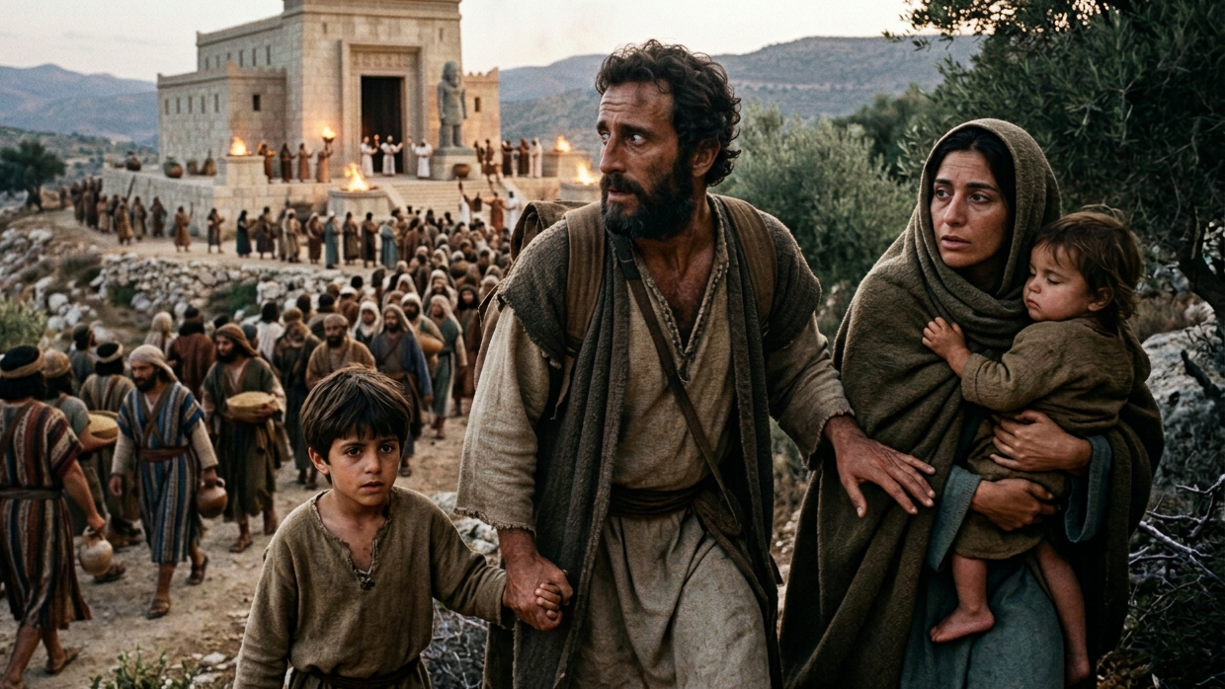
God Is Working in the Lives of Others

Slide 17
From High to Low
Then Jezebel sent a messenger unto Elijah, saying, So let the gods do to me, and more also, if I make not thy life as the life of one of them by to morrow about this time. And when he saw that, he arose, and went for his life, and came to Beer-sheba, which belongeth to Judah, and left his servant there. But he himself went a day’s journey into the wilderness, and came and sat down under a juniper tree: and he requested for himself that he might die; and said, It is enough; now, O LORD, take away my life; for I am not better than my fathers (1 Kings 19:2–4).

Slide 18
Elijah Feels Alone
And, behold, there came a voice unto him, and said, What doest thou here, Elijah? And he said, I have been very jealous for the LORD God of hosts: because the children of Israel have forsaken thy covenant, thrown down thine altars, and slain thy prophets with the sword; and I, even I only, am left; and they seek my life, to take it away (1 Kings 19:13–14).

Slide 19
God Was Still Working in the Lives of Others
…and Elisha the son of Shaphat of Abel-meholah shalt thou anoint to be prophet in thy room… Yet I have left me seven thousand in Israel, all the knees which have not bowed unto Baal, and every mouth which hath not kissed him (1 Kings 19:16b, 18).

Slide 20
Conclusion
Everyone of God’s people can boldly follow His Will
For these three reasons

Slide 21
Reasons
God Can Take Care of His People
God is Present with His People
God Is Working in the Lives of Others

