Slide 1
Developing a Missionary Heart.

Slide 2
The “Faith Promise” Mission support is based on 2 Cor. 8,9
God is inviting/challenging His people to partner with Him in blessing those in another country.
8:3 “For to their power… yea, and beyond their power they were willing of themselves; 4 Praying us with much intreaty that we would receive the gift, and take upon us the fellowship of the ministering to the saints.
5 And this they did, not as we hoped, but first gave their own selves to the Lord, and unto us by the will of God.”

Slide 3
This passage uses Jesus as our Great example.
2 Cor 8:9
“For ye know the grace of our Lord Jesus Christ, that, though he was rich, yet for your sakes he became poor,
that ye through his poverty might be rich.”
2 Cor 9:15 “ Thanks be unto God for his unspeakable (indescribable) gift!”

Slide 4
It’s God’s Grace than enables us
to recognize and respond to God”!
2 Cor 8:1 “we do you to wit of the grace of God bestowed on the churches of Macedonia…”
“Grace” (charis) is used 7 times in 2 Cor 8,9!
“the divine influence upon the heart,
and its reflection in the life;
including gratitude”
Strong's Greek & Hebrew Dictionary.

Slide 5
A Missionary is someone who’s
Been sent on a mission!
Jesus is our Great Example! Jn 20:21
“as my Father hath sent me,
even so
send I you.”
(See also 2 Cor 5:20.21)

Slide 6
Have you ever wondered what motivates someone to leave the comforts and conveniences of home to endure the ordeal of Preparation, Deputation, and then Separation from Family, Familiarity, and Friends?

Slide 7
“as my Father hath sent me,
even so send I you.” Jn 20:21
Barnabas was one of the first “Missionaries”.
He was “sent” to Antioch. Acts 11:19-25
He was “sent” to Asia minor. Acts 13
He was “sent” to Cyprus. Acts 15:39
He was “Sent” to Reveal & Reflect God’s heart!
2 Cor. 5:20 “we are ambassadors for Christ”

Slide 8
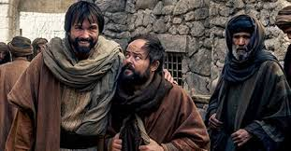
Missionaries are not
“Super Saints”!
They’re ordinary Christians who have recognized God’s “extraordinary” heart and partnered with Him to reach others.
By examining Barnabas’ journey,
I hope to reveal God’s process for
developing His heart
in each of us.

Slide 9
How to Cultivate a Missionary Heart.
“as my Father hath sent me,
even so send I you.”
Jn 20:21
1. Become An Encouragement
In Your Church Acts 4:36
"And Joses, who by the apostles was surnamed Barnabas,
(which is, being interpreted,
The son of consolation"
Parak’lēsis: comfort/encouragement (John 14:16)

Slide 10
“So Send I you” Jn 20:21
Become an Encourager!
A. Barnabas was a builder!
1) Encouraged the Church in Jerusalem. Acts 4:36
2) Encouraged Saul when others rejected him. Acts 9:27
3) Encouraged the Church in Antioch. Acts 11:22,23
4) Personally sought Saul to help in Antioch. Acts 11:25
5) Chosen to plant churches with Paul. Acts 13
6) Encouraged/Discipled John Mark. Acts 15:37-39
He was sensitive to the needs around him.

Slide 11
Gal 6:7-10 “whatsoever a man soweth, that shall he also reap…
9 And let us not be weary in well doing:
for in due season we shall reap, if we faint not.
10 As we have therefore opportunity,
let us do good unto all men, especially unto them who are of the household of faith.”
Soon the season for planting will pass! Jn 9:4

Slide 12
1. Become an Encouragement!
B. His Name Was Changed To
Reflect His Nature. Pr. 22:1
"A good name is rather to be chosen than great riches, …"
1) You can’t choose your birth name,
but you can decide what you’ll
become known as. (Acts 4:36)
“he was surnamed Barnabas…
son of consolation”
“as my Father hath sent me,
so send I you.”
Jn 20:21

Slide 13
Acts 11:24 “For he was a good man,
(agathos: useful, beneficial)
Are you “useful” to God?
and full of the Holy Ghost and of faith:
Jesus called the Holy Ghost the “Comforter.”
(Jn 14:16;26; 15:26; 16:7)
and much people were added unto the Lord.”
Acts 11:24

Slide 14
“So Send I you” Jn 20:21
C. We’ll Never Impact The World
For Christ If We Neglect Those
Around Us And Abroad.
80% of all mis­sion­ar­ies will not fin­ish one term on the mis­sion field* because of…
a) Interpersonal conflict
b) Discouragement.
Gal. 6:10 "As we have therefore opportunity, let us do good unto all men, especially unto them who are of the household of faith.“
*http://worldim.com/2012/01/lets-reverse-the-statistics/

Slide 15
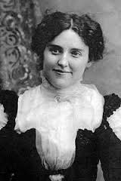
“So Send I you” Jn 20:21
2) Are you a “Son/daughter” of consolation?
“Do not wait until some deed of greatness
you may do,
Do not wait to shed your light afar;
To the many duties ever near you now be true,
Brighten the corner where you are.”
Ina Ogdon 1913

Slide 16
2. Be Willing To Sacrifice To Accomplish God’s Will. (Acts 4:37)
It “costs” something to minister to others!
Understand Stewardship.
1) A Steward is a manager,
not an owner! (Mt. 25:14)
“The earth is the Lord’s and the fulness thereof…” 1 Cor. 10:26
“Ye have robbed me…
in tithes and offerings”
Mal. 3:9,10

Slide 17
2. Be Willing To Sacrifice To Accomplish God’s Will. (Acts 4:37)
2) The early believers “got this”.
Acts 4:32 “And the multitude of them that believed were of one heart and soul:
neither said any of them that ought of the things which he possessed
was his own…”
4:37 “Barnabas…Having land, sold it,
and brought the money,
and laid it at the apostles' feet.”
It “costs” something to minister to others!

Slide 18
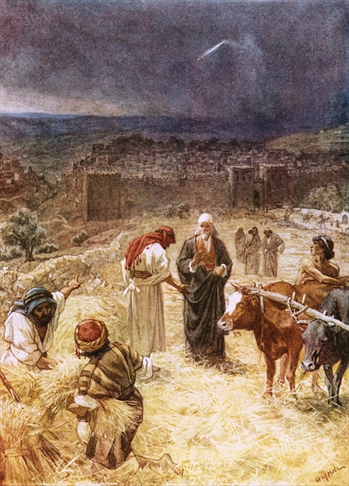
“So Send I you” Jn 20:21
3) King David “Got this”
a) To make atonement for his sin, David needed to build an altar.
“All these things did Araunah, …give unto the king. …
²⁴ And the king said …, Nay; but I will surely buy it of thee at a price:
neither will I offer burnt offerings unto the LORD of that which doth cost me nothing.”
2 Samuel 24:23-24

Slide 19
b) David dedicated that land to build God’s Temple.
1 Chr 29:9,14
“the people rejoiced, for that they offered willingly, … with perfect heart they offered willingly to the LORD:
and David the king also rejoiced with great joy….
But who am I, and what is my people, that we should be able to offer so willingly after this sort?
for all things come of thee,
and of thine own have we given thee.”

Slide 20
2. Be Willing To Sacrifice To Accomplish God’s Will. (Acts 4:37)
It “costs” something to serve God and others!
Understand Stewardship.
B. God considers this “Our Reasonable Service” Ro. 12:1,2
λατρεία λογικός (logikos’ latrei’a)
Rational response and expression of our Worship!
See Rev. 4:11

Slide 21
2.Be willing to sacrifice for God.
“Present your bodies… to God …which is your reasonable service”
Someday we’ll all “get this”!
Rev. 4:11 “Thou art worthy,
O Lord, to receive glory
and honor and power:
for thou hast created all things,
and for thy pleasure they are and were created.”
See also Phil. 2:5-10

Slide 22
C. Our Resources are a:
Sacred Trust. 1 Tim. 6:17-20
“Charge them… that they
do good, be rich in good
works, ready to distribute,
willing to communicate….
keep (guard) that which
is committed to thy trust.”
It “costs” something to serve God and others!

Slide 23
C. Our Resources are a:
2) Specific Test. Mt 25:14-30; Lk 16:10-13
“He that is faithful in that which is least is faithful also in much: and he that is unjust in the least is unjust also in much.
If therefore ye have not been faithful in the unrighteous mammon, who will commit to your trust the true riches?
And if ye have not been faithful in that which is another man's, who shall give you that which is your own?
Ye cannot serve God and mammon”

Slide 24
Mt 16:24-27
“If any man will come after me,
let him deny himself,
and take up his cross, and follow me.
25 For whosoever will save his life shall lose it…
26 For what is a man profited, if he shall gain the whole world, and lose his own soul? …
27 For the Son of man shall come in the glory of his Father with his angels;
then he shall reward every man according to his works.”

Slide 25
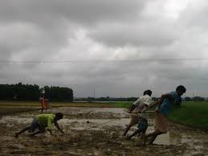
“So Send I you” Jn 20:21
Are you willing to “Downsize” in order to “Do More” for God?
An American took a picture of a man pulling a plow in Asia.
The missionary explained that the man had sold his ox to raise money to build the village church.
Ladies in Brother King’s Japanese Churches.

Slide 26
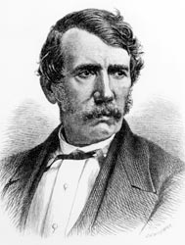
“People speak of the sacrifice I have made in spending so much of my life in Africa.
Can that be called a sacrifice which simply paid back as a small part of a great debt owing to our God,
which we can never repay?
All these are nothing compared with he glory which shall be revealed in and for us.
I never made a sacrifice!”
“If a commission by an earthly King is considered an honor,
How can a commission by the Heavenly King be considered a Sacrifice?”
David Livingstone

Slide 27
CT Studd (1860-1931) left all to serve as a Missionary to China, India and Africa.
While serving in China, he received his inheritance at the age of 25.
He gave it all away to other Ministries!
When he learned that he still had 3,400 pounds left after his gifts to others;
He decided to give it to his new wife as a wedding present.

Slide 28
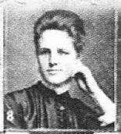
Priscilla Livingstone Stewart was as sure of God as her husband.
She determined to "start clear" at her wedding and gave that sum away, too!
“If Jesus Christ be God and died for me,
then no sacrifice is too great for me
to give for Him.” CT. Studd

Slide 29
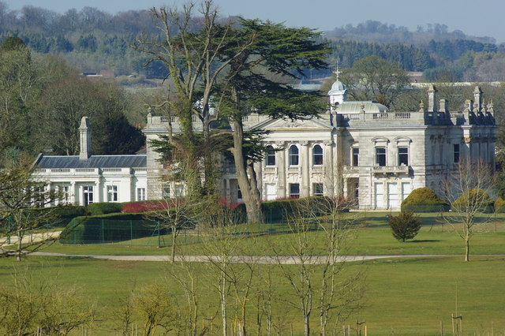
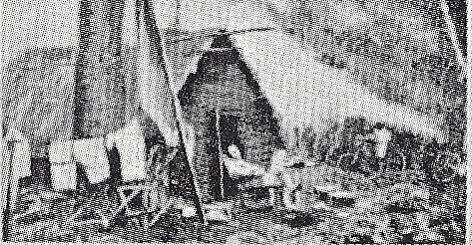
The Home he grew up in.
His home in Africa.
“Some want to live within the sound of church or chapel bell;
I want to run a rescue shop, within a yard of Hell!”

Slide 30
Two little lines I heard one day,
Traveling along life’s busy way;
Bringing conviction to my heart,
And from my mind would not depart;
Only one life, ’twill soon be past,
Only what’s done for Christ will last.

Slide 31
Only one life, yes only one,
Soon will its fleeting hours be done;
Then, in ‘that day’ my Lord to meet,
And stand before His Judgement seat;
Only one life, ’twill soon be past,
Only what’s done for Christ will last.

Slide 32
Only one life, the still small voice,
Gently pleads for a better choice.
Bidding me selfish aims to leave,
And to God’s holy will to cleave;
Only one life, ’twill soon be past,
Only what’s done for Christ will last.

Slide 33
Only one life, a few brief years,
Each with its burdens, hopes, and fears;
Each with its claims I must fulfill,
living for self or in His will;
Only one life, ’twill soon be past,
Only what’s done for Christ will last.
C.T. Studd

Slide 34
What are you willing to do that will outlive you?
Become an Encourager/builder by investing in others!
Sacrifice Earth’s temporary
“wood, hay, stubble”
for God’s eternal
“Gold, Silver, precious stones”
1 Cor. 3:10-15

Slide 35
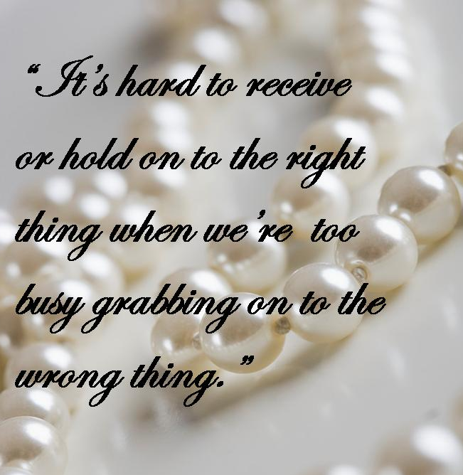
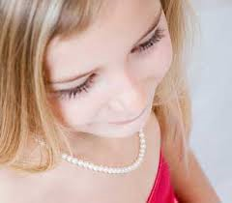
Jenny’s pearls

