Slide 1
Developing a Missionary Heart.

Slide 2
A missionary is simply
A person sent on a mission!
“as my Father hath sent me,
even so
send I you.”
John 20:21

Slide 3
2 Cor 5:19-20 “God was in Christ,
reconciling the world unto himself,
….and hath committed unto us
the word of reconciliation!
20 Now then we are ambassadors for Christ, as though God did beseech you by us:
we pray you in Christ's stead,
be ye reconciled to God.”
katalas’so: changed, transformed

Slide 4
“as my Father hath sent me,
even so send I you.” Jn 20:21
Barnabas was one of the first “Missionaries”.
He was “sent” to Antioch. Acts 11:19-25
He was “sent” to Asia minor. Acts 13
He was “sent” to Cyprus. Acts 15:39
Since he was “Sent” to Reveal & Reflect God’s heart;
Notice the process God used to Transform His heart.

Slide 5
Barnabas was willing to:
1. Become An Encouragement
to those around him. Gal. 6:7-10
Acts 4:36 "And Joses, who by the
apostles was surnamed Barnabas,
(which is, being interpreted,
The son of consolation"
Parak’lēsis: comfort/encouragement (John 14:16)
How to Cultivate a Missionary Heart.

Slide 6
“So Send I you” Jn 20:21
Become an Encourager!
A. Barnabas was a builder!
1) Encouraged the Church in Jerusalem. Acts 4:36
2) Encouraged Saul when others rejected him. Acts 9:27
3) Encouraged the Church in Antioch. Acts 11:22,23
4) Personally sought Saul to help in Antioch. Acts 11:25
5) Chosen to plant churches with Paul. Acts 13
6) Encouraged/Discipled John Mark. Acts 15:37-39
He was sensitive to the needs around him.

Slide 7
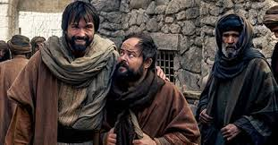
Acts 11:24 “For he was a good man,
(agathos: useful, beneficial)
Are you “useful” to God?
and full of the Holy Ghost and of faith:
Jesus called the Holy Ghost the “Comforter.”
(Jn 14:16;26; 15:26; 16:7)
and much people were added unto the Lord.”

Slide 8
2. Be Willing To Sacrifice (prioritize) To Accomplish God’s Will. (Acts 4:37)
“Seek ye first the kingdom of God..”
Mt 6:33
Ex. 20:3; Dt 6:4,5
Mt 22:37,38
Understand Priorities.
Jn 21:15 “Lovest thou me
more than these?”
Col 1:17-18 “he is before all things, and by him all things consist.
he is the head of the body, …
that in all things he might have
the preeminence.”

Slide 9
1 Cor 16: 14-16
A. Understand Priorities.
“Let all your things be done with charity.
…ye know the house of Stephanas,
…that they have addicted themselves
(tasso: arranged in order)
to the ministry of the saints.
That ye submit yourselves (hypotasso) unto such”
What have you “addicted yourself” to?

Slide 10
Luke 14: 33-35
A. Understand Priorities.
Jesus spoke of “counting the cost”
“So likewise, whosoever he be of you that
forsaketh not (apotas’somai) all that he hath,
he cannot be my disciple.
34 Salt is good: but if the salt have lost his savour, wherewith shall it be seasoned?
It is neither fit for the land, nor yet for the dunghill; but men cast it out.
He that hath ears to hear, let him hear.”

Slide 11
2. Be Willing To Sacrifice (prioritize) To Accomplish God’s Will. (Acts 4:37)
“Seek ye first the kingdom of God..”
Mt 6:33
B. Understand Stewardship.
1) A Steward is a manager! (Mt 25:14-30)
1 Cor 4:1-2 “Let a man so account of us, as of the ministers of Christ,
and stewards of the mysteries of God.
Moreover it is required in stewards, that a man be found faithful.”
pistos’: trustworthy

Slide 12
Mt 25:14-30
1) A Steward is a manager! (Mt 25:14-30)
“Well done good and faithful servant”
2) The early Church “got this”. Acts 4:32
“And the multitude of them that believed were of one heart: neither said any of them that ought of the things
which he possessed was his own…”
3) Barnabas “got this” 4:37 “Barnabas…Having land, sold it, and brought the money, & laid it at the apostles' feet.”
4) Someday we’ll all “get this”. Rev. 4:11
1 Cor 3:9 “we’re laborers together with God”

Slide 13
“So Send I you” Jn 20:21
C. Our resources are a both a “Trust” and a “Test”! (Mt 25)
“He that is faithful in that which is least is faithful also in much:
he that is unjust in the least is unjust also in much.
If therefore ye have not been faithful in the unrighteous mammon, who will commit to your trust the true riches?
if ye have not been faithful in that which is another man’s,
who shall give you that which is your own?
No servant can serve two masters: …
Ye cannot serve God and mammon. “ Luke 16:10-15

Slide 14
Barnabas was willing to:
Be an encouragement
Sacrifice (Prioritize) in order to partner with God.
Believe in the power of God to Change lives!
God’s in the Transformation
Business. (2 Cor 3:18; 5:17)
How to cultivate
a Missionary
Heart

Slide 15
3. Believe God could Change Lives!
“he had respect unto the recompense of the reward” (Heb 11:26)
“So Send I you” Jn 20:21
A. Barnabas “Invested” In Others.
1) He took risks to work with Saul (Paul). Acts 9:26-28
2) He gave John Mark a 2nd chance. (Acts 15:37-39)
Who are you currently investing in?
“I’ve never seen God change water into wine,
but I’ve seen him change beer into groceries!”

Slide 16
Barnabas was willing to:
4. Expose Himself To What God Is Doing Outside Of His Comfort zone.
He Was Willing To Go On A “Short Term” Mission Trip.
(307 miles)
Acts 11:19-30
How to cultivate
a Missionary
Heart

Slide 17
“So Send I you”
Barnabas Was Willing To Go On A “Short Term” Mission Trip. (307 miles)
Acts 11:19-30
Vs 23,24 Who, when he came, and had seen the grace of God, was glad, and exhorted them all, that with purpose of heart they would cleave unto the Lord.
For he was a good man, and full of the Holy Ghost and of faith:
and much people was added unto the Lord. “

Slide 18
“So Send I you”
Expose Himself To What God Is Doing
Outside Of His Comfort zone.
B. He Was Willing To “Share The Load”.
Vs 25,26 “Then departed Barnabas to Tarsus, for to seek Saul: …brought him unto Antioch. …
the disciples were called Christians first in Antioch.
1) He discipled Saul (Paul) who later replaced him
as the leader. (Acts 13:1)
2) He had John the Baptist’s attitude: John 3:30
“He must increase, but I must decrease.”

Slide 19
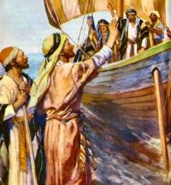
“So Send I you”
Barnabas was willing to:
Expose Himself To What God Is Doing
Outside Of His Comfort zone.
C. Became instrumental in raising funds for others. Acts 11:27-30 “Then the disciples, every man according to his ability, determined to send relief unto the brethren which dwelt in Judaea:
Which also they did, and sent it …
by the hands of Barnabas and Saul.”

Slide 20
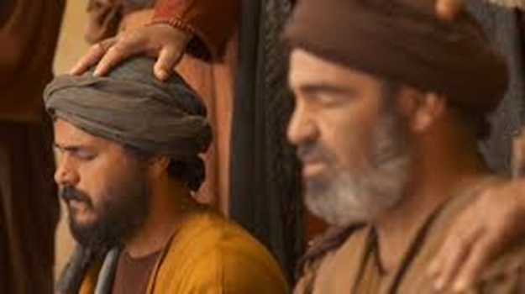
“So Send I you” Jn 20:21
5. Learn to Listen/Respond to God’s Voice Acts 13:1-4
A. It was while Barnabas and Saul were ministering in Antioch that
God called them to be “Missionaries”!
Acts 13:2-3 “As they ministered to the Lord, the Holy Ghost said, Separate me Barnabas and Saul for the work whereunto I have called them.
⁴ ”So they, being sent forth by the Holy Ghost, …preached the word of God”

Slide 21
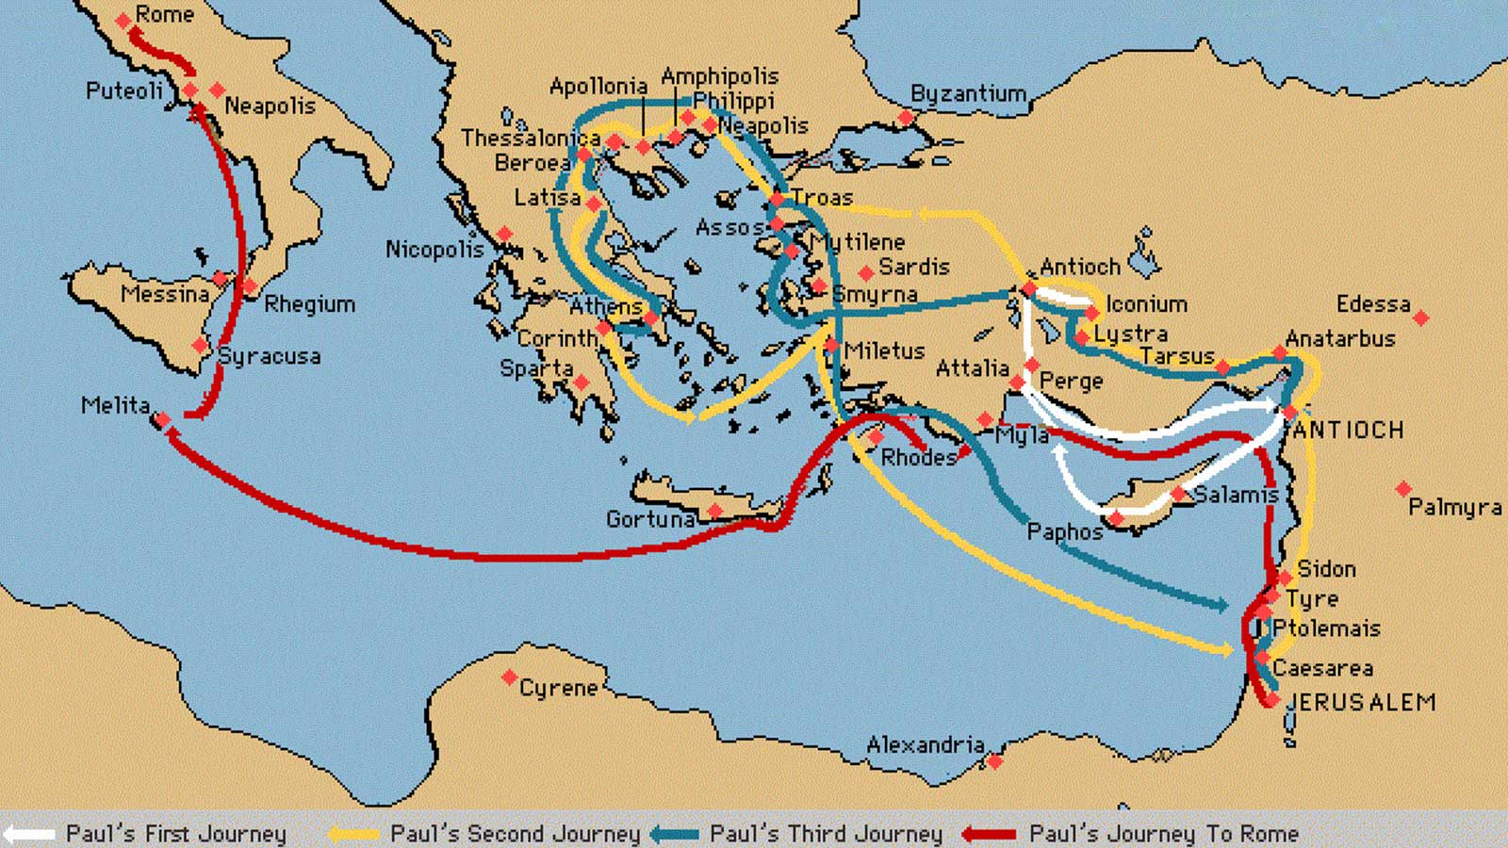
B. Their obedience resulted in the Gospel reaching Europe
“So Send I you” Jn 20:21
(and eventually America)!

Slide 22
To develop into a “World Class Christian”…
“So Send I you” Jn 20:21
1. Purpose to be an encouragement.
Look for ways to Lift up others!
(emails, phone, letters, visits)
2. Be willing to Sacrifice the temporary for the
Eternal.
Consider “Downsizing” to “Do More” for God!

Slide 23
“So Send I you” Jn 20:21
3. Believe in God’s power to
change lives!
Invest in others!
4. Expose Yourself To What God Is Doing outside
Of your Comfort zone.
Read missions newsletters, take missions trips, visit a Crisis Pregnancy Center, Prison, or Rescue Mission.

Slide 24
“So Send I you” Jn 20:21
To develop into a “World Class Christian”…
5. Learn to “Listen” for (and to) God’s Voice. Acts 13:3
“as they ministered to the Lord (Master)
the Holy Ghost said, separate me Barnabas…
for the work whereunto I have called them”
“I heard the voice of the Lord…who will go for us?
Then said I, “Here I am, Send Me!”
Isaiah 6:8

Slide 25
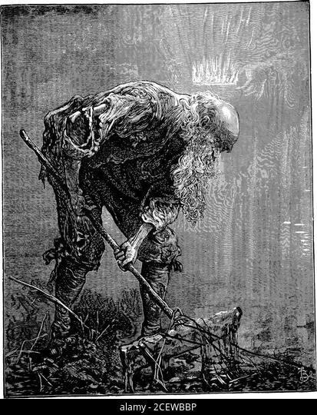
Satan convinces us that we are unusable and keeps us so preoccupied with the cares of this world,
That we fail to invest in eternity. (Mark 4:19)
John Bunyan’s classic “Pilgrim’s Progress” was written while he was imprisoned (1661-1673) for being a Baptist preacher.
This is a scene called
“the Muckraker”
at the home of the “Interpreter”
1678

Slide 26
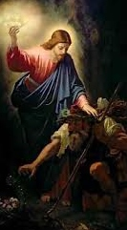
How often does Jesus try to redirect our own focus away from the “muck” of this world and toward eternity?
Mt. 6:20,21
“Lay up for yourselves
treasures in heaven.”
For where your treasure is,
there shall your heart be.”
Are you willing to exchange your “wood, hay, and stubble”,
for God’s “Gold, Silver, and Precious stones”? 1 Cor. 3:12

Slide 27
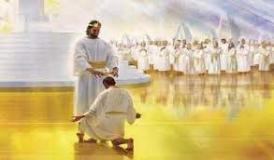
Mt. 25:21
Can you imagine the interest on the investment Barnabas has earned because of his “supporting role” in the lives of so many? (1 Cor 2:9)
“Well done, thou good (beneficial)
and faithful (pistos) servant:
thou hast been faithful (trustworthy)
over a few things,
I will make thee ruler over many things:
enter thou into the joy of thy lord.” Mt 25:21
2 Cor. 5:10

