Slide 1
DESTINY

Slide 2
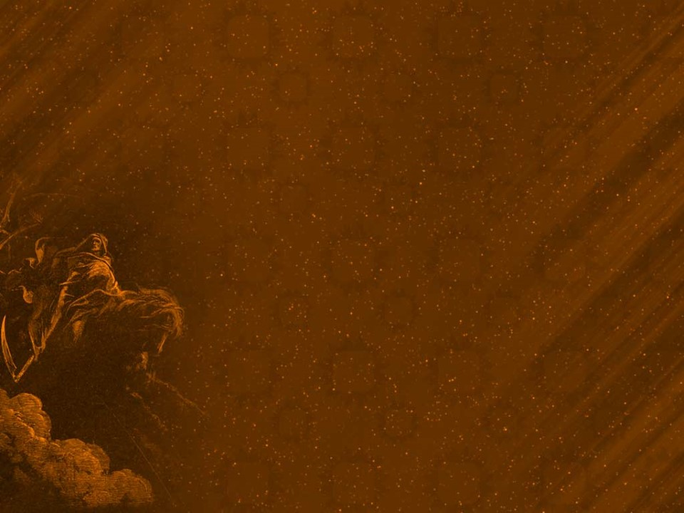
Eternity
Our Mortal lives are represented by the small “dot” on this “eternal” timeline.
Our “afterlife” is represented by the “ray”.
What we do during the small “dot” affects everything that happens on the “Ray.”
James 4:14 “life is …a vapor that appeareth
for a little time, then vanisheth away.”
Ps 90:12 “So teach us to number our days,
that we may apply our hearts unto wisdom.”

Slide 3
”It is appointed unto men once to die, Hebrews 9:27
Most modern tombstones sum up our mortal lives with a small “dash”.
What we do during our brief “dash” determines what happens next!

Slide 4
Older tombstones often had epitaphs that summarized the life “lost.”

Slide 5
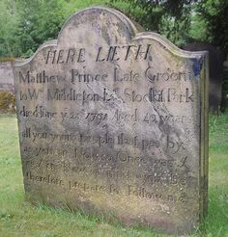
Pause, stranger, when you pass me by, As you are now, so once was I. As I am now, soon you will be.
So prepare for death, and follow me.
To follow you I’m not content,
Until I know which way you went!
Why should we “prepare” for Death?
How should we “prepare for Death?

Slide 6
What you do with Jesus during your “dash”;
determines your Destination
after your dash is done. (Jn 3:18; 36)
”It is appointed unto men once to die,
but after this the judgment:”
Hebrews 9:27
Κρίσις (Kri’sis) Decision (for or against); justice (specially divine law)

Slide 7
What you do For Jesus during your “dash”;
determines your Destiny after your dash.
2 Cor 5:9-10 “Wherefore we labor, that, whether present or absent, we may be accepted of him…
we must all appear before the judgment seat of Christ;
(βῆμα {bēma} Platform, throne, tribunal
that every one may receive the things done in his body, according to that he hath done,
whether it be good (agathos) or bad. (kakos)

Slide 8
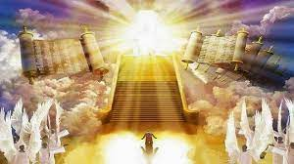
2 Cor 5:11 “Knowing therefore the terror of the Lord
we persuade men”

Slide 9
In Luke 16 Jesus reveals many remarkable
(and related) principles.
Vs. 1-9: Story of the unfaithful steward.
vs 1 “A certain rich man had a steward…who wasted his goods…
2 Give and account of thy stewardship.”
Vs 10-13: Makes an application to our lives.
“If you have not been faithful in… mammon (Money)
who will commit to your trust the true riches?
If you’ve not been faithful in that which is another man’s, who will give you that which is your own?”

Slide 10
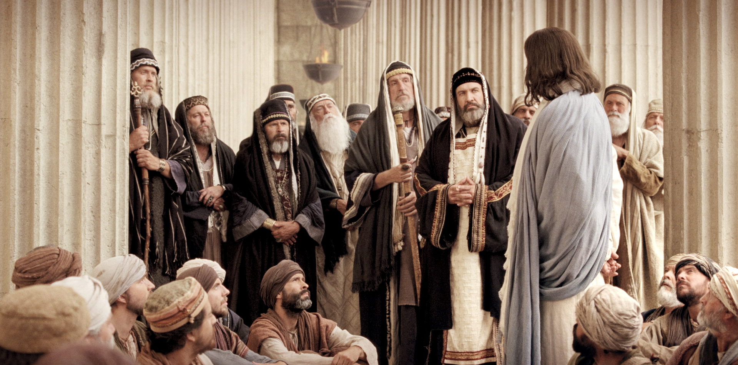
Vs. 14: The covetous Pharisees recognized the point and “derided him”.
Jesus simply replied:
Vs 15: ”Ye are they which justify yourselves
before men;
but God knows your hearts:”

Slide 11
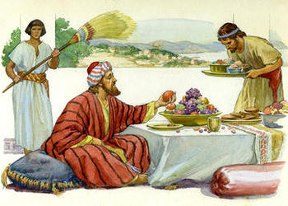
Jesus closes Luke 16 by pulling back the veil of eternity to reveal what happens when the “dot” and “dash” end. Vs 19-31
Vs 19: “There was a certain rich man,
which was clothed in purple and fine linen,
and fared sumptuously every day:
This was not a parable,
but Jesus’ account of actual events!

Slide 12
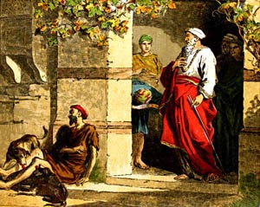
Vs. 20-21 “And there was a certain beggar named Lazarus, which was laid at his gate, full of sores,
And desiring to be fed with the crumbs
which fell from the rich man's table:
moreover the dogs came
and licked his sores.”

Slide 13
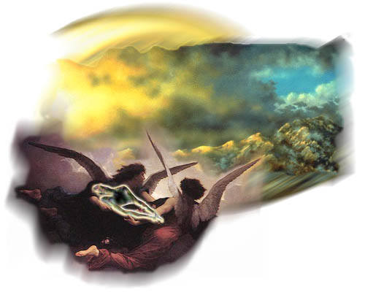
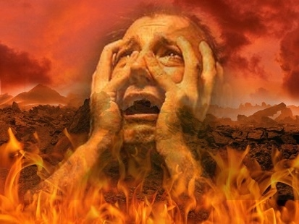
Vs 22 “And it came to pass, that the beggar died, and was carried by the angels into Abraham's bosom: (Paradise)
the rich man also died,
and was buried;
23 And in hell
he lift up his eyes,
being in torments,”

Slide 14
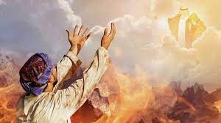
Luke 16:23-24 “and in hell…he seeth Abraham afar off, and Lazarus in his bosom.
And he cried and said, Father Abraham, have mercy on me, and send Lazarus, that he may dip the tip of his
finger in water,
and cool my tongue;
for I am tormented in this flame.

Slide 15
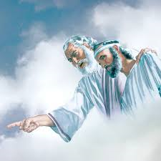
Vs 25 “But Abraham said, Son,
remember that thou in thy lifetime
receivedst thy good things,
and likewise Lazarus evil things:
but now he is comforted,
and thou art tormented.”

Slide 16
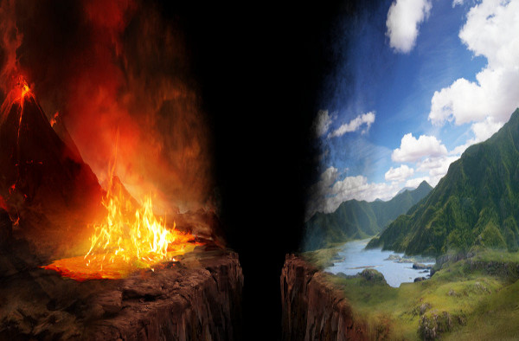
Vs 26 “beside all this, between us and you there is a great gulf fixed:
so that they which would pass from hence
to you cannot;
neither can they pass to us, that would come from thence.”

Slide 17
Vs 27,28 “Then he said, I pray thee therefore, father, that thou wouldest send him to my father's house: For I have five brethren;
that he may testify unto them,
lest they also come into this place of torment.”

Slide 18
Vs. 29 “They have Moses and the prophets; let them hear them.”
Vs 30 “Nay, father Abraham: but if one went unto them from the dead, they will repent.”
Vs 31 And he said unto him, If they hear not Moses and the prophets,
neither will they be persuaded,
though one rose from the dead.”

Slide 19
In Luke 16 Jesus revealed:
1. Death is Inevitable! Vs 22
“it came to pass, that the beggar died, …
the rich man also died”
Death is the great equalizer! Eccl. 2:16; Ro. 6:23
Eccl. 8:8 “There is no man that hath power over the spirit to retain the spirit;
neither hath he power in the day of death:
there is no discharge in that war!”

Slide 20
In Luke 16 Jesus revealed:
2. Death is Transitional!
It’s not a “conclusion”,
but the Introduction into Eternity! Vs. 22,23
Eccl 12:7 “Then shall the dust return to the earth as it was: and the spirit shall return unto God who gave it.”
There’s no hint of “soul sleep” here.
The instant after death,
both were ushered into eternity!

Slide 21
3. Death is “Destinational” 22,23
There’s only two destinations after death.
A. Paradise (aka: Abraham’s Bosom)
“Lazarus was carried …to Abraham’s bosom.”
1) Before Jesus’ death and ascension,
those who died in faith went to paradise. Lk 23:43
“Today shalt thou be with me in paradise.”
(Παράδεισος {para’deisos} An Eden, a park)
2) Since Abraham is called “the father of faith”
(Ro. 4:11,12, 16) , it’s “nicknamed” after Him.

Slide 22
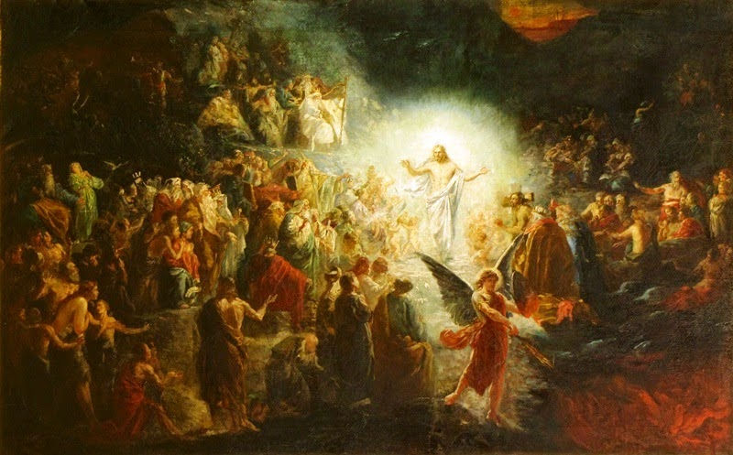
3) After Jesus’ resurrection, he led these to Heaven.
Eph. 4:8-10 “When he ascended up on high, he led captivity captive...Now that he ascended, what is it but that he also descended first into the lower parts of the
earth? (Abraham’s bosom)
He that descended is the same also that ascended up far above all heavens,
that he might (ful)fill
all things.”

Slide 23
4) Now believers go directly to heaven at death.
Jn 14:1,2; 2 Cor 5:1,8-10
“we know that if our earthly house of this tabernacle (body) were dissolved, (died)
we have an house (new body)…
eternal in the heavens…
8 We are confident, and willing rather to be absent from the body, and to be present with the Lord.
9 Wherefore we labor, that, whether present or absent,
we may be accepted of him.”
euar’estos fully pleasing Mt. 25:21

Slide 24
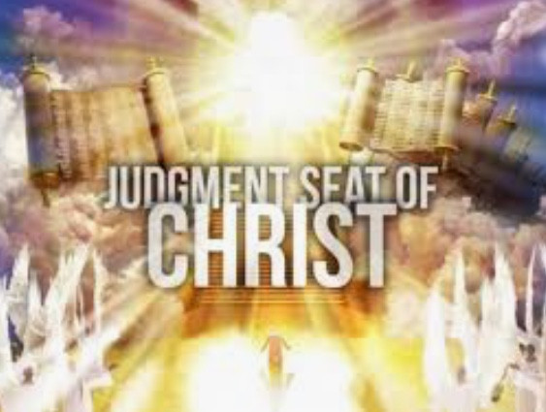
5) Our final rewards will be granted at the Bema
seat at the end of the age. (1 Cor 3:10-15; 2 Cor. 5:10)
“For we must all appear before the judgment seat of Christ; that every one may receive the things done in his body,
according to that he hath done, whether it be good or bad.”
1 Cor 3:13-14 “Every man's work shall be made manifest:
for the day shall declare it…
If any man's work abide which he hath built,
he shall receive a reward.”
Misthos: pay for service!

Slide 25
5) Our final rewards will be granted at the Bema
seat at the end of the age. (1 Cor 3:10-15; 2 Cor. 5:10)
Rev 14:12-13 ”Here is the patience of the saints: here are they that keep the commandments of God, and the faith of Jesus.
¹³ And I heard a voice from heaven saying, Blessed are the dead which die in the Lord…:
Yea, saith the Spirit, that they may rest from their labors;
and their works do follow them.”

Slide 26
6) Paradise (and Heaven) is a place of
a) Comfort. Vs 25 “now he is comforted”
b) Clarity. 1Cor. 13:12 “Now we see through a glass, darkly,
but then face to face.”
c) Companionship. “Abraham’s bosom” Heb. 12:22-23
“ye are come unto …the city of the living God…
and to an innumerable company of angels,
To the …church of the firstborn, which are written in heaven, and to God the Judge of all,

Slide 27
Heb. 12:23 “and to Jesus
the mediator of the new covenant.”
What will you say to Him?
What will he
say to You?
Mt 25:14-30

Slide 28
Mt 25:21 “Well done, thou good and faithful servant:
thou hast been faithful over a few things,
I will make thee ruler over many things:
enter thou into the joy of thy lord.”

Slide 29
There are only two destinations at Death:
1) Paradise (Now Heaven)
“Lazarus was carried by angels into (paradise)”
2) Hell: ᾅδης (hades) “The rich man also died, and in hell he lift up his eyes being in torment.”
Heb 9:27 ”It is appointed unto men once to die,
but after this the judgment:”
What will your destiny be after your Death?

Slide 30
What will your destiny be after your Death?
Why? John 3:16-18
John 3:36 “He that believeth on the Son
(pisteuō: to entrust, credit, put confidence in)
hath everlasting life:
and he that believeth not the Son
shall not see life;
but the wrath of God abideth on him.”

Slide 31
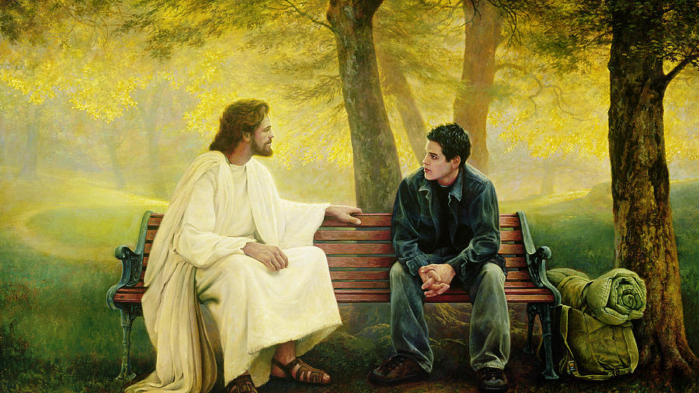
Which part of John 3:36 applies to you?
Greg Olsen “Lost and Found”

