Slide 1
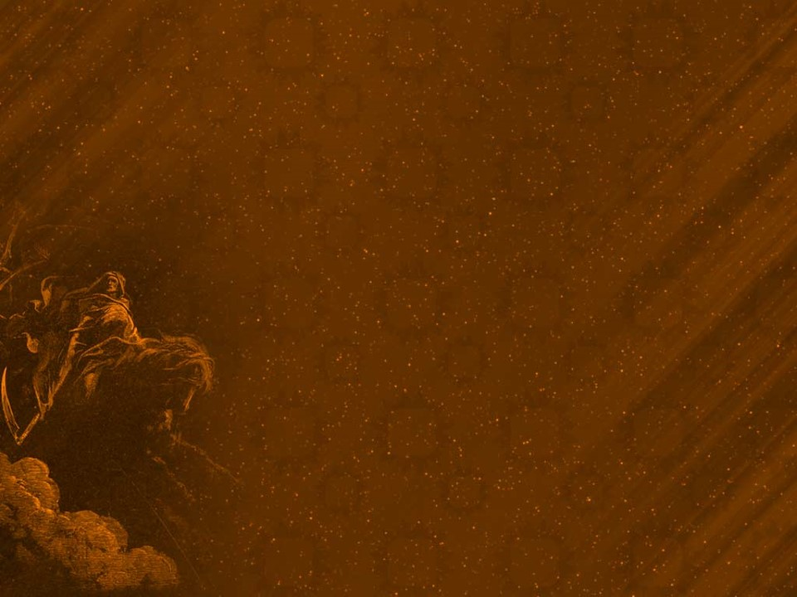
Eternity
Our Mortal lives are represented by the small “dot” on this “eternal” timeline.
Our “afterlife” is represented by the “ray”.
What we do during the small “dot” affects everything that happens on the “Ray.”
James 4:14 “life is …a vapor that appeareth
for a little time, then vanisheth away.”
Ps 90:12 “So teach us to number our days,
that we may apply our hearts unto wisdom.”

Slide 2
”It is appointed unto men once to die, Hebrews 9:27
Most modern tombstones sum up our mortal lives
with a small “dash”.
What we do during our brief “dash” determines what happens next!

Slide 3
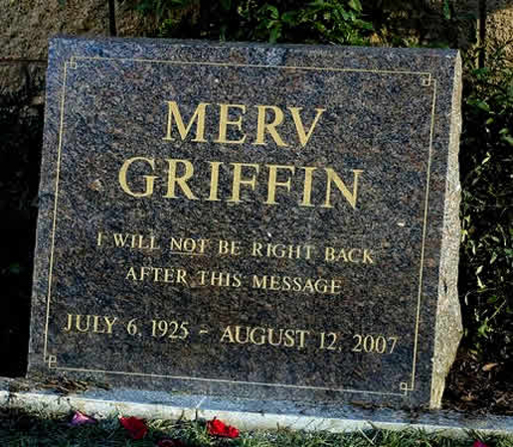
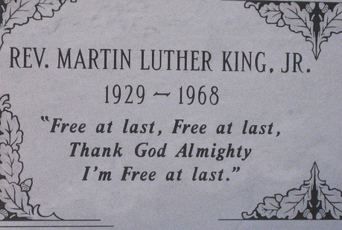
Older tombstones often had “epitaphs” that summarized the life “lost.”

Slide 4
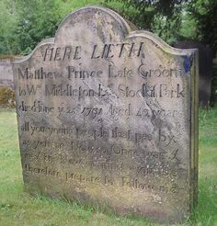
Pause, stranger, when you pass me by, As you are now, so once was I. As I am now, soon you will be.
So prepare for death, and follow me.
To follow you I’m not content,
Until I know which way you went!
Why should we “prepare” for Death?
How should we “prepare for Death?

Slide 5
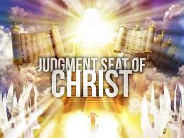
Destiny after the “Dash”
”It is appointed unto men once to die,
but after this the judgment:”
Hebrews 9:27
Κρίσις (Kri’sis) Decision (for or against); tribunal; justice (specially divine law)

Slide 6
In Luke 16 Jesus reveals many remarkable (and related) principles.
Vs. 1-9: Story of the unfaithful steward.
“A certain rich man had a steward…
who wasted his goods…
Give and account of thy stewardship.”
Vs 10-13: Makes an application to our lives.
“If you have not been faithful in… mammon who will commit to your trust the true riches?
If you’ve not been faithful in that which is another man’s, who will give you that which is your own?”

Slide 7
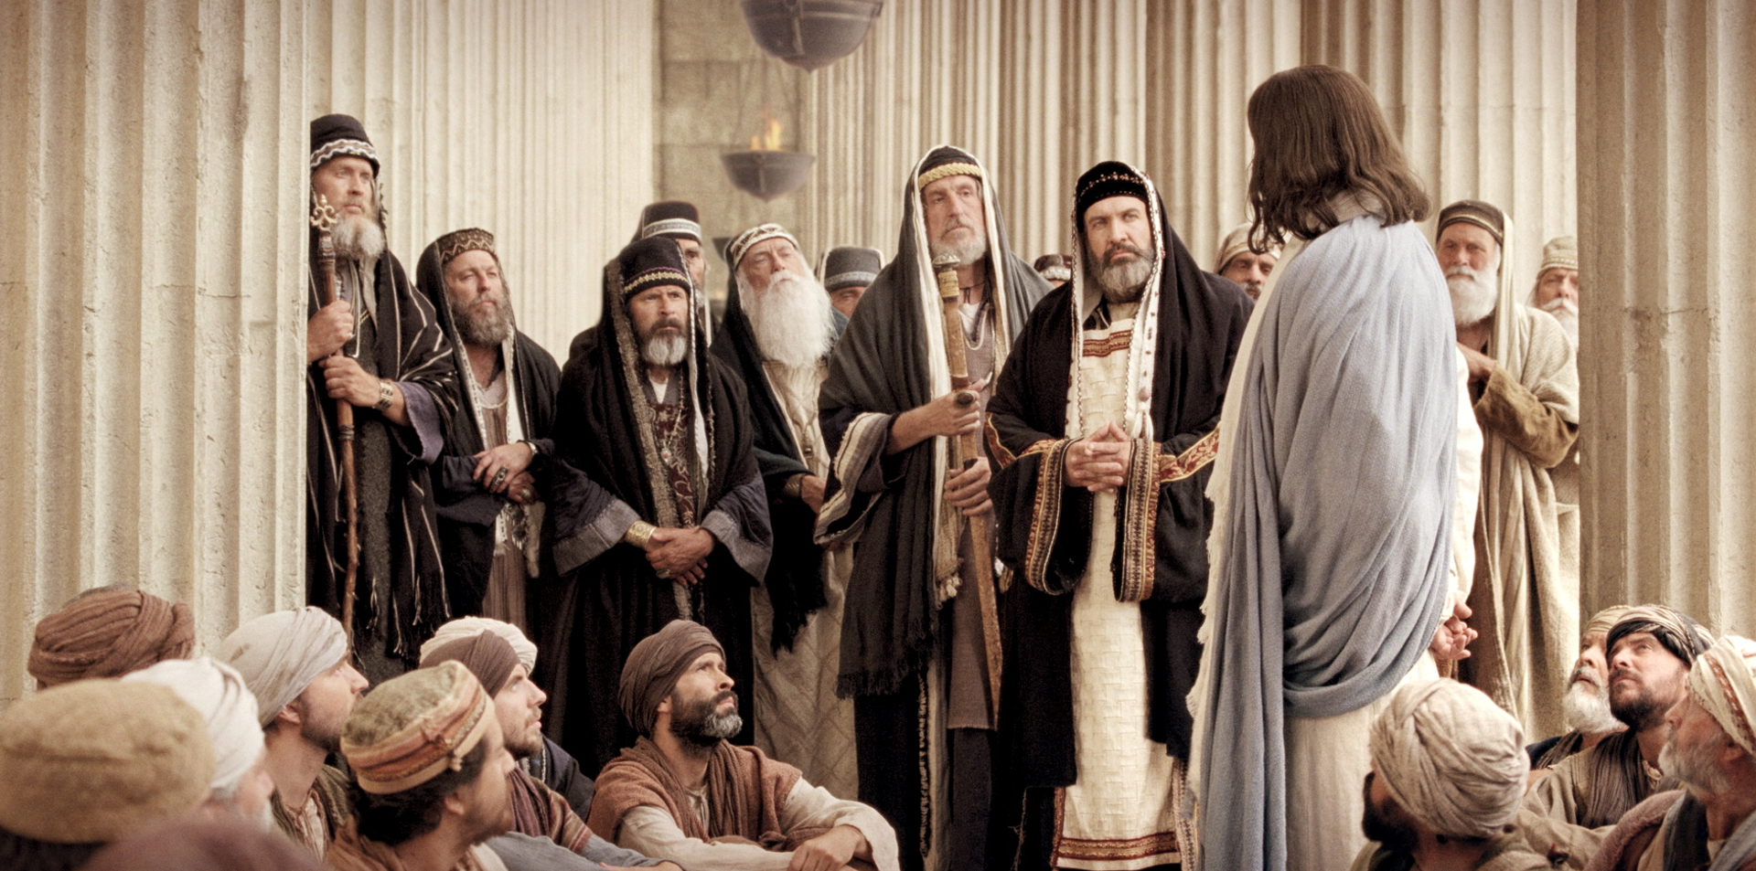
Vs. 14: The covetous Pharisees recognized the point and “derided him”.
Jesus simply replied:
Vs 15: ”Ye are they which justify yourselves
before men; but God knoweth your hearts:”

Slide 8
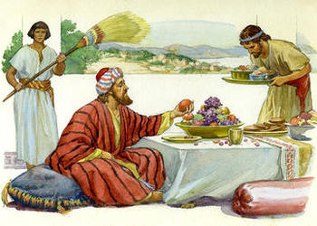
Jesus closes this chapter by pulling back the veil of eternity to reveal what happens when the “dot” and “dash” end. Vs 19-31
Vs 19: “There was a certain rich man,
which was clothed in purple and fine linen,
and fared sumptuously every day:
This was not a parable,
but Jesus’ account of actual events!

Slide 9
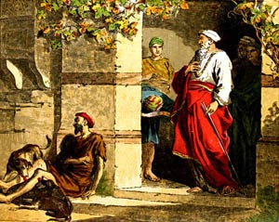
Vs. 20-21 “And there was a certain beggar named Lazarus, which was laid at his gate, full of sores,
And desiring to be fed with the crumbs which fell from the rich man's table:
moreover the dogs came and licked his sores.”

Slide 10
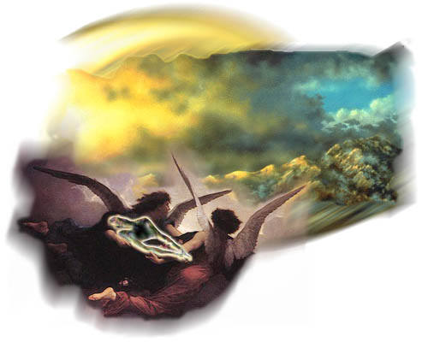
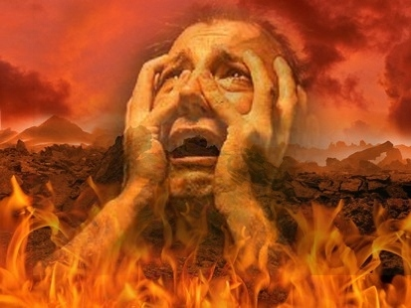
Vs 22 “And it came to pass, that the beggar died, and was carried by the angels into Abraham's bosom:
(Paradise)
the rich man also died, and was buried;
vs 23 And in hell
he lift up his eyes,
being in torments,”

Slide 11
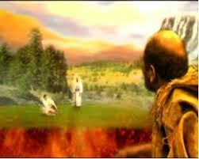
Luke 16:23-24 “and in hell…seeth Abraham afar off, and Lazarus in his bosom.
And he cried and said, Father Abraham, have mercy on me, and send Lazarus, that he may dip the tip of his finger in water, and cool my tongue;
for I am tormented in this flame.
Vs 25 “But Abraham said, Son, remember that thou in thy lifetime receivedst thy good things, and likewise Lazarus evil things:
but now he is comforted, and thou art tormented.”

Slide 12
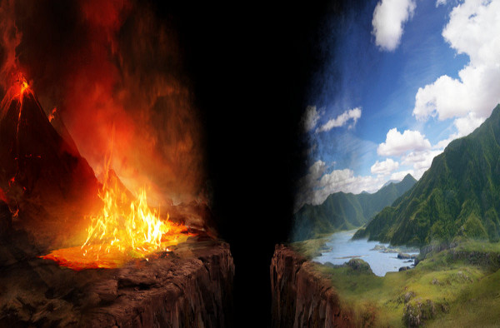
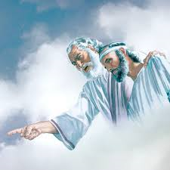
Vs 26 “beside all this, between us and you there is a great gulf fixed: so that they which would pass from hence to you cannot; neither can they pass to us, that would come from thence.”

Slide 13
Vs 27,28 “Then he said, I pray thee therefore, father, that thou wouldest send him to my father's house:
For I have five brethren; that he may testify unto them, lest they also come into this place of torment.”

Slide 14
Vs. 29 “They have Moses and the prophets; (God’s Word)
let them hear them.”
Vs 30 “Nay, father Abraham: but if one went unto them from the dead, they will repent.”
Vs 31 And he said unto him, If they hear not Moses and the prophets, neither will they be persuaded, though one rose from the dead.”

Slide 15
In Luke 16 Jesus revealed:
1. Death is inevitable! Vs 22
“it came to pass, that the beggar died, …
the rich man also died”
Death is the great equalizer! Eccl. 2:16
Eccl. 8:8 “There is no man that hath power over the spirit to retain the spirit;
neither hath he power in the day of death:
there is no discharge in that war!”

Slide 16
In Luke 16 Jesus revealed:
1. Death is inevitable! Vs 22
2. Death is not the “conclusion”, but the
Introduction into Eternity! Vs. 22,23
Eccl 12:7 “Then shall the dust return to the earth as it was: and the spirit shall return unto God who gave it.”
There’s no hint of “soul sleep” here.
The instant after death, both were ushered into eternity!

Slide 17
3. There are ultimately only two
destinations after death. Vs. 22,23
A. Paradise (aka: Abraham’s Bosom)
“Lazarus was carried …to Abraham’s bosom.”
1) Before Jesus’ death and ascension, those who
died in faith went to paradise. Lk 23:43
“Today shalt thou be with me in paradise.”
Παράδεισος (para’deisos) An Eden, a park
2) Since Abraham is called “the father of faith”
(Ro. 4:11,12, 16) , it’s “nicknamed” after Him.

Slide 18
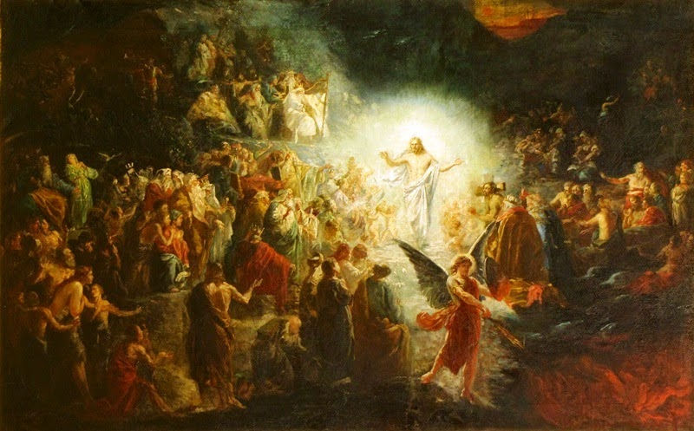
3) After Jesus’ ascension, he led these to Heaven.
Eph. 4:8-10 “When he ascended up on high, he led captivity captive...Now that he ascended, what is it but that he also descended first into the lower parts of the earth? (Abraham’s bosom)
He that descended is the same also that ascended up far above all heavens, that he might fill all things.”

Slide 19
4) Now believers go directly to heaven at death.
Jn 15:1,2; 2 Cor 5:1,8-10
“we know that if our earthly house of this tabernacle (body)…were dissolved, (died) we have
an house (new body)…eternal in the heavens…
We are confident, and willing rather to be absent from the body, and to be present with the Lord.
Wherefore we labor, that, whether present or absent, we may be accepted of him.
For we must all appear before the judgment seat of Christ; that every one may receive the things done in his body, according to that he hath done,
whether it be good or bad.”

Slide 20
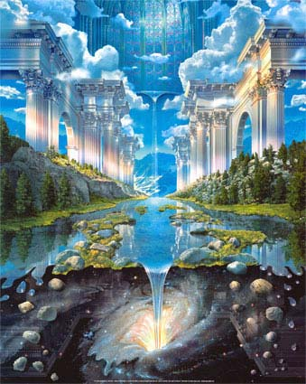
For Believers
1 Cor. 3:9-15; 2 Cor. 5:10; 2 Peter 1:11
New heaven & Earth
Heaven
Paradise

Slide 21
5) Our final reward will be evaluated at the Bema seat at
the end of the age. (2 Cor. 5:10)
Rev 14:12-13 ”Here is the patience of the saints: here are they that keep the commandments of God, and the faith of Jesus.
¹³ And I heard a voice from heaven saying unto me,
Write, Blessed are the dead which die in the Lord…:
Yea, saith the Spirit, that they may rest from their labors;
and their works do follow them.”

Slide 22
6) Paradise (and Heaven) is a place of
a) Comfort. Vs 25 “now he is comforted”
b) Clarity. 1 Cor. 13:12 “Now we see through
glass, darkly, but then face to face.”
c) Companionship. “Abraham’s bosom”
Heb. 12:22-23 “ye are come unto mount Sion, and
unto the city of the living God… and to an
innumerable company of angels,
To the …church of the firstborn, which are written
in heaven, and to God the Judge of all,
and to the spirits of just men made perfect,
and to Jesus the mediator of the new covenant.”

Slide 23
3. There are only two destinations.
A. Paradise (Now Heaven)
B. Hell: ᾅδης (hades)
“The rich man also died, and in hell he lift up his eyes being in torment.”
1) It’s a type of “jail” to hold unrepentant
humanity until the final judgment.

Slide 24
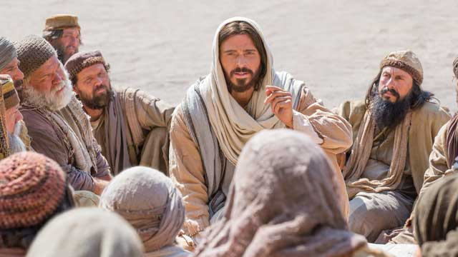
1) Hades is a type of “jail” to hold unrepentant
humanity until the final judgment.
Ezek. 18:20 “The soul that sinneth, it shall die.”
Ro. 6:23 “The wages of sin is death.”
Jn 3:18 “He that believeth on him is not condemned:
but he that believeth not is condemned already”
John 8:24 “if ye believe not that I am he,
ye shall die in your sins.”

Slide 25
Heb. 9:27 “It is appointed unto man
once to die, after this the Judgment.”
2) At the final judgment, the souls in hades
will reunite with the bodies for sentencing”.
Rev 20:13 “death and hell delivered up the dead which were in them: and they were judged
every man according to their works.”
a) This “sentencing” takes place at the end of
the age, since the effect of our choices
outlive us!
“and death and hell (hades) were cast into the lake of fire.” (ge’enna) Rev. 20:14

Slide 26
For Unrepentant Unbelievers
Revelation 20:11-15
Hades / Hell
Mt 25:41 “Depart from me…into everlasting fire, prepared for the devil and his angels”

Slide 27
3) Hell (mentioned 65 times) is a place of:
a) Clarity.
Hades from οἶδα (Eidō): to know, be aware!
(1) He recognized Abraham, Lazarus!
(2) He remembered his life and family!
b) Corruption (Suffering) “tormented in this flame”
Jesus described Hell in Mark 9:44 as: “Where their worm dieth not,
and the fire is not quenched.”
(1) He Felt, saw, experienced!
(2) Unsatisfied desires. “drop of water”

Slide 28
3) Hell (mentioned 65 times) is a place of:
a) Clarity.
b) Suffering. “tormented in this flame”
c) Remembering and Regret.
“Son Remember…” Luke 16:25
“I have five brethren…
come to this place of torment” vs 28

Slide 29
Henry Wadsworth Longfellow (1807-1882)
A PSALM OF LIFE published 1838
TELL me not, in mournful numbers,
Life is but an empty dream ! —
For the soul is dead that slumbers,
And things are not what they seem.
Life is real ! Life is earnest!
And the grave is not its goal ;
Dust thou art, to dust returnest,
Was not spoken of the soul.

Slide 30
Not enjoyment, and not sorrow,
Is our destined end or way ;
But to act, that each to-morrow,
Find us farther than to-day.
Art is long, and Time is fleeting,
and our hearts, though stout and brave,
Still, like muffled drums, are beating,
Funeral marches to the grave.

Slide 31
In the world's broad field of battle,
In the bivouac of Life,
Be not like dumb, driven cattle!
Be a hero in the strife !
Trust no Future, howe'er pleasant!
Let the dead Past bury its dead !
Act,— act in the living Present!
Heart within, and God o'erhead !
Lives of great men all remind us,
We can make our lives sublime,
And, departing, leave behind us,
Footprints on the sands of time ;

Slide 32
“Footprints, that perhaps another,
Sailing o'er life's solemn main,
A forlorn and shipwrecked brother,
Seeing, shall take heart again.
Let us, then, be up and doing,
With a heart for any fate ;
Still achieving, still pursuing,
Learn to labor and to wait.”
Henry Wadsworth Longfellow (1807-1882)

Slide 33
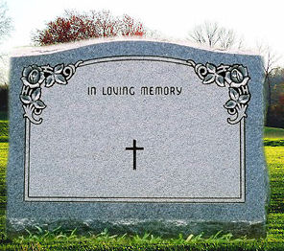
”It is appointed unto men once to die,
but after this the judgment:”
Hebrews 9:27
Your Name
Birth Death
What will your Destiny be
after the “Dash?”

