Slide 1
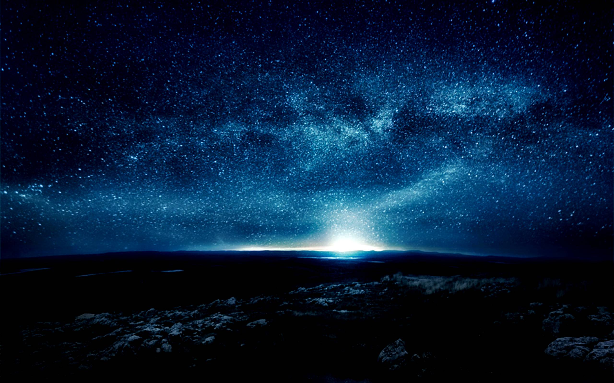
“Where there is no vision,
(Ḥāzôn’: Dream, inspiration, direction)
from ḥāzâ: perception
the people perish:”
(pāraʿ: expose, dissolve, turn back)
Pr. 29:18

Slide 2
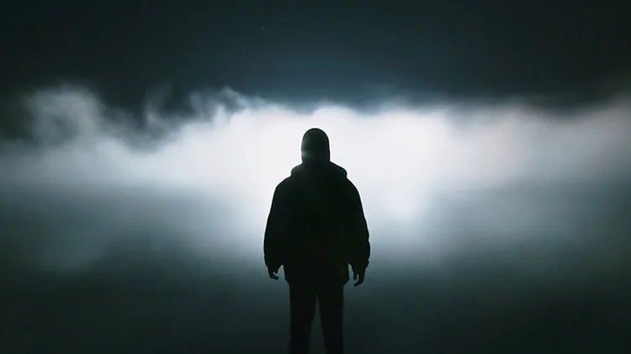
Satan’s a master at poisoning our perception (2 Cor 4:4);
Turning our dreams
into his nightmares. (John 10:10)

Slide 3
Thankfully,
God’s a Dream (Direction/Hope) Giver!

Slide 4
Jer 29:11 “For I know the thoughts that I think toward you, saith the LORD, thoughts of peace, not evil,
to give you an expected end” (tiqwâ aḥarît’)
(a cord, hope for a future posterity, reward)

Slide 5
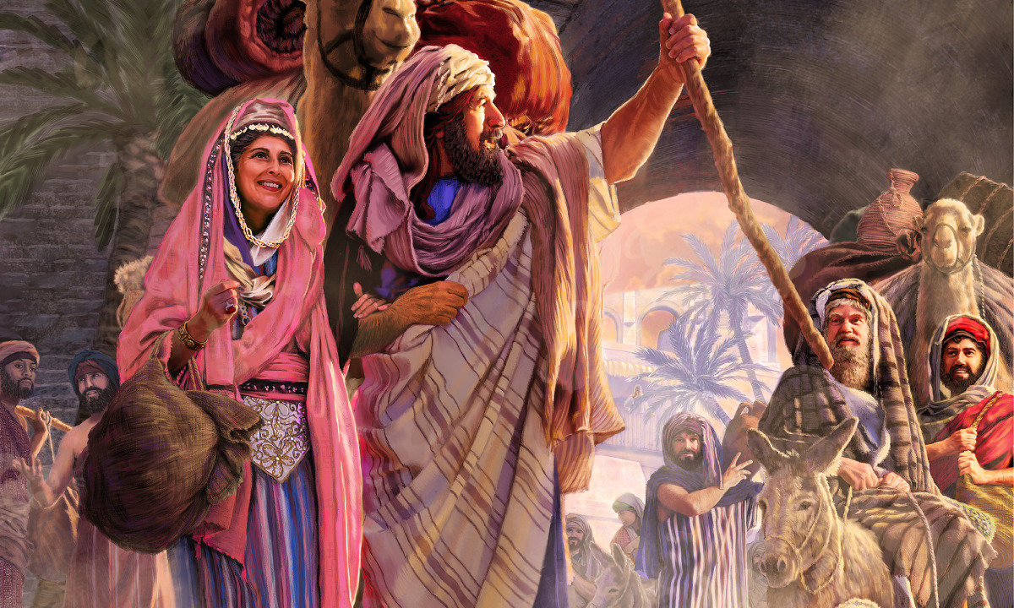
God created us for an “expected end” (Rev. 4:11)
and encourages us to seek it
and gives us examples to guide us. (1 Cor 10:11)
(Him!) Jer 29:12-14
Isaiah 51:1-2 “Hearken to me, ye
that follow after righteousness,
ye that seek the LORD:
Look unto Abraham…
for I called him …,
and blessed him,
and increased him.”

Slide 6
When God called childless Abram (lofty father) at 70
“to go out into a place which he should after receive for an inheritance,
(He) obeyed; and he went out,
not knowing whither he went.
By faith he sojourned in the land of promise,
as in a strange country, dwelling in tabernacles …:
For he looked for a city which hath foundations,
whose builder and maker is God.”
Heb 11:8-10

Slide 7
Notice the Pattern/Process of God’s Call:
1. It starts with a (our) Dream/Hope.
A. Abram’s dreams were nice,
B. He/We (and our dreams) are limited by our:
1) Perception (Clarity/Understanding) Eph. 4:18
2) Power (Ability) Phil. 4:13
3) Patience (Durability) Heb. 10:36
C. Limitations usually lead to frustrations.
Gen. 11:30 “But Sarai was barren….”
but narrow.

Slide 8
It starts with a (our) Dream/Hope.
Usually after some frustration, disappointment:
2. God reveals His Dreams/Hope for us.
A. God had much Bigger dreams for Him!
1) Abram could see a small family of his own.
God had something larger in mind! Gen. 15:5
“he brought him forth abroad, and said, Look now toward heaven, and tell (sāpar: scribe) the stars,
if thou be able to number them:

Slide 9
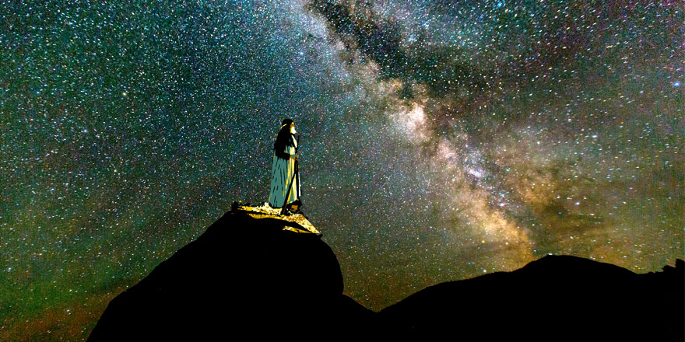
5 “So shall thy seed be.
And he believed in the LORD;
and he counted it to him for righteousness.”

Slide 10
2. God reveals His Dreams/Hope for us.
A. God had much bigger dreams for Him!
B. God has much Better Dreams for Him!
1) Abram wanted a family to Bless;
God wanted Him to Bless the World!
Gen 12:2-3 “Thou shalt be a blessing…
in thee shall all families be blessed!”
God wants to bless you,
so that you can be a blessing to others!

Slide 11
3. God’s Dreams come with Directions:
A. They’re Purposeful
Gen. 12:1a “The LORD had said unto Abram,
Get thee out of thy country, and from thy kindred, and from thy father's house…”
B. They’re Progressive!
Gen. 12:1b “unto a land that I will shew thee:
Ps 119:105 “Thy word is a lamp unto my feet,
and a light unto my path.” (1 Jn 1:5-7)

Slide 12
4. Expect Distractions, detours and delays.
A. Some will seek to distract and delay us
as we purpose to pursue God’s call (dream).
1) Abram’s family (Border Bullies) distracted and delayed him in “Haran”.
2 Cor 6:14 “Be ye not unequally yoked together with unbelievers: for what fellowship hath righteousness with unrighteousness?
and what communion hath light with darkness?”
(See Luke 14:25-35)

Slide 13
Dreams➔ Directions➔ Distractions/Detours➔
5. There’ll be Inevitable Disappointments
A. We’ll face some “wastelands” (deserts) in
the pursuit of God’s call that will produce:
1) Discouragement Gen. 12:10 “famine”
2) Doubt (about God and ourselves!) Ps 78:19
3) Danger. Dt 2:20 “That also was a land of giants”
(Battle for the Rescue of Lot in Gen. 14)

Slide 14
The inevitable disappointments ➔
6. Critical Decisions (faith, family, feelings)
Choices we make in the “deserts of doubt”
have consequences affecting us, and others.
(Egypt, Sarah, Hagar, Lot, Isaac, etc)
Ro. 14:7 “For none of us liveth to himself, …”
Ro. 14:23 “Whatsoever is not of faith is sin”.
Gal. 6:7 “Whatever ye sow, that shall ye also reap”
For good or evil!

Slide 15
Dreams➔ Directions ➔ Distractions ➔
Disappointments ➔ Decisions ➔
7. Development (of our Faith/Character)
A. Faith is Revealed in the difficult
deserts of disappointment (James 1:2-5),
not in the delightful desserts
of pleasure/prosperity!

Slide 16
Faith is Revealed in our disappointment.
1) During such seasons we learn to recognize:
a) Who We are.
2) Moses, (Ex. 3,4) Elijah (1 Kg 19), David (Ps 119:71),
And even Jesus modeled this! (Mt 4; Heb. 5:8)
Jn 8:31 “Then said Jesus to those which
believed on him:
then are ye my disciples indeed;
And ye shall know the truth,
and the truth shall make you free.’”
b) Who God is.
c) Whose plan is best!
‘If ye continue in my word,
About what/who?
From what/who?

Slide 17
7. Development (of our Faith/Character)
Faith is Revealed in our disappointments.
B. Faith is Refined in our disappointments.
1) God seeks to use the consequences of our
decisions (good and bad) to develop our Faith in:
a) Who He is. (His Person/Nature) Jn 14:21
b) Who We are! (Our Position {in Him}) Jn 15
c) What He Wants. (His Plans for us.)
Ro. 12:1,2

Slide 18
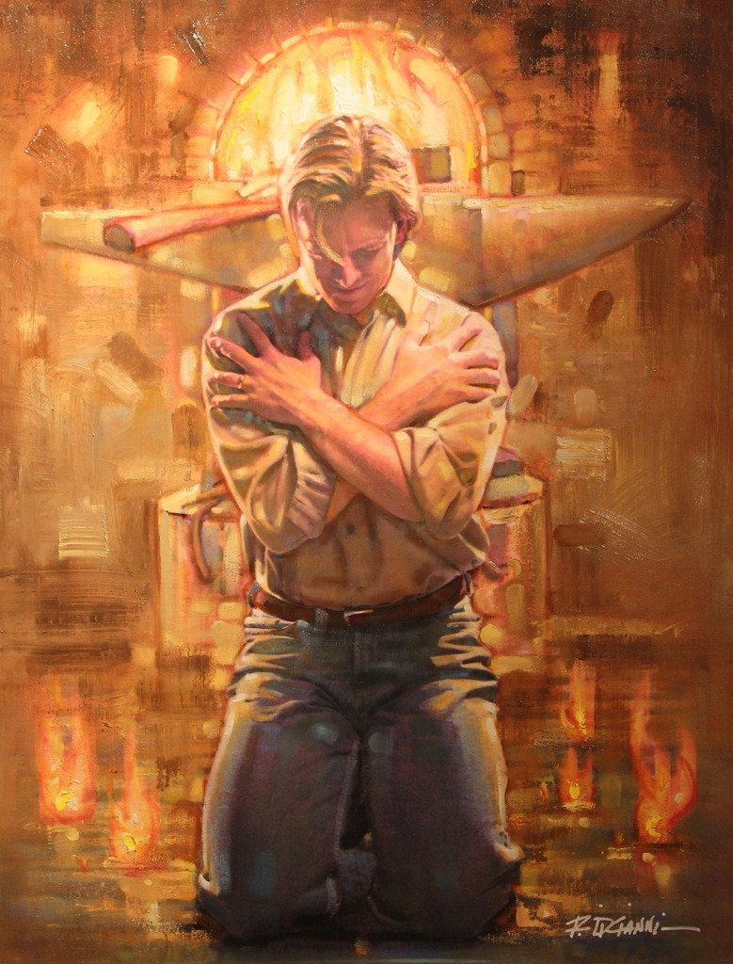
B. Faith is Refined in disappointments.
1 Peter 1:6-7 “ye rejoice, though now for a season, if need be,
ye are in heaviness through manifold temptations:
7 That the trial of your faith,
(Dokim’ion: test, trustworthiness)
being much more precious than of gold that perishes,
though it be tried with fire,

Slide 19
1 Pt 1:7,8 “That the trial of your faith…
Though it be tried with fire;
might be found unto praise and honor and glory at the appearing of Jesus Christ:
8 Whom having not seen, ye love;
in whom, though now ye see him not,
yet believing, ye rejoice
with joy unspeakable
and full of glory:”

Slide 20
7. Development (of our Faith/Character)
Faith is Revealed through disappointment
B. Faith is Refined through disappointment.
C. Faith is Requisite to/for healthy relationships!
1) It’s tied (related) to love! (1 Cor 13:13)
“Now abideth (meno: to stay!) See Jn 15
Faith (pistis: reliance, dependence, trust)
Hope (elpis: anticipation, expectation, confidence)
Charity.” (agape: benevolent love)

Slide 21
2) It’s tested in (and through) hardships.
Is 48:10,11 “I have refined thee..
I have chosen thee in the furnace of affliction.
For mine own sake …will I do it:
for how should my name be polluted?”
Ro 2:24 “For the name of God is blasphemed among the Gentiles
through you.”

Slide 22
Conclusion: Ro. 8:28
“All things work together (synerge’ō: cooperate)
for good (agathos: to benefit)
to them that love God,
to them who are called (klētos’: invited/appointed)
according to his purpose. (Pro’thesis: intention)
What’s God’s ultimate intention/purpose?
Prothesis comes from protith’ēmi, meaning:
to send/set forth, exhibit!

Slide 23
We are God’s “Exhibit”
to an unbelieving world! 1 Pt 2:9
“But ye are a chosen generation, a royal priesthood, an holy nation, a peculiar people;
(peripoi’ēsis: purchased, preserved, precious)
that ye should shew forth (exangellō: messenger)
(aka: exhibit, reveal!)
the praises of him who hath called you out of darkness into his marvellous light:”

Slide 24
Because we’re God’s “Exhibits”, (messengers)
He’s actively at work to prepare us. (Mal. 3:17,18)
Ro. 8:28 “…who are called according to his purpose.
29 for whom He did foreknow,
he did also predestinate
to be conformed to the image of his son,
(symmorphos: jointly transformed)
That he (Jesus) might be the firstborn
among many brethren”

Slide 25
Where are you in your faith Journey?
1) Still pursuing your own dreams?
2) Embracing God’s Dreams for your life?
3) Honestly trying to Pursue God’s Directions?
4) Distracted or delayed by “border bullies”?
5) Disappointed by delays or difficulty?
6) Teetering on the brink of Critical decisions?
(Deciding “to follow Jesus” or yourself?)
7) Allowing (cooperating with) God to develop you?

Slide 26
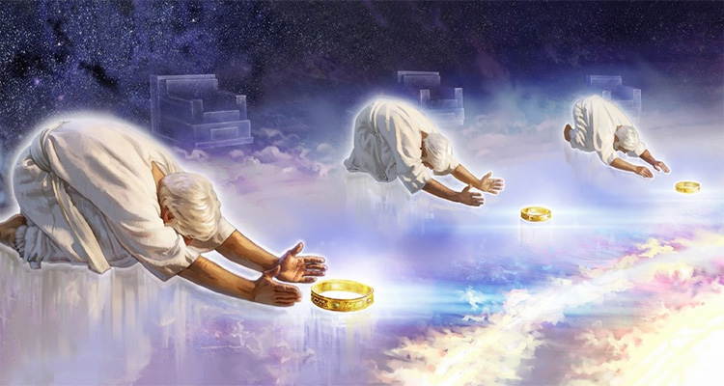
Rev. 4:11
“Thou art worthy,
O Lord,
to receive glory
and honour
and power:
for thou hast created all things,
and for thy pleasure they are and were created.”
Thelēma: will (62x); desire (1x); Pleasure (1x)

Slide 27
Heb. 11:6 “without faith it is impossible to please him:
for he that cometh to God must believe
that he is,
and that he is a rewarder of them
that diligently seek him.”
Do you?
Will You?
Are you willing to pursue God’s Process for your Development toward His Purpose?
Ro. 12:1,2 “…That ye may prove what is that good and acceptable and perfect will of God.”

Slide 28
What’s God Dream for you? Jer 29:11
Are you willing to pursue it (Him)?

