Slide 1
2 Cor 10:3-5; 1 Tim 4:1-2; 2 Tim. 2:1-4, 22-26
2 Cor 2:11 “Lest Satan should get an advantage of us:
for we are not ignorant of his devices.”

Slide 2
“We are not ignorant of his devices”
No’ema: mind, purpose, disposition
Jn 10:10 “thief comes…to steal, kill, destroy…”
Mark 3:24 “if a kingdom be divided against itself,
that kingdom cannot stand.
25 a house (heart) divided against itself…cannot stand…
27 No man can enter into a strong man's house, and spoil his goods, except he will first bind the strong man;
and then he will spoil his house.”

Slide 3
Jn 10:10 “…to steal, kill, destroy…”
Mk 3:27 “except he will first bind the strong man;
and then he will spoil his house.”
Who’s the “strong man” in your house?
Who are the “strong men/women” in our Church/Communities/Nation?
How would you “Bind them”
if you were Satan?

Slide 4
Satan’s devices include using:
Our Limited Perspective ➔ Complaining
Our Lustful Pleasures ➔ Compulsions
Our Propensity for Perversion ➔ Corruption
Jer 3:20,21 “for they have perverted their way,
and they have forgotten the LORD their God.”
His goal is our Rebellion! (1 Sam 15:23;
God’s Goal is our Repentance/Restoration!
Ps. 23:3; 2 Chron. 7:14

Slide 5
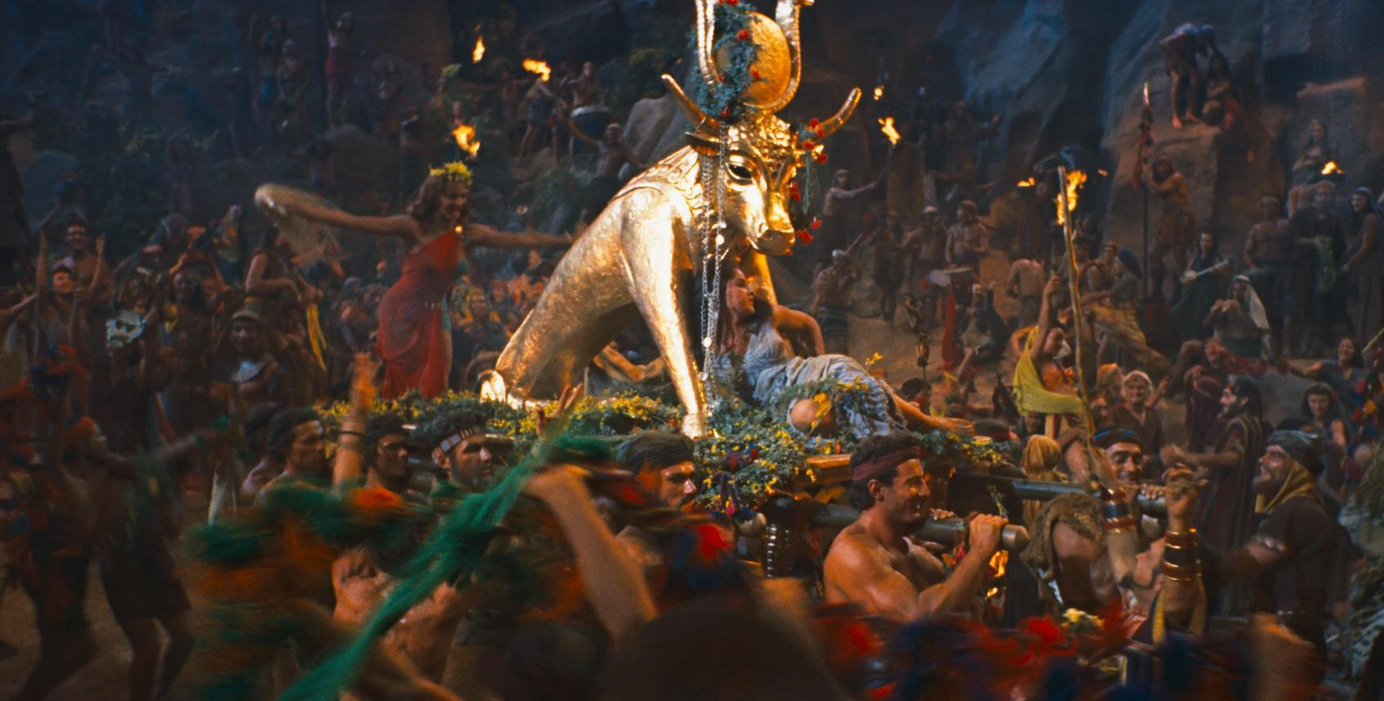
Departing from God ➔ Drifting toward Satan
and our ultimate Destruction. Jn10:10a
1 Cor 10:5 “they were overthrown in the wilderness.
6 Now these things were our examples,
to the intent we should not lust after evil things,
as they also lusted.
7 Neither be ye idolaters…”

Slide 6
Defining Idolatry (Old Testament)
Lev 19:4 “Turn ye not unto idols…” (elîl: good for nothing)
Jer 8:19 “provoked me... with graven images…strange vanities?”
(heb’el: emptiness {from habal: to lead astray})
Lev. 26:30 “cast …upon your idols, (gillûl’îm: To wallow/trust)
and my soul shall abhor (gaal’: reject) you.”
1 Sam 15:23 “rebellion is as the sin of witchcraft,
and stubbornness is as iniquity and idolatry.” (terāpîm)
From rapha: promises to heal, repair
(from rapa: actually weakens and consumes.)

Slide 7
Defining Idolatry (New Testament)
1 Cor 10:7 “Neither be ye idolaters” Eidōlolat’rēs: from eidolon (form) and latreu’o (to serve /worship)
by implication a heathen god!
20 …the things which the Gentiles sacrifice,
they sacrifice to devils, and not to God:
and I would not that ye should have
fellowship with devils.”
Idolatry opens us up to demonic influence.

Slide 8
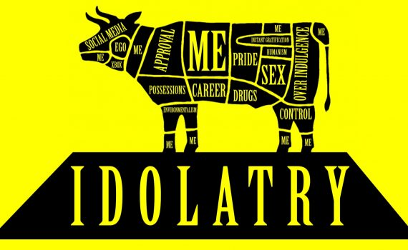
“Any thing which usurps the place of God
in the hearts of his rational creatures.”

Slide 9
Pt 2: Why are we so prone to idolatry?
1. Because we Delight in it!
(or at least in what “it” promises.)
A. We’re “wired” for desire.
God made us with desires. Gen. 2:18
1) Physical: Food, air, pleasure, warmth
2) Emotional/ relational: Approval, appreciation
3) Spiritual: Intimacy, purpose (Ecc. 3:11)

Slide 10
2. Delighting in Idolatry
A. We’re “wired” for desire.
B. Sin corrupts (rewires) those desires.
1) Sin offers to fulfil those desires:
a) In the wrong way Heb. 13:4; Pr. 5:18-23
“in the greatness of his folly he shall go astray.”
Sin: hamartano: miss the mark & forfeit the prize.
Jms 1:13-17 “every good…perfect gift…”
b) At the wrong time. Mt 4:1-10

Slide 11
B. Sin corrupts (rewires) those desires.
1) Sin offers to fulfil those desires:
a) In the wrong way Heb. 13:4; Pr. 5:18-23
b) At the wrong time. Mt 4:1-10; Micah 2:10
“Arise ye, and depart; for this is not your rest:
because it is polluted, (ṭāmēʾ: contaminated)
it shall destroy you, (ḥābal’: bind, twist)
even with a sore destruction.”
(ḥēb’el: a noose)

Slide 12
C. Idolatry (or the powers behind it) promises to
meet our needs (desires),
1) The Relationship between lust and idolatry
1 Cor. 10:6 “Now these things were our examples,
to the intent we should not lust after evil things,
without God!
from Epi (Superimpose {time, order, priority, or direction})
Thumos (Passion) from thyo (to rush / sacrifice)
7 Neither be ye idolators”

Slide 13
C. Idolatry (or the powers behind it) promises to
meet our needs (desires), without God.
2) Idolatry “promises” to Satisfy our desires/lust for:
a) Pleasure (Isthar/Astoreth Num. 25)
b) Provision (Baal/Isthar Jer. 44:15-27)
c) Protection (Ahaz & Assyrian gods 2 Kings 16)
d) Direction (Ahaziah to Baalzebub 2 Kings 1)
e) Purpose (Jezebel 1 Kings 16:31-33)
(Simon the Sorcerer Acts 8:9-11)

Slide 14
1 Cor 10:7-8 “Neither be ye idolaters…,
sat down to eat and drink, and rose up to play.
8 Neither let us commit fornication,
as some of them committed,
and fell in one day three and twenty thousand.”
Because of Balaam’s counsel! Numbers 22-24
(See also 2 Pt 2:12-15; Jude 11)

Slide 15
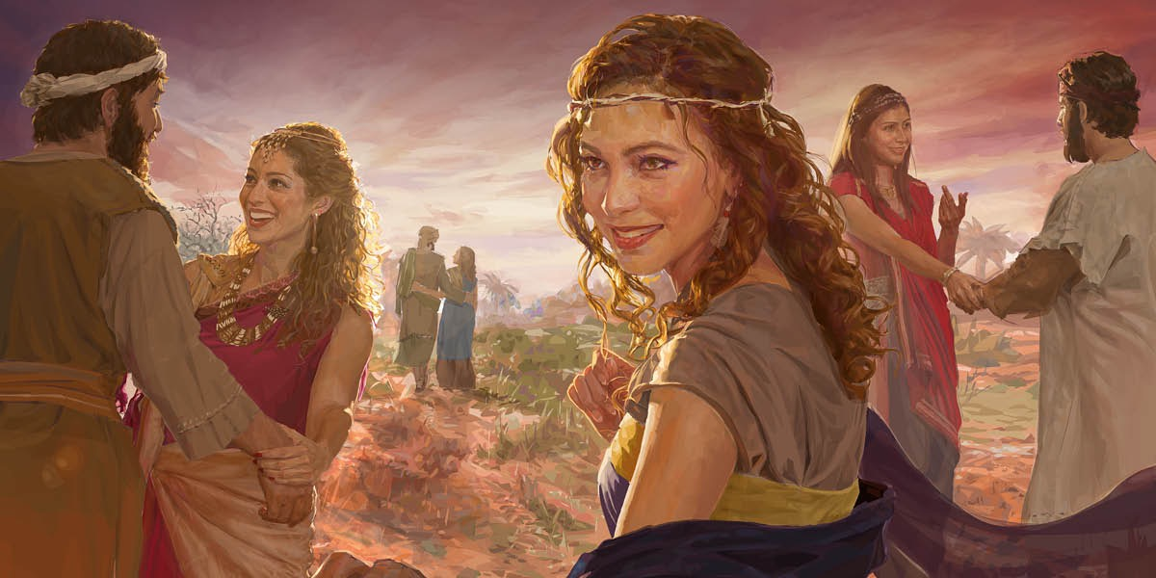
Numbers 25
1 “…the people began to commit whoredom
with the daughters of Moab.
2 And they called the people unto the sacrifices of their gods: and the people did eat, and bowed down to their gods.
3 And joined himself unto Baalpeor:
and the anger of the LORD was kindled against Israel.”

Slide 16
Pt 2: Why are we so prone to idolatry?
Because we delight in it! (Its promises)
Because we’re Deceived by it.
A. By its Temptation
1) Satan uses our “desires” (thumos) as bait
(the promise to satisfy them)
to superimpose his agenda (the hook)
onto/ over) our hearts (epi)
in order to corrupt them! (Jms 1:13-16)

Slide 17
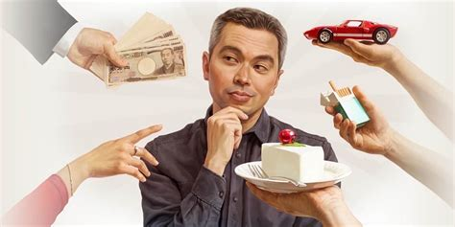
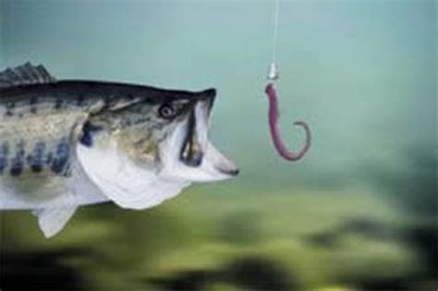
a) The “bait” is made to “look” so good that
we “overlook” the hook hidden inside!
2 Tim. 2:26 “the snare of the devil,
who are taken captive of him at his will”

Slide 18
2) This is how Sin was introduced. Gen. 3:1-8
“Now the serpent was more subtle subtil…
…yea hath God said…ye shall not die…
Your eyes shall be open…Ye shall be as gods…
She saw…
Took the fruit…
Gave to her husband…
Sowed fig leaves…
Heard God…
and hid themselves.”

Slide 19
3) This process is repeated regularly Ro 7:9-12
“I was alive without the law once: but when the commandment came, sin revived, and I died.
10 .. the commandment, which was ordained to life,
I found to be unto death.
11 For sin taking occassion…deceived me,
and by it slew me.”
(Ro 5:12; 6:23)

Slide 20
Because we’re deceived by it.
A. By its temptation. (promise to deliver)
B. By its timing. Remember “epi” means to
superimpose “in time, place, order, priority!”
1) Satan tempts us to be our own God by providing
for our own “needs” (Phil. 4:19) in our own time!
2 Tim. 4:10 “Demas hath forsaken me,
having loved this present (nyn: now) world…”
Compare 2 Tim. 2:4, 22-26; Phil. 3:18,19
1 Pt 2:11 “fleshly lusts which war against the soul”

Slide 21
Why are we so prone to idolatry?
Because we Delight in it! (it’s promises)
Because we’re Deceived by it. (Ro. 7:9-12)
3. Because we’re Diseased with it.
A. Sin, by its nature, is infectious! (1 Jn 5:19-21)
“And we know that we are of God, and the whole world lieth in wickedness. (poneros: diseased)
And we know that the Son of God is come,
and hath given us an understanding, …
Little children, keep yourselves from idols.”

Slide 22
1) Sin works and spreads within us. Ro 7:13-21
“But sin, that it might appear sin, working death in me by that which is good; that sin by the commandment might become exceeding sinful.
For we know that the law is spiritual:
but I am carnal, sold under sin.
15 For that which I do I allow not: for what I would, that do I not; but what I hate, that do I …
Now then it is no more I that do it,
but sin that dwelleth in me.”

Slide 23
1) Sin works and spreads within us. Ro 7:13-24
For I know that in me (that is, in my flesh,) dwelleth no good thing: for to will is present with me;
but how to perform that which is good I find not.
For the good that I would I do not:
but the evil which I would not, that I do….
21 I find then a law, that, when I would do good,
evil is present with me.
24 O wretched man that I am! who shall deliver me from the body of this death? “

Slide 24
1) Sin works/ spreads within us. Ro 7:13-21
2) Sin works against us
Gal 5:17 “For the flesh lusteth (epithumeo)
against the Spirit,
and the Spirit against the flesh:
and these are contrary the one to the other:
so that ye cannot do the things that ye would.”
3. Because we’re Diseased by it. (Idolatry)
A. Sin, by its nature, is infectious! (1 Jn 5:19-21)
(and God!).

Slide 25
3) Sin works through us! Notice its family tree:
Gal 5:19-21 “Now the works of the flesh are manifest, which are these; Adultery, fornication (porneia), uncleanness (impurity), lasciviousness, (wantonness)
20 Idolatry, witchcraft, (pharmakei’a)
hatred, variance, (quarrels) emulations, (jealousy)
wrath (passion), strife (contention), seditions (division), heresies (disunion),
21 Envyings (spite, ill will), murders, drunkenness, revellings (carousal, letting loose), and such like:”

Slide 26
We are prone to idolatry because:
We delight in it; We’re Deceived by it;
And we’re ultimately Diseased by it.
This disease is terminal!
Ex. 32:7 “thy people,
have corrupted (shāḥat’)
themselves”
wasted, ruined, destroyed

Slide 27
Ex. 32:7 “thy people, have corrupted themselves”
2 Peter 2:19 “While they promise them liberty,
they themselves are the servants of corruption:
for of whom a man is overcome,
of the same is he brought in bondage.”
Pr 5:22-23 “His own iniquities shall take the wicked…, and he shall be holden with the cords of his sins.
He shall die without instruction; and in the greatness of his folly he shall go astray.”

Slide 28
Life is short
(James 4:14)
Death is Sure
(Heb. 9:27)
Sin is the Cause
(Ro. 5:12)
Christ is the Cure.
(Ro. 6:23)
Jn 5:40; Mt 11:28-30

