Slide 1
2 Cor 10:3-5; 1 Tim 4:1-2; 2 Tim. 2:1-4, 22-26
2 Cor 2:11 “Lest Satan should get an advantage of us:
for we are not ignorant of his devices.”

Slide 2
Jesus taught us to pray “deliver us from evil…” Mt 6:13
Ponēros: evil {in effect or influence}, diseased.
Satan uses Sin (Idolatry) to
“deliver us to evil”
1 Cor 10:20 “that the things which the Gentiles sacrifice, they sacrifice to devils, and not to God:
and I would not that ye should have fellowship (koinōnos: partner, common) with devils.”
(daimonion: demons!)

Slide 3
Satan uses the temptation of idolatry to:
Get us to drift from God. Jms 1:14
“tempted when he is drawn away of his own lust”
Get us caught in the current (infection) of sin.
Vs 14 b “and enticed” (deleaz’ō: deluded/trapped)
15 Then when lust hath conceived, it bringeth forth sin:”
(Hamartia: trespass, offence) from hamartano:
Get us Shipwrecked by sin. (1 Tim. 1:19) Jms 1:15
“and sin, when it is finished, (apotele’ō: consummated)
bringeth forth (apokye’ō: breeds) death.”
(Separation)

Slide 4
Jesus came to “deliver us from evil…” Mt 6:13
Deliver (rhy’omai) has the idea of choosing
(getting caught up in) a (different) current.
Christ’s sacrifice can deliver us from:
1. The Penalty of sin (Ro. 6:23; 2 Cor. 5:21)
Heb. 9:26 “but now…hath he appeared to put away sin (athet’ēsis: cancel, disannul)
by the sacrifice of himself.”

Slide 5
Christ’s sacrifice can deliver us from:
1. The Penalty of sin (Ro. 6:23; 2 Cor. 5:21)
A. We avail ourselves of this gift by Faith!
Ro 5:1-2 “Therefore being justified (dikaio’ō: rendered innocent) by faith, (pistis: conviction, reliance, trust)
we have peace (from eiro: to join) with God
through our Lord Jesus Christ: (Jn 8:24; Acts 4:12)
By whom also we have access
by faith into this grace…” (Gal. 2:8,9)

Slide 6
Christ’s sacrifice can deliver us from:
1. The Penalty of sin (Ro. 6:23; 2 Cor. 5:21)
A. We avail ourselves of this gift by Faith!
B. This is commonly known as Salvation!
Mt 1:21 “she shall bring forth a son,
and thou shalt call his name JESUS:
(Jesus {Iēsous’} from the Hebrew Yehôwshû’waʿ:
Jehovah Saves!)
for he shall save his people from their sins.”

Slide 7
Christ’s sacrifice can deliver us from:
2. The Power of Sin! 1 Cor 5:6-8
6 “…a little leaven leavens the whole lump.
7 Purge out therefore the old leaven, (sin)
that ye may be a new lump, as ye are unleavened.
For even Christ our passover is sacrificed for us:
8 Therefore let us keep the feast, not with old leaven, neither with the leaven of malice and wickedness;
(Poneria: from poneros; evil influence/infection)
but with the unleavened bread of sincerity and truth.”

Slide 8
A. We also avail ourselves of this by faith. Ro 6:3-6
3 “Know ye not, that so many of us as were baptized into Jesus Christ were baptized into his death?
4 Therefore we are buried with him by baptism into death:
that like as Christ was raised up from the dead by the glory of
the Father,
5 For if we’ve been planted together in the likeness of his death, we shall be also in the likeness of his resurrection:
6 Knowing this, that our old man is crucified with him,
that the body of sin might be destroyed,
that henceforth we should not serve sin.”
even so we also should walk in newness of life.

Slide 9
A. We also avail ourselves of this by faith. Ro 6:7-10
7 “For he that is dead is freed from sin.
(Dikaio’ō: justified, regarded as just, innocent)
8 Now if we be dead with Christ,
we believe that we shall also live with him:
9 Knowing that Christ being raised from the dead dieth
no more;
10 For in that he died, he died unto sin once:
but in that he liveth, he liveth unto God.
death hath no more dominion over him.

Slide 10
1) This is both a command and a choice
(with consequences) Ro 6:11-13
11 “Likewise reckon (logiz’omai: take inventory, realize)
ye also yourselves to be dead indeed unto sin,
but alive unto God through Jesus Christ our Lord.
12 Let not sin therefore reign in your mortal body,
that ye should obey it in the lusts thereof. “
“Reckon” and “let not” are imperative verbs
(signifying a command)
in the present tense. (continual action)

Slide 11
1) This is both a command and a choice Ro 6:13,14
13 “Neither yield ye your members as instruments of unrighteousness unto sin:
but yield (Paristēmi: stand/stay beside) yourselves to God,
(Also an imperative verb in present tense!)
The opposite of “resist” (anthis’tēmi). James 4:7-8
as those that are alive from the dead, and your members (bodies) as instruments of righteousness unto God.
14 For sin shall not have dominion over you:
for ye are not under the law, but under grace.”

Slide 12
1) This is a command and a choice! (with consequences)
Ro 6:16-18 “Know ye not, that to whom ye yield yourselves servants to obey, his servants ye are
to whom ye obey; whether of sin unto death,
or of obedience unto righteousness?
17 But God be thanked, that ye were the servants of sin,
but ye have obeyed from the heart that form of doctrine (truth) which was delivered you.
18 Being then made free from sin,
(eleuthero: liberated/exempted)
ye became the servants of righteousness.”

Slide 13
1) This is a command and a choice! (with consequences)
Ro 6:20 “For when ye were the servants of sin,
ye were free from righteousness.
21 What fruit had ye then in those things
whereof ye are now ashamed?
for the end of those things is death.
22 But now being made free from sin, and become servants to God, ye have your fruit unto holiness,
and the end everlasting life.
23 For the wages of sin is death; but the gift of God is eternal life through Jesus Christ our Lord.”

Slide 14
2) This is a continual choice. Galatians 2:20-21
“I am crucified (systauro’ō: extinguished) with Christ:
perfect tense (action has already happened)
passive voice (it happened to me)
indicative mood (statement of fact)
nevertheless I live; yet not I,
and the life which I now live in the flesh
I live by the faith of the Son of God, who loved me,
and gave himself for me.
21 I do not frustrate the grace of God:”
(Athete’ō: despise, neutralize, reject, disannul)
but Christ liveth in me:

Slide 15
B. Deliverance from The Power of Sin involves
1) A Prayer of Dedication (surrender Ro. 12:1,2)
“I beseech you therefore, brethren, by the mercies of God, that ye present your bodies a living sacrifice, holy, acceptable unto God,
which is your reasonable (logikos) service.
And be not conformed to this world:
but be ye transformed by the renewing of your mind,
that ye may prove what is that good, and acceptable,
and perfect, will of God.”

Slide 16
B. Deliverance from The Power of Sin involves
2) A Process of Sanctification 1 Th.2:13
“God hath …chosen you to salvation through
sanctification of the Spirit
(Hagias’mos: to purify.
1 Pt 2:9 “ye are a chosen generation, a royal priesthood, an holy nation, a peculiar people;
that ye should shew forth the praises of him who hath called you out of darkness into his marvellous light:”
and belief of the truth:
From Hagiaz’ō: to consecrate)

Slide 17
B. Deliverance from The Power of Sin involves
1) A Prayer of Dedication (surrender Ro. 12:1,2)
2) A Process of Sanctification 1 Th 5:23-24
“the very God of peace sanctify you wholly;
and I pray God your whole spirit and soul and body be preserved blameless unto the coming of our Lord Jesus Christ.
24 Faithful is he that calleth you,
who also will do it.”
(Phil. 2:13)

Slide 18
Jesus wants to “deliver us from (the penalty and power of) evil…” Mt 6:13
Deliver (rhy’omai) has the idea of choosing (getting caught up in) a (different) current/path.
We choose which path (current) we take.
Pr 4:23-27 “Keep thy heart with all diligence;
for out of it are the issues of life…
26 Ponder the path of thy feet, and let all thy ways be
established. …
27 remove thy foot from evil.”

Slide 19
“deliver us from evil” Mt 6:13
1 Cor 10:13-14 “There hath no temptation taken you but such as is common to man: but God is faithful, who will not suffer you to be tempted above that ye are able;
but will with the temptation also make a way to escape, that ye may be able to bear it.
14 Wherefore, my dearly beloved,
flee (pheu’gō: shun/run) from idolatry.”
Get/Stay out of the current of sin!

Slide 20
Application: How can we shift currents/paths?
1) Recognize Satan’s devices. (purpose/disposition)
Jms 1:14 “every man is tempted when he’s drawn away of his own lusts and enticed. (dolos: trapped)
2) Realize where Satan’s path/current leads!
15 Then when lust hath conceived, it bringeth forth sin, and sin, when it is finished, bringeth forth death.”
(Jn 10:10a)
3) Resist the temptation to drift from God.
16 “Do not err, (planao: drift from safety) my …brethren.

Slide 21
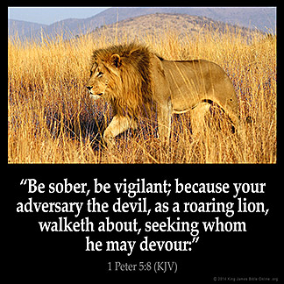
How do Lions hunt?
Who do they hunt?
Why do they hunt?
Devour: katapinō
drown or consume
9 ”Whom resist stedfast
in the faith…”
“Resist”: anthistēmi
Stand against,
opposite!

Slide 22
9 ”Whom resist stedfast in the faith…”
“Resist” (anthistēmi) to Stand against, opposite!
James 4:7-8 “Submit yourselves therefore to God.
Resist the devil, and he will flee from you.
⁸ Draw nigh to God,
and he will draw nigh to you.
(We usually do the opposite!)
Cleanse your hands, ye sinners; and purify your hearts,
ye double minded.”

Slide 23
Application: How can we shift currents/paths?
4) Remember God’s purpose/plan. Jn 10:10b; Rev. 4:11
Jms 1:15 “Every good gift and every perfect gift is from above, and cometh down from the Father of lights,
16 With whom is no variableness, neither shadow …
17 Of his own will begat he us with the word of truth, that we should be a kind of firstfruits of his creatures.”
God wants us to become like Christ!
Ro. 8:28,29

Slide 24
Application: How can we shift currents/paths?
5) Realize (take inventory) of our own evil infection.
19 “Wherefore, my beloved brethren, let every man be swift to hear, slow to speak, slow to wrath:
20 For the wrath of man worketh not
the righteousness of God.”
(See Eph. 4:26; 1 Jn 1:6-8; Ps. 139:23,24)
“Search me, O God, and know my heart: try me, and know my thoughts: And see if there be any wicked way in me, and lead me in the way everlasting.”

Slide 25
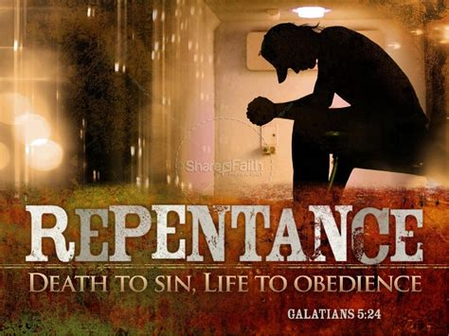
Application: How can we shift currents/paths?
6) Repent (metanoe’ō: think differently) of
(and about) our sin. 21a “wherefor lay apart
all filthiness
(rhypari’a: immorality)
and superfluity
(perissei’a: superabundance)
of naughtiness,
(kakia: depravity, malignity)

Slide 26
Application: How can we shift currents/paths?
7) Respond to God’s Grace and Provision 21b
“and receive with meekness the engrafted word,
emphy’tos: implanted (See Mt 13:3-9;18-23)
Make room for God’s “prescription”.
which is able to save your souls.”
8) Apply what God is teaching you! 22
“But be ye doers of the word, and not hearers only, deceiving your own selves.”

Slide 27
Rev 12:9-11
“the great dragon was cast out, that old serpent, …which deceiveth the whole world: he was cast out into the earth, and his angels were cast out with him.
10 And I heard a loud voice saying in heaven,
Now is come salvation, and strength, and the kingdom
of our God, and the power of his Christ:
for the accuser of our brethren is cast down,
which accused them before our God day and night.

Slide 28
Rev 12:11 “And they overcame him
by the blood of the Lamb,
and by the word of their testimony;
and they loved not their lives unto the death.
12 Therefore rejoice, ye heavens, …
Woe to the inhabiters of the earth and of the sea!
for the devil is come down unto you, having great wrath, because he knoweth that he hath but a short time.”

Slide 29
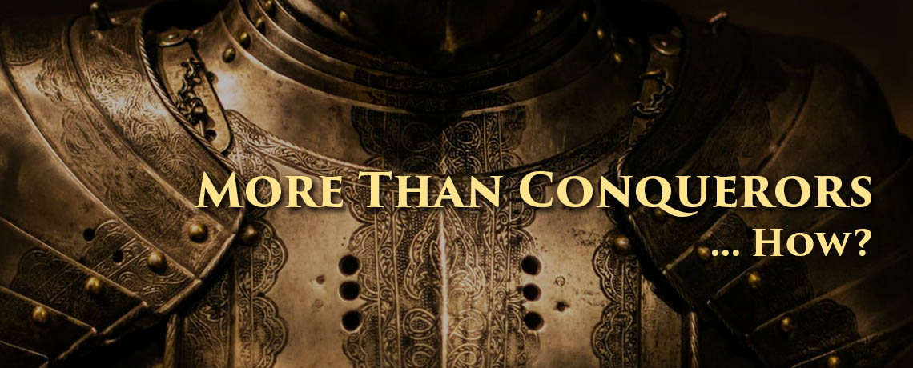
Will you allow yourself to become overcome by the devil,
or purpose to be an “overcomer”?
Romans 8:31-39
“Through Him that loved us!”
1 John 4:4; 5:4

