Slide 1
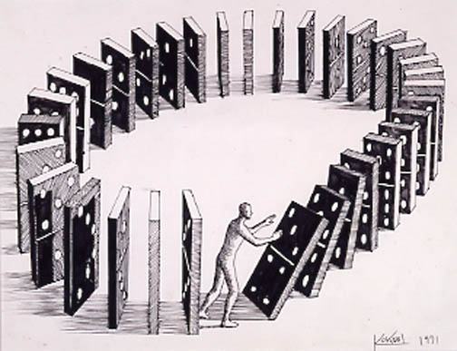
In the struggle for self awareness and control there’s a predictable cycle that’s seen:
In individual souls (Romans 7:14-25; Gal. 5:16-26)
and entire societies. (Romans 1:18-32)

Slide 2
The Cause (Problem): Our Perception (Conscience) has been Polluted (Corrupted) by:
Satan (2 Cor 4:4) “blinded the minds”
Selfishness (Jer 17:9) “Heart is deceitful…”
Sin (Ro 1:21)“Became vain (mataio’ō: idolatrous) in their imagination (dialogismos’: reasoning {logic})
and their foolish heart was darkened”
(Skotizo: obscured)

Slide 3
The Consequences (Pain): Satan, Selfishness and Sin will inevitably Produce:
Shortsighted-ness. Heb. 11:25,26
Suffering: Pr 14:12; Mt 7:13
Separation: Is. 59:1,2; Mt 7:22
“I never knew you: depart from me,
ye that work iniquity.”

Slide 4
In describing humanity in Jesus said: Mt 24:12 “because iniquity (Self will) shall abound,
the love of many shall wax cold.“
Paul reaffirmed this in 2 Tim 3:1-4
“For men shall be lovers of their own selves…
without natural affection…lovers of pleasures…”
Into this self-centered and sin saturated world,
Jesus came in order to provide us a way to find direction, peace, and hope. (Mt 11:28,29, Jn 14:6)

Slide 5
The price for this “path” was his Life!
Is 53:6 “All we like sheep have gone astray; we have turned every one to his own way;
the LORD hath laid on him the iniquity of us all!
10 Yet it pleased the LORD to bruise him;
he hath put him to grief:
when thou shalt make his soul an offering for sin,
he shall see his seed, he shall prolong his days,
and the pleasure of the LORD
shall prosper in his hand.”

Slide 6
He became the Cure (God’s Promise)
for our contaminated conscience,
offering us:
A New Heart (compass): Ez 36:25-26
“Ye shall be clean from all your filthiness,
and from all your idols, and I will cleanse you.
26 A new heart also will I give you,
and a new spirit will I put within you:”
(rûaḥ: wind, breath, courage)

Slide 7
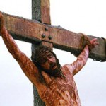

Slide 8
A New Hope Jer. 29:10-14
10 “After 70 years be accomplished at Babylon I will visit you, and perform my good word toward you…
11 For I know the thoughts (maḥăšāḇâ’: plans)
that I think toward you, saith the LORD,
(ḥāšaḇ’: to regard, weave, purpose)
thoughts of peace, (šālôm: welfare)
and not of evil, (ra’: malignant evil, harm)
to give you an expected end!”
(tiqwâ ‎aḥarît) hope of a future reward, posterity!

Slide 9
Psa 16:11 “Thou wilt shew me the path of life:
in thy presence is fulness of joy;
at thy right hand there are pleasures for evermore.”
Jn 10:10 “The thief comes to steal, kill, destroy.
I am come that they might have life,
and that they might have it more abundantly”
How do we find “this path of life”
and avail ourselves of God’s Promise
of a New Heart and Hope?

Slide 10
1. It Starts With Repentance. (Truth)
Jer 29:12 “Then shall ye call upon me, ye shall go and pray unto me, and I will hearken unto you.
13 And ye shall seek me, and find me,
when ye shall search for me with all your heart.
14 And I will be found of you, saith the LORD:
and I will turn away your captivity…”
We won’t be truly open to the cure until
we rightly understand (diagnose) the cause!

Slide 11
1. It Starts With Repentance. (Truth)
B. To recognize & respond to God’s directions,
we must “Repent” or “Rethink”
Mt 4:17 “Jesus began to preach, and to say Repent:
(metanoeō: understand, perceive, think,
For the kingdom of heaven is at hand.”
Luke 13:3 “except ye repent, ye shall all likewise
perish.” (apol’lymi: be destroyed)
(See John 5:39,40; 8:24 “if ye believe not I am he…)
our own!
Differently!)

Slide 12
A. To recognize and respond to God’s directions,
we must “Repent” or “Rethink” our own! Is.55:6-8 “Seek ye the LORD while he may be found,
call upon him while he is near.
Let the wicked forsake (ʿāzaḇ: relinguish) his way
and the unrighteous man his thoughts: (maḥăšāḇâ)
and let him return unto the LORD,
and he will have mercy upon him;
and to our God, for he will abundantly pardon.…
For My thoughts are not your thoughts”

Slide 13
A. We must Repent or “Rethink” our own:
1) Worthiness!
a) I can’t “earn” forgiveness! (Titus 3:5; Rom. 4)
I can only “accept” (Trust) God’s Grace! Eph. 2:8,9
2) Way (Pr 14:12; 16:25; Is. 53:6; Mt 7:13
a) In order to thrive in “the Kingdom of Heaven”,
we must shift our allegiance away from our own
“kingdom on earth.” (See Col. 1:12-14)
Mt. 6:24 “No man can serve two masters…
33 “But seek ye first the Kingdom of God…”

Slide 14
How do we avail ourselves of God’s Promise of a New Heart and Hope?
1. It’s Started With Repentance. (Truth!)
2. It’s Sustained through Rest (Trust.)
Pr. 3:5,6 “Trust in the Lord with all thine heart,
…lean not to thine own understanding.
In all thy ways acknowledge him,
(yada: know, understand, consider)
and He shall direct (Yashar: prosper) thy paths.”

Slide 15
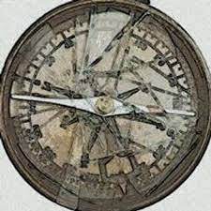
2. It Continues through Rest (Trust.)
Just as a damaged compass can misdirect us,
1) Our Past experiences can damage/distort:
a) Our current perspective
b) Our future hope/plans.
2) Failing to process our Past Pain
(fix the compass) can produce:
a) Bitterness that poisons. (Heb 12:15)
b) Scars/walls that undermine Future Faith Trust.

Slide 16
B. Our Hope can affect our peace!
1) Satan uses past rejection, failures, and sin to
keep us from facing the future with faith.
a) He’s known as: “The accuser” (Rev. 12:10)
2) Israel had trouble feeling “hope” as they were
being forced into slavery, so God directed
Jeremiah and Ezekiel to remind them to:
a) Repent of the sins of the past. Jer 29:12-14
b) Refocus on the future. Jer 29:4-6
“Build houses, plant gardens…marry…seek peace…”

Slide 17
2. It’s Sustained through Rest (Trust.)
C. Our Faith/Hope is related to our Focus.
Phil. 4:6-8
1) Israel had a history of focusing on the past.
Num 11:5 “We remember the fish, which we did eat in Egypt freely; …
18 …it was well with us in Egypt…”
Num. 14:4 “… Let us make a captain,
and let us return into Egypt.”

Slide 18
“You can be 100 percent saved and still spend the majority of your time in Egypt!
Unbelievers aren’t the only ones who contribute to Egypt’s overcrowding.”
Unbelievers aren’t the only ones who contribute to Egypt’s overcrowding.”

Slide 19
C. Our Faith is related to our Focus.
1) Israel had a history of focusing on the past.
2) Countless people get sidetracked and
stop dreaming/daring/trusting
because of their painful pasts.
3) You can’t safely navigate forward
When you’re looking backwards!

Slide 20
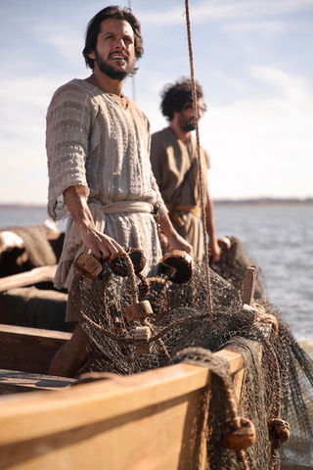
3) Can’t navigate forward by looking backwards.
After a miserable night fishing Jesus tells Peter to “launch out into the deep and let down your nets
for a draught“ Lk. 5:4
Luke 5:5 “Master, we have toiled all the night, and have taken nothing:
nevertheless at thy word
I will let down the net.”

Slide 21
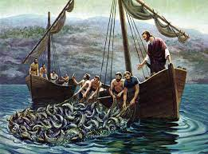
Jesus was basically asking them to “try again” under Christ’s supervision.
(Shift their focus!)
Luke 5:6 “when they had this done, they inclosed a great multitude of fishes…
11 and when they had brought their ships to land,
they forsook all,
and followed him.”

Slide 22
In spite of our painful past, God Graciously intercepts our lives and challenges us
to Dare to Dream again!
In Luke 4:17-22 Jesus chose a very specific passage of scripture to introduce the purpose of his ministry.
Isaiah 61:1-3

Slide 23
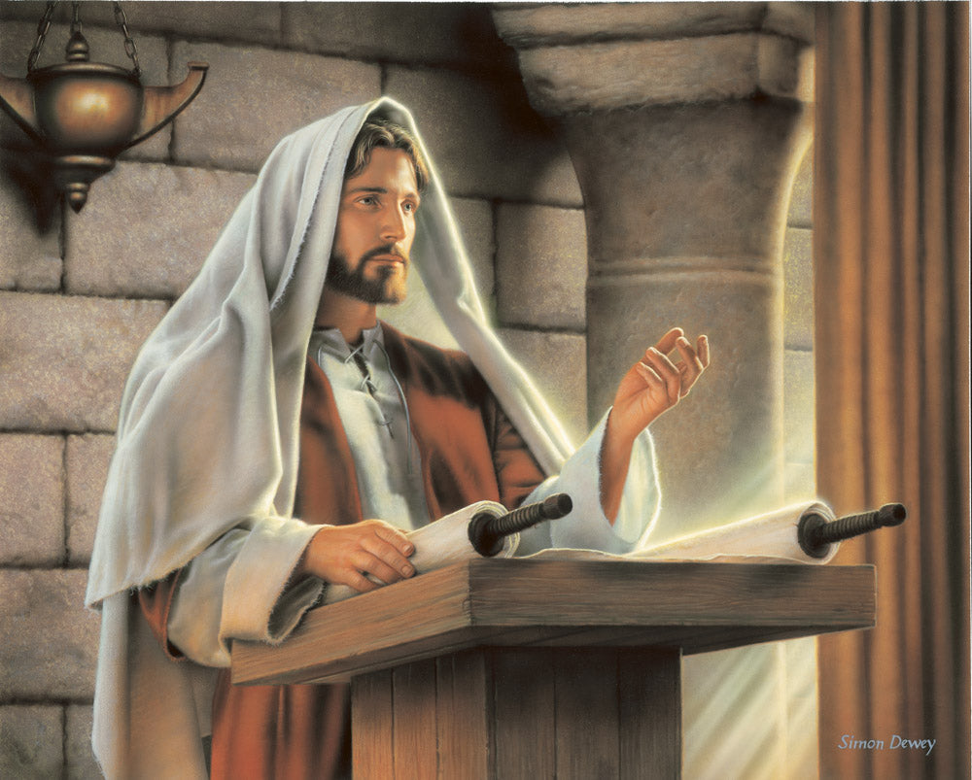
Notice the text of his first message in Nazareth.
Is 61:1 “The Spirit of the Lord GOD is upon me; because
He hath anointed me to preach good tidings
unto the meek;
he hath sent me to bind up the brokenhearted,
to proclaim liberty
to the captives,
and the opening of the prison to them that are bound;
Luke 4:17-22

Slide 24
3 “To appoint unto them that mourn in Zion,
to give unto them beauty for ashes,
the oil of joy for mourning,
Notice the text of his first message in Nazareth.
the garment of praise
for the spirit of heaviness;
that they might be called trees of righteousness,
the planting of the LORD,
that he might be glorified.”
Luke 4:17-22

Slide 25
Over the next several weeks we’re going to examine how God intercepts the lives of broken and misdirected people
and invites them to exchange their:
Disappointment (ashes)
Mourning
Heaviness
(Isaiah 61:1-6)
for His Destiny (beauty.)
for His magnificent Joy
for His Hope, Peace and Praise

Slide 26
Why does God do this for us?
To Reflect His Glory: Is. 61:3
“That they might be called trees of righteousness,
the planting of the Lord,
2) To Rebuild the “Old Paths” of Blessing.
“They shall build the old wastes” Vs 4
3) To Represent Him to others. Vs 6.
“ye shall be named the Priests of the Lord:
men shall call you the Ministers of our God.”
that He might be glorified.”

Slide 28
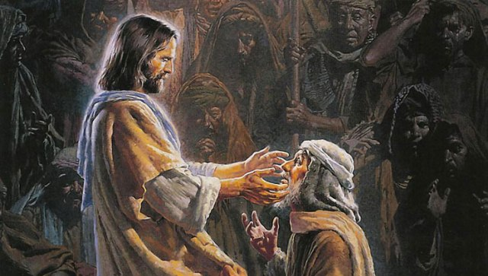
One sat alone beside the highway begging
His eyes were blind the light he could not see.
He clutched his rags, and shivered in the shadows.
Then Jesus came
and bade His darkness flee.

Slide 29
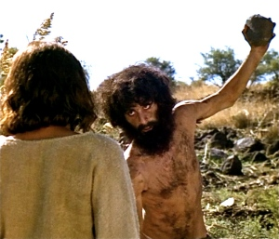
From home and friends the evil spirits drove him,
Among the tombs he dwelt in misery;
He cut himself as demon powers possessed him,
Then Jesus came, and set the captive free.

Slide 30
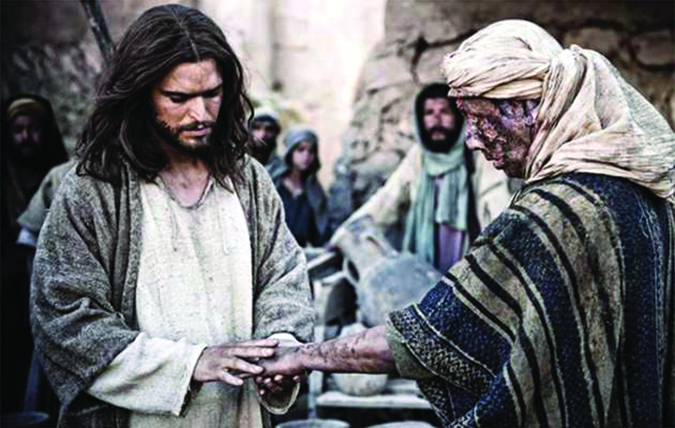
Unclean, Unclean the leper cried in torment,
The deaf, the dumb in helplessness stood near;
The fever raged, disease had gripped its victim
Then Jesus came and cast out every fear.

Slide 31
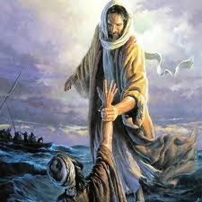
And so today we find the Savior able
We can not conquer passion, lust, or sin.
Our broken hearts have left us sad and lonely,
But Jesus comes to dwell Himself within.

Slide 32
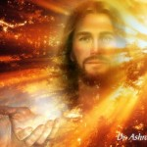
When Jesus comes the tempter’s power is broken.
When Jesus comes the tears are washed away.
He takes the gloom
and fills the life with glory
For all is changed when Jesus comes to stay.
Gloria Roe / Oswald J. Smith / Homer Rodeheaver

Slide 33
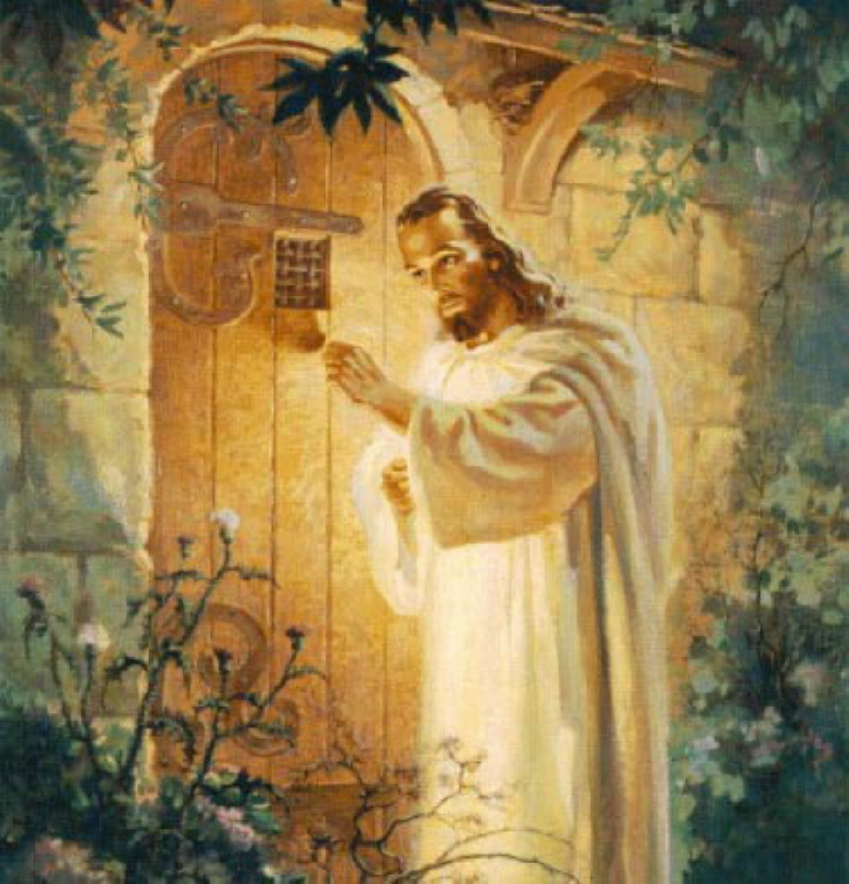
Jesus has come to offer you
Rev. 3:20
Eternal Life
Jn 3:16
Ps 16:11
Abundant Life
Jn 10:10
How have you responded?

