Slide 1
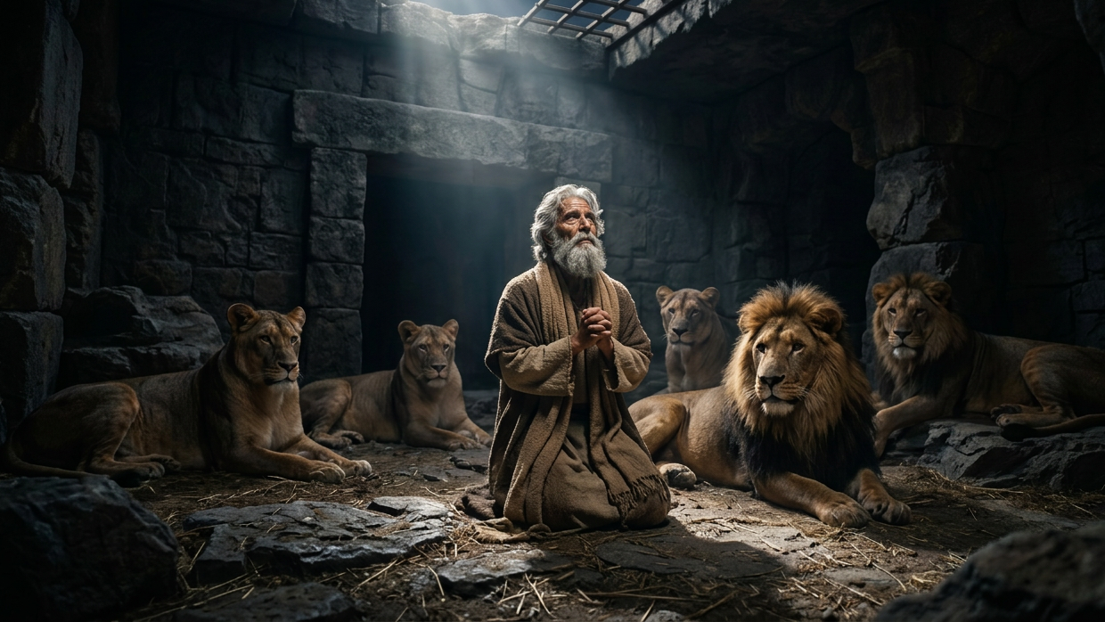
Daniel: The Kneeling Prophet
By Joseph Peters

Slide 2

Goal
Everyone of God’s people should honor God, regardless of the consequences
For these three reasons

Slide 3
Reasons
Daniel’s Honor of God Led Others to Jealousy
Daniel’s Honor of God Led Him to Punishment
Daniel’s Honor of God Led to the Exaltation of Him and God

Slide 4
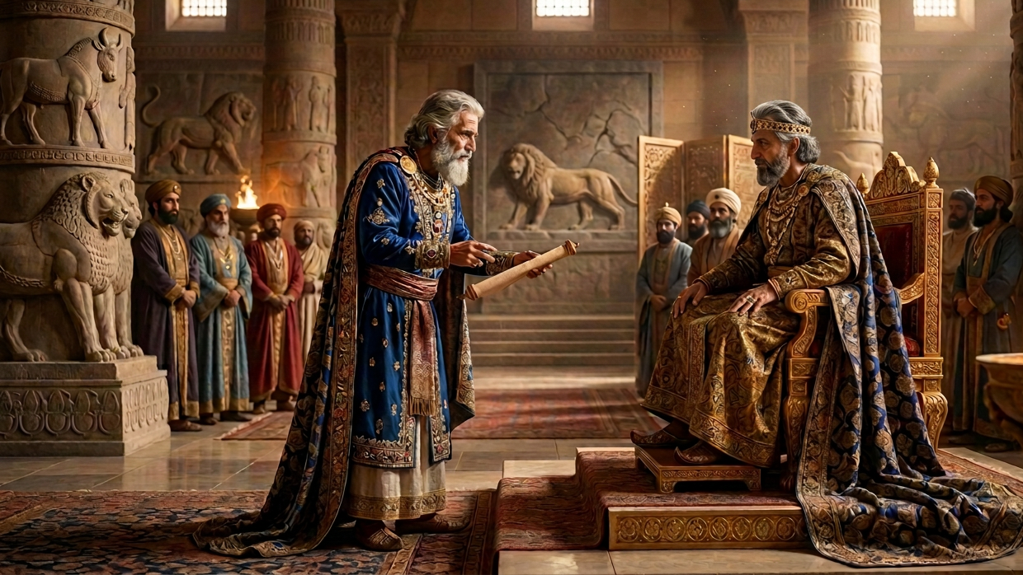
Daniel’s Honor of God Led Others to Jealousy

Slide 5
Jealousy VS Faithfulness
Then this Daniel was preferred above the presidents and princes, because an excellent spirit was in him; and the king thought to set him over the whole realm. Then the presidents and princes sought to find occasion against Daniel concerning the kingdom; but they could find none occasion nor fault; forasmuch as he was faithful, neither was there any error or fault found in him. Then said these men, We shall not find any occasion against this Daniel, except we find it against him concerning the law of his God (Dan 6:3–5).

Slide 6
A Trap for the Prideful and the Faithful
Then these presidents and princes assembled together to the king, and said thus unto him, King Darius, live for ever. All the presidents of the kingdom, the governors, and the princes, the counsellers, and the captains, have consulted together to establish a royal statute, and to make a firm decree, that whosoever shall ask a petition of any God or man for thirty days, save of thee, O king, he shall be cast into the den of lions (Dan 6:6–7).

Slide 7
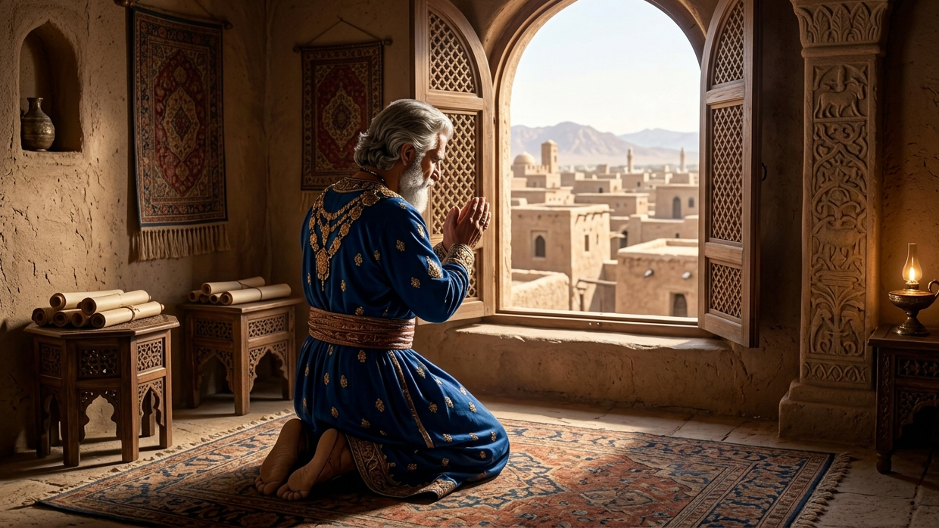
Daniel’s Honor of God Led Daniel to Punishment

Slide 8
Daniel’s Faithfulness to God
Now when Daniel knew that the writing was signed, he went into his house; and his windows being open in his chamber toward Jerusalem, he kneeled upon his knees three times a day, and prayed, and gave thanks before his God, as he did aforetime. Then these men assembled, and found Daniel praying and making supplication before his God (Dan 6:10–11).

Slide 9
The King Becomes Upset… With Himself
Then answered they and said before the king, That Daniel, which is of the children of the captivity of Judah, regardeth not thee, O king, nor the decree that thou hast signed, but maketh his petition three times a day. Then the king, when he heard these words, was sore displeased with himself, and set his heart on Daniel to deliver him: and he laboured till the going down of the sun to deliver him (Dan 6:13–14).

Slide 10
The King Caught Daniel’s Contagious Faith
Then these men assembled unto the king, and said unto the king, Know, O king, that the law of the Medes and Persians is, That no decree nor statute which the king establisheth may be changed. Then the king commanded, and they brought Daniel, and cast him into the den of lions. Now the king spake and said unto Daniel, Thy God whom thou servest continually, he will deliver thee (Dan 6:15–16).

Slide 11
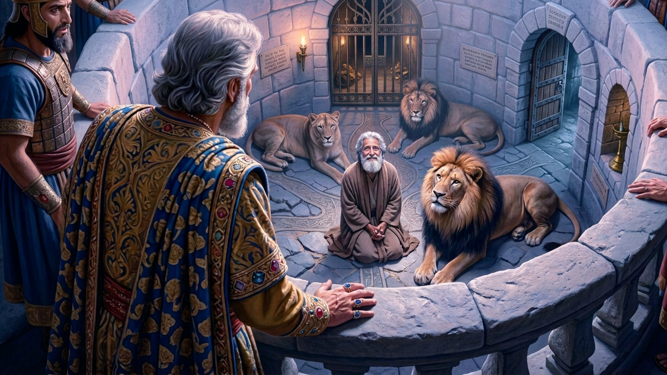
Daniel’s Honor of God Led to the Exaltation of Him and God

Slide 12
The King’s Desperate Hope in Daniel’s God
Then the king went to his palace, and passed the night fasting: neither were instruments of musick brought before him: and his sleep went from him. Then the king arose very early in the morning, and went in haste unto the den of lions. And when he came to the den, he cried with a lamentable voice unto Daniel: and the king spake and said to Daniel, O Daniel, servant of the living God, is thy God, whom thou servest continually, able to deliver thee from the lions (Dan 6:18–20)?

Slide 13
God Protected Daniel
Then said Daniel unto the king, O king, live for ever. My God hath sent his angel, and hath shut the lions’ mouths, that they have not hurt me: forasmuch as before him innocency was found in me; and also before thee, O king, have I done no hurt. Then was the king exceeding glad for him, and commanded that they should take Daniel up out of the den. So Daniel was taken up out of the den, and no manner of hurt was found upon him, because he believed in his God (Dan 6:21–23).

Slide 14
Jealousy that Led to Destruction
And the king commanded, and they brought those men which had accused Daniel, and they cast them into the den of lions, them, their children, and their wives; and the lions had the mastery of them, and brake all their bones in pieces or ever they came at the bottom of the den (Dan 6:24).

Slide 15
God’s Exaltation
I make a decree, That in every dominion of my kingdom men tremble and fear before the God of Daniel: for he is the living God, and stedfast for ever, and his kingdom that which shall not be destroyed, and his dominion shall be even unto the end. He delivereth and rescueth, and he worketh signs and wonders in heaven and in earth, who hath delivered Daniel from the power of the lions. So this Daniel prospered in the reign of Darius, and in the reign of Cyrus the Persian (Dan 6:26–28).

Slide 16
Conclusion
Everyone of God’s people should honor God, regardless of the consequences
For these three reasons

Slide 17
Reasons
Daniel’s Honor of God Led Others to Jealousy
Daniel’s Honor of God Led Him to Punishment
Daniel’s Honor of God Led to the Exaltation of Him and God

