Slide 1
Principles for Powerful Living
Principles for Powerful and Productive Living.

Slide 2
Principle 1: The Passion Principle!
Col. 3:23 “And whatsoever ye do, do it heartily,
(Ek psyche: from the soul)
as to the Lord, and not unto men;
24 Knowing that of the Lord ye shall receive
the reward of the inheritance:
for ye serve the Lord Christ.” ”
The antithesis (and nemesis) of Passion is Apathy. (lack of interest, enthusiasm, or concern)

Slide 3
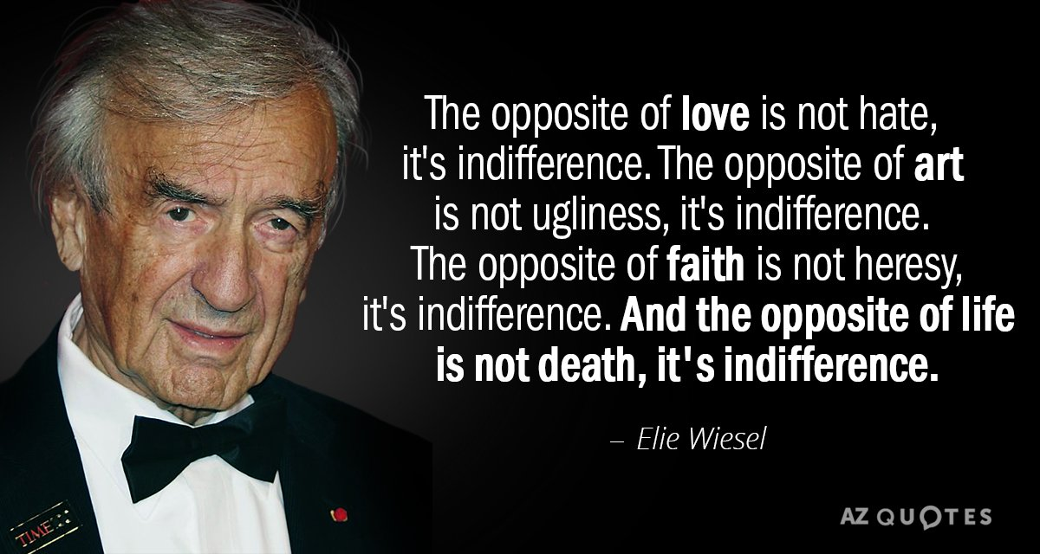
Holocaust survivor and Nobel Laureate

Slide 4
Apathy is illustrated in Jesus’ letter to the church in Ephesus. Rev. 2:1-7
4 “thou hast left thy first love!
Remember therefore from whence thou art fallen,
and repent,
and do the first works;
or else I will come unto thee …,
and will remove thy candlestick ….”
Rev. 3:14-22

Slide 5
Like all diseases, the earlier you detect it,
the easier it is to treat.
Symptoms of Apathy include:
Self Reliance (Rev. 3:17; Pr. 22:3-5)
Spiritual Blindness (Rev. 3:17; Mt 13:13-15)
Scorning (dismissing) Godly Counsel.
(Rev 3:18; Pr. 1:23-32)

Slide 6
Understanding is key to combatting.
Some causes/complications of Apathy:
Entropy (age) (Rev. 1:12,13; 2:4; 3:15-21)
Gravity (environment) (Mt. 6:19-33; 2 Tim 4:10)
Diet (appetite) (Col. 2:8-10; 1 Jn 2:15,16; Phil. 3:18-19)
Poison (Infection) (1 Jn 1:6-10; 1 Cor 11:30-31)
“For this cause (sin) many are weak
and sickly among you…”

Slide 7
Solutions to Spiritual (Relational) Apathy
1. Recognition
A. Of our Role (our actual condition)
Rev 2:4 “… thou hast left (forsaken) thy first love.”
B. Of our “Royalty”. (1 Pt 2:9)
“ye are a chosen generation, a royal priesthood,
an holy nation, a peculiar people…”
(peripoi’ēsis: purchased, preserved, & precious!)

Slide 8
1. Recognition/ Remembrance of our:
C. Of our Responsibility. 1 Pt 2:9 “…that ye
should shew forth the praises of him who hath called
you out of darkness
D. Of the Road back! Rev. 3:18
“I counsel thee to…anoint thine eyes with eyesalve,
that thou mayest see.”
1) Irritation often precedes Illumination!
Gal 4:16; John 3:19; 2 Cor. 4:4-6 and 2 Pt 1:5-9
into his marvellous light:

Slide 9
Solutions to Spiritual (Relational) Apathy
2. Repentance. “and Repent” Re.2:5
A. Rebuke often precedes Repentance
3:19 “As many as I love, I rebuke and chasten.
Be zealous therefore and repent”
(metanoeio: reconsider {with compunction})
2 Cor 7:10 “Godly sorrow worketh repentance”
B. Sincere Repentance is necessary for
genuine reconciliation (1 Jn 1:5-10)

Slide 10
Rev 2:5 “Remember…Repent…
3. Repeating vs 5 “and do thy first works”
A. “Do” (poieo: to bring forth, commit to)
B. “First” protos: foremost {in time, place or importance}
1) Mt 6:33 “seek ye first the Kingdom of God,
And His righteousness,
and all these things shall be added unto thee”
2) Contrast with those in Phil 3:14 “Who mind
(phroneo: value, regard) earthly things”

Slide 11
C. Repetition is the key to learning and the
mark of learned/developed discipline.
1) Our daily decisions/actions develop our disciplines
and determine our destiny. Pr 16:3
“Commit thy works unto the LORD,
(gālal’: to roll on, commit to, trust)
and thy thoughts
(Maḥashābâ’: plans, purposes, imagination)
shall be established.”
(kûn: prepared, appointed)

Slide 12
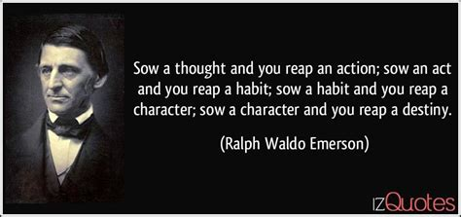
“Sow a thought and you reap an action; sow an act and you reap a habit;
sow a habit and you reap a character; sow a character
and you reap a destiny.”

Slide 13
2) You can’t be a “disciple” without discipline.
Luke 14:33 “So likewise, whosoever he be of you that forsaketh not (Apotas’sōmai: arrange in order)
all that he hath,
Where does God fit in your “arranged order”?
34 Salt is good: but if the salt have lost his savour, wherewith shall it be seasoned?
35 It is neither fit for the land, nor yet for the dunghill; but men cast it out.
He that hath ears to hear, let him hear.”
he cannot be my disciple.

Slide 14
Where does God deserve to place in your “arranged order”?
Col 1:16-18 “For by him were all things created,
all things were created by him,
And he is before all things,
and by him all things consist.
And he is the head of the body, the church:
who is the beginning, the firstborn from the dead;
that in all things he might have the preeminence.”
Proteuo: from Protos…FIRST! Ex. 20:3; Mt. 22:37
and for him:

Slide 15
Which of these is God’s Spirit trying to get you to focus on?
“Remember from whence thou art fallen
and Repent (Reconsider)
And do (repeat) thy first works!
What are the consequences for ignoring Him?
“or else I will come unto thee quickly,
and will remove thy candlestick out of his place,
except thou repent.”

Slide 16
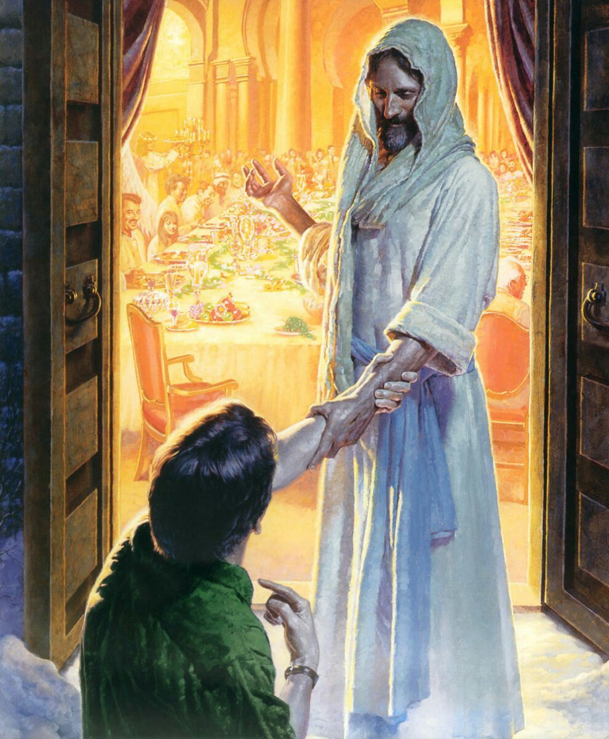
Another word for Repeating is Renewal!
This is the heart of God! Rev. 21:5 “Behold I make all things new!
⁶ It is done! I am Alpha and Omega.. I will give to him that is athirst the fountain of the water of life freely.
⁷ He that overcometh shall inherit all things;
and I will be his God,
and he shall be my son.”

Slide 17
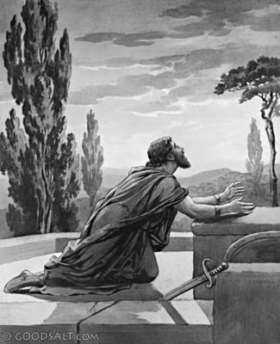
David (1 Sam. 13:14; Acts 13:22) experienced this!
Ps 51:6-9 “thou desirest truth in the inward parts: and in the hidden part thou shalt make me to know wisdom.
Purge me with hyssop, and I shall be clean:
wash me, and I shall be whiter than snow.
Make me to hear joy and gladness;
that the bones which thou hast broken may rejoice.
Hide thy face from my sins,
and blot out all mine iniquities.”

Slide 18
Ps 51:10-13 “Create in me a clean heart, O God;
and renew (ḥādash’: rebuild, repair)
a right (kûn: prepared, ready) spirit within me.
Cast me not away from thy presence;
and take not thy holy spirit from me.
(Remember Saul? 1 Sam. 16:14)
Restore unto me the joy of thy salvation;
and uphold me with thy free spirit.
Then will I teach transgressors thy ways;
and sinners shall be converted unto thee. “
(See Eph. 4:30)

Slide 19
Application:
1) Renewal is a Partnership. 1 Cor 3:9
“We’re laborers together with God”
David couldn’t renew himself. Ps. 51:16,17
“thou desirest not sacrifice; else would I give it:
thou delightest not in burnt offering.
The sacrifices of God are a broken spirit:
a broken and a contrite heart, O God,
thou wilt not despise.”

Slide 20
Application:
2) Renewal is a Process (1 Jn 1:5-10) involving:
Honest recognition. Vs 5-6 “If we say we have
fellowship and walk in darkness, we lie!”
Genuine Repentance vs 7-8
Honest Confession 9-10 “If we confess our sins…”
Delightful Restoration (Cleansing) vs 7,9
“he is faithful and just to forgive us our sins
and to cleanse us from all unrighteousness”

Slide 21
Renewal is a Partnership & Process. James 4:6-9
Entropy drains our hope and energy.
“But he giveth more grace.
Wherefore he saith, God resisteth the proud,
but giveth grace unto the humble.
Submit yourselves therefore to God.
Resist the devil, and he will flee from you.
Draw nigh to God,
and he will draw nigh to you.

Slide 22
Renewal is a Partnership & Process. James 4:6-9
“Cleanse your hands, ye sinners;
and purify your hearts,
ye double minded.
Be afflicted, and mourn, and weep:
let your laughter be turned to mourning,
and your joy to heaviness.
(That’s Repentance!)

Slide 23
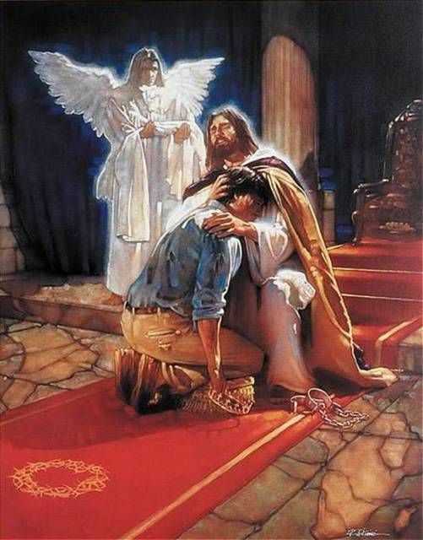
Renewal is a Partnership & Process. James 4:10
“Humble yourselves in the sight of the Lord,
and he shall lift you up.”
Will you partner with God in this Process of Renewal.

Slide 24
Ps. 23:3 “He restoreth my soul:
he leadeth me in the paths of righteousness
for his name's sake.”
John 10:27 “My sheep
hear my voice…,
and they follow me.”
Are you?
Do You?
Will You?

