Slide 2
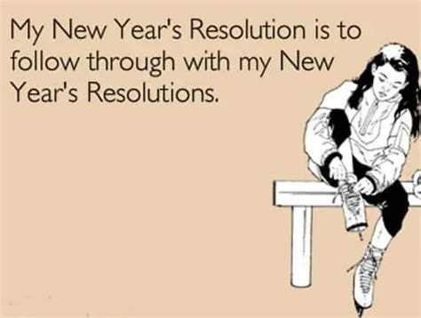
Many face a New Year with both hope & discouragement.

Slide 3
Many are looking for some new trick or idea that will make lasting change easy and painless.
This shallow approach to change can be seen everywhere from lottery tickets to weight loss pills.
Some have found a way to profit by keeping the status quo.
despair.com produces calendars to mock those who try to challenge the status quo.

Slide 5
Thousands take to the streets of Pamplona for the running of the bulls at Spain's controversial San Fermin festival with seven men left needing hospital treatment.

Slide 7
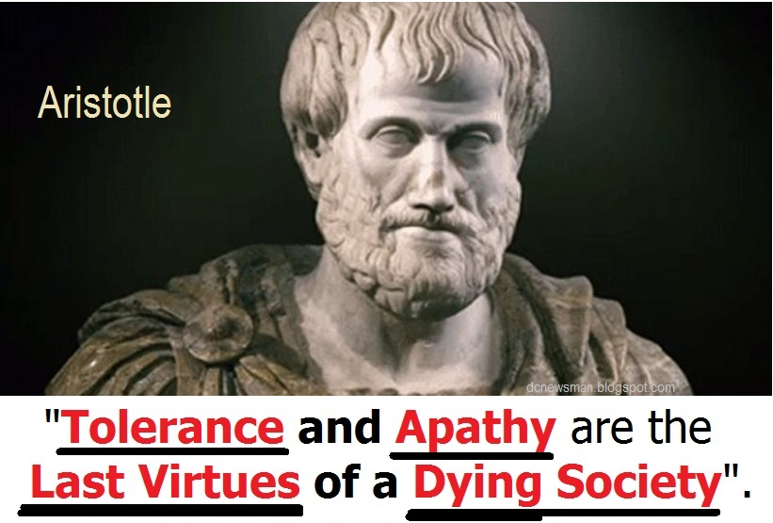

Slide 8
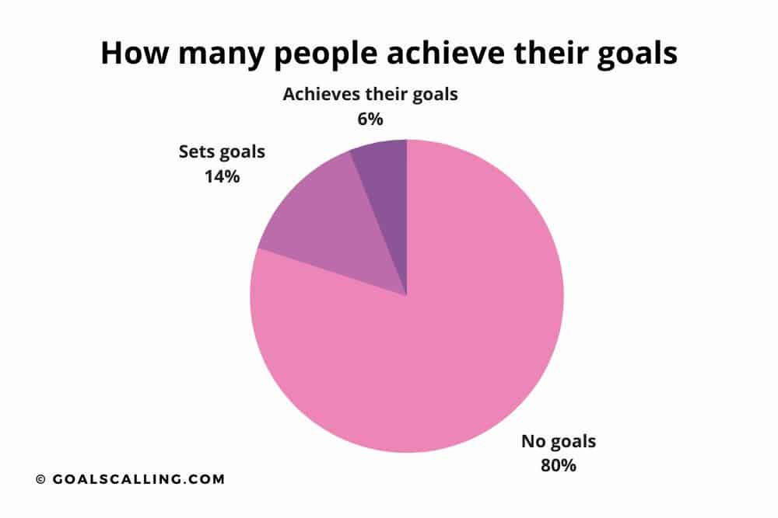
<1 % review the goals regularly
< 3% write
down their goals.

Slide 9
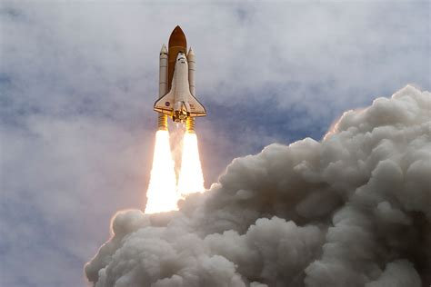
Maturity and experience teach us that significant and lasting change is painful and requires
Effort, Energy, and Commitment.
For lasting success, we must weave into the fabric of our being basic principles by which we chose to operate.
It’s our commitment to these principles
that enables us to rise above the
mediocrity of the mundane
and overcome the “gravity” or pull
of this world on our lives.

Slide 10
What “Principles” guide (and guard)
your journey?
Biblical Principles act as both a map and a compass to guide us when the paths and choices are confusing.
Ps 16:11 “Thou wilt shew me the path of life:
in thy presence (pânîym’: face)
is fulness (śōbaʿ: satisfaction) of joy;
at thy right hand there are pleasures (nāʿîm: delights)
for evermore.” (nēṣ’aḥ: perpetual confidence, goal)
from nāṣaḥ’: the bright object at a distance
travelled towards.

Slide 11
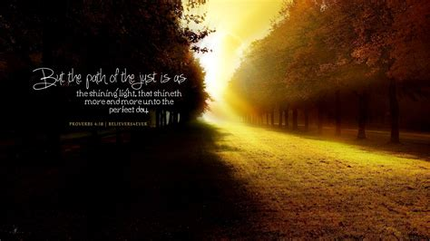
What “Principles” guide (and guard)
your journey?
Pr. 4:18
“the path of the just is as the shining light,
that shineth more and more unto the perfect day.”

Slide 12
Proverbs 4 contrasts the two basic “paths” available to each of us.
The Path of Wisdom 4:1-13; 18-27
A. The Price of Wisdom. Vs 5
“Get wisdom, (ḥokmâ’: life skills)
get understanding: (bînâ’: to distinguish, perceive)
1) “Get” (qānâ’) means to procure by purchase!
(See Is. 55:1,2; Rev. 3:18)
forget it not; (nēṣ’aḥ: to mislay, be oblivious of)
neither decline from the words of my mouth.
(Nāṭâ’: stretch out or bend away, pervert)

Slide 13
Proverbs 4 contrasts the two basic “paths” available to each of us.
The Path of Wisdom 4:1-13; 18-27
B. The Protection of Wisdom. Vs 6
“Forsake her not,
(ʿāzab’: relinquish, refuse)
and she shall preserve thee:
(shāmar’: hedge, protect)
love her, and she shall keep thee.”
(nāṣar: guard)

Slide 14
Proverbs 4 contrasts the two basic “paths” available to each of us.
The Path of Wisdom 4:1-13; 18-27
C. The Priority of Wisdom. Vs 7
“Wisdom is the principal thing;
Rēʾshît’: the first, in place, time, order or rank
therefore get wisdom: and with all thy getting
get understanding.” (bînâ’: from bîn; perception, ability to distinguish/discern)

Slide 15
Proverbs 4 contrasts the two basic “paths” available to each of us.
The Path of Wisdom 4:1-13; 18-27
D. The Prosperity of Wisdom. 8,9
8 “Exalt her, and she shall promote thee:
she shall bring thee to honor,
when thou dost embrace her.
9 She shall give to thine head an ornament of grace:
(ḥēn: favor, graciousness)
a crown of glory shall she deliver to thee.”
(Tiphʾârâh’: majesty, bravery, beauty)
See 2 Tim. 4:8

Slide 16
Proverbs 4 contrasts the two basic “paths” available to each of us.
The Path of Wisdom 4:1-13; 18-27
D. The Prosperity of Wisdom. 10-11
10 “ Hear, O my son, and receive my sayings;
and the years of thy life shall be many.
11 “I have taught thee in the way of wisdom;
I have led thee in right paths.”
(yōsher; from Yashar: prosperous)

Slide 17
Proverbs 4 contrasts the two basic “paths” available to each of us.
The Path of Wisdom 4:1-13; 18-27
E. The Peace of Wisdom. 12
12 “When thou goest, thy steps shall not be straitened; (yāṣar’ vexed, distressed)
and when thou runnest,
thou shalt not stumble.”

Slide 18
Proverbs 4 contrasts the two basic “paths” available to each of us.
The Path of Wisdom 4:1-13; 18-27
F. The Process of Wisdom. 13
“Take fast hold
(ḥāzaq’: strengthen, repair, fortify).
of instruction; (Mûsār’: reproof, correction)
let her not go: keep her; (natsar: protect)
for she is thy life.” (ḥay’: strength, vitality)

Slide 19
Proverbs 4 contrasts the two basic “paths” available to each of us.
2. The Path of Wickedness. 4:14-17,24
A. It’s a popular path. 14 “Enter not into
the path (ʾōraḥ’: well traveled road)
of the wicked, (rāshāʿ: condemned)
1) Jesus called it the “broad way” in Mt. 7:13
(Eury’chōros: spacious)
“and many there be which go in thereat”
a) It has to be “broad” because we’re all naturally
“condemned”. (Ro. 3:10,23; Jn 3:18)

Slide 20
2. The Path of Wickedness. 4:14-17,24
B. It’s a Poison (Destructive) Path. 14 “and go not in the
way (derek: course of life, mode of action)
of evil men. (ra: mischief, misery)
Pr 14:12; 16:25 “There is a way which seems right
(Yashar’: straight) unto a man,
but the end thereof are the ways of death.”
(mā’wet: death, ruin)
It’s the Broad Way that “leads to destruction” Mt 7:13
Apō’leia: ruin, waste; From appol’ymi: to destroy fully

Slide 21
2. The Path of Wickedness. 4:14-17,24
B. It’s a Poison (Destructive) Path. Vs 16,17
“For they sleep not, except they have done
mischief; (rāʿaʿ: to spoil or break, vex)
and their sleep is taken away,
unless they cause some to fall.
(kāshal’: waver, stumble)
For they eat the bread of wickedness,
and drink the wine of violence.”

Slide 22
2. The Path of Wickedness. 4:14-17,24
C. It’s a pretentious (deceitful) path. 24
“Put away from thee a froward mouth,
(Iqqeshût’: distorted, false)
and perverse lips put far from thee.”
(Lāzût’: twisted, turned aside, to depart)

Slide 23
2. The Path of Wickedness. 4:14-17,24
D. It’s a Dark Path 4:19
“The way of the wicked is as darkness:
apēlâ’: gloomy, dark, concealed)
they know not (yada’: recognize, understand)
at what they stumble.” (kashal: fall, be overthrown)
18 “but the path of the just is as the shining light, that shineth more and more unto the perfect day.”

Slide 24
Conclusion Pr. 4:20-27
20 My son, attend to my words;
incline thine ears…
21 Let them not depart from thine eyes;
keep them in the midst of thine heart.
22 For they are life unto those that find them, …
23 Keep thy heart with all diligence;
for out of it are the issues of life.

Slide 25
Conclusion: Pr. 4:24-27
²⁴ ”Put away from thee a froward mouth,
and perverse lips put far from thee.
25 Let thine eyes look right on,
and let thine eyelids look straight before thee.
26 “Ponder (palas’: prepare, weigh) the path of thy feet,
and let all thy ways (der’ek: course of life)
be established. (kûn: prepared, confirmed)
27 Turn not to the right hand nor to the left:
remove thy foot from evil.”

Slide 26
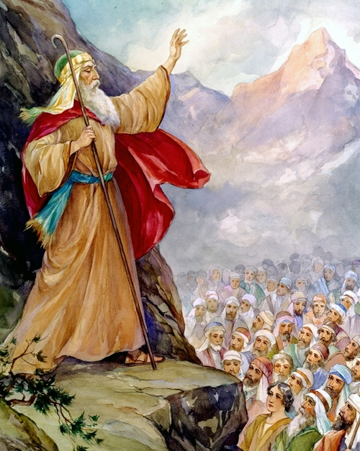
In Deut. 30:15-18 prepares the people to enter the promised land.
¹⁵ ”See, I have set before thee this day life and good,
and death and evil;
¹⁶ In that I command thee this day to love the LORD thy God, to walk in his ways,
and to keep his commandments
and his statutes and his judgments,
that thou mayest live and multiply:
and the LORD thy God shall bless thee in the land whither thou goest to possess it.

Slide 27
Application: Deut. 30:15-18
¹⁷ But if thine heart turn away, so that thou wilt not hear,
but shalt be drawn away, and worship other gods, and serve them;
¹⁸ I denounce unto you this day,
that ye shall surely perish,
and that ye shall not prolong your days upon the land…”

Slide 28
Deut. 30:19-20
^{19 “}I call heaven and earth to record this day against you,
that I have set before you life and death, blessing and cursing:
therefore choose life,
that both thou and thy seed may live:
²⁰ That thou mayest love the LORD thy God, …obey his voice, and …cleave unto him:
for he is thy life, and the length of thy days:
that thou mayest dwell in the land which the LORD sware unto thy fathers…”

Slide 29
On the Damascus Road Christ intersected Saul and set him on a new path. Acts 26:16, 18
16 “I have appeared unto thee for this purpose,
to make thee a minister and a witness of these things which thou hast seen, …
18 To open their eyes, and to turn them from darkness to light,
and from the power of Satan unto God,
that they may receive forgiveness of sins,
and inheritance among them which are sanctified
by faith that is in me.”

Slide 30
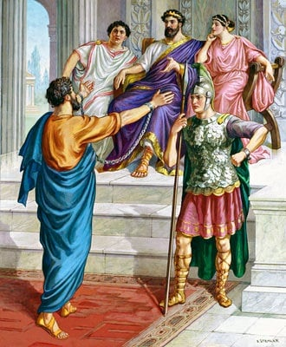
Acts 26:19 “Whereupon, O king Agrippa,
I was not disobedient unto the heavenly vision:”

Slide 31
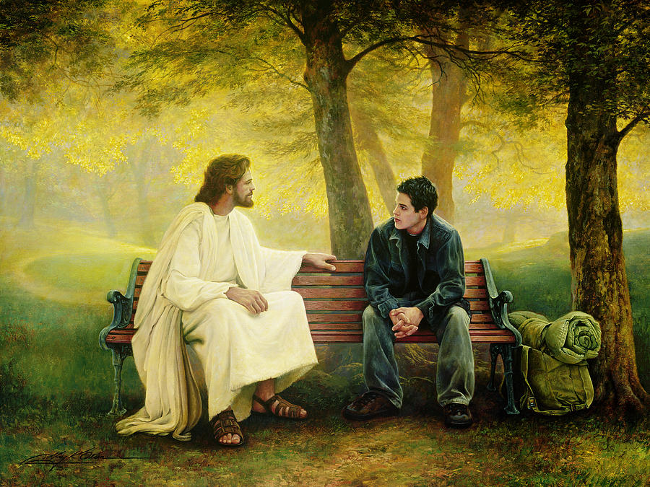
Has the light of Christ intersected your life?
Does he have a purpose for you?
Are you being obedient
to your heavenly calling?

