Slide 1
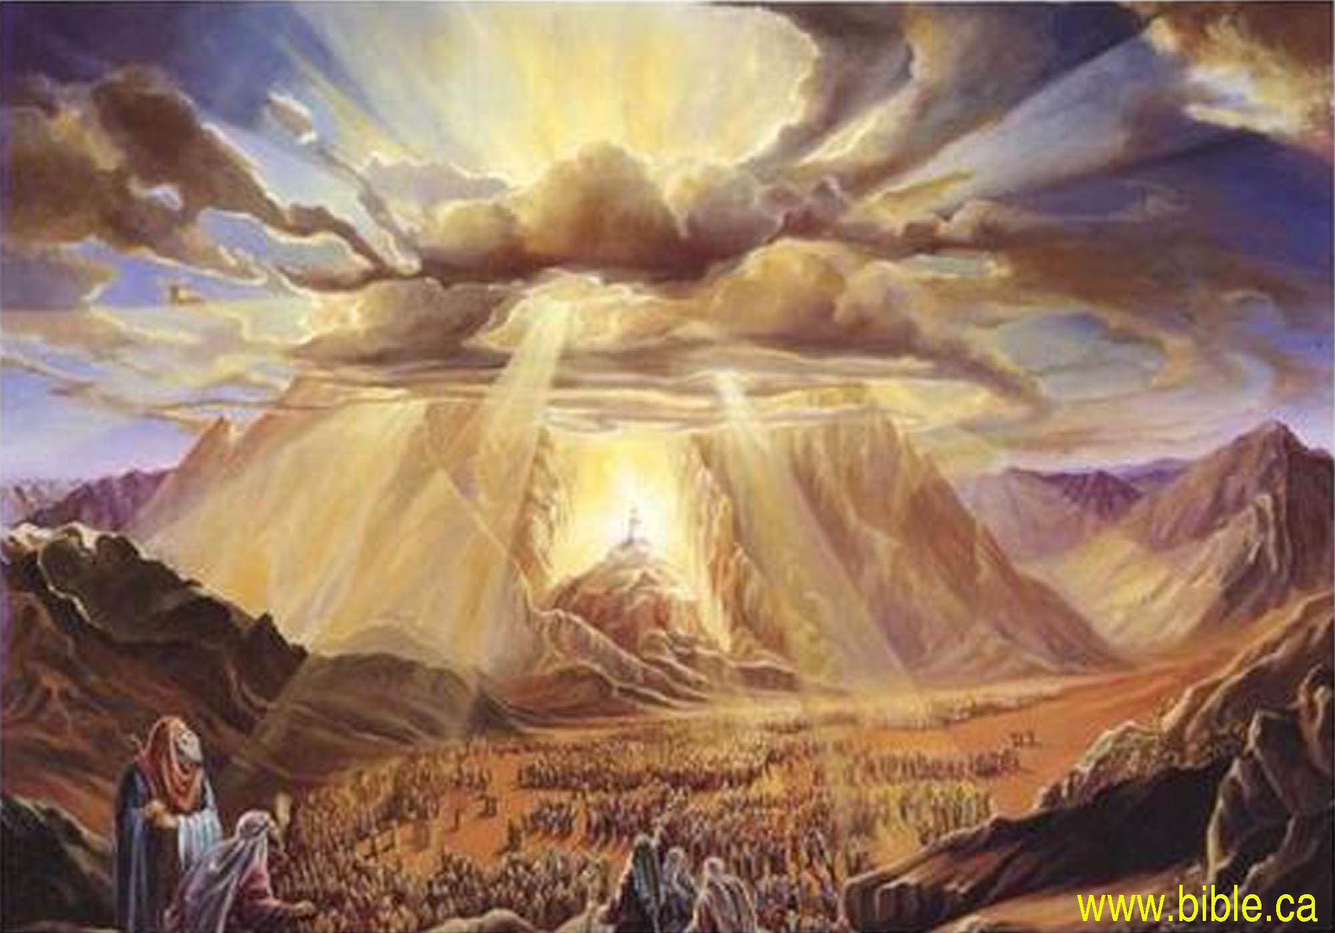
The Nature of God
is revealed in the
Exodus of Israel

Slide 2
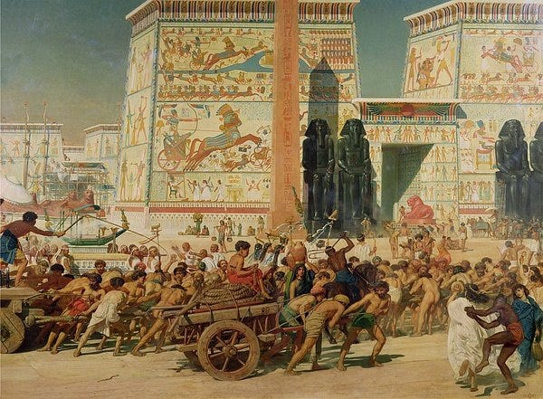
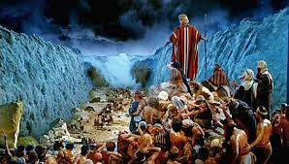
1 Cor. 10:11 “These things happened unto them (Israel) for examples, and they are written for our admonition.”
Redemption
Ex. 12
Deliverance
Ex. 13-15
Bondage
Ex. 1-11

Slide 3
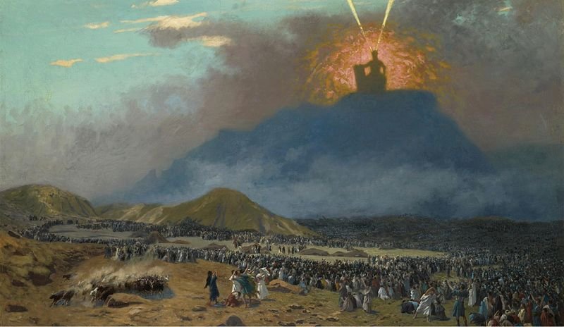
1 Cor. 10:11 “These things happened unto them (Israel) for examples, and they are written for our admonition.”
Opportunity
Ex. 19
Responsibility
Ex. 20-31

Slide 4
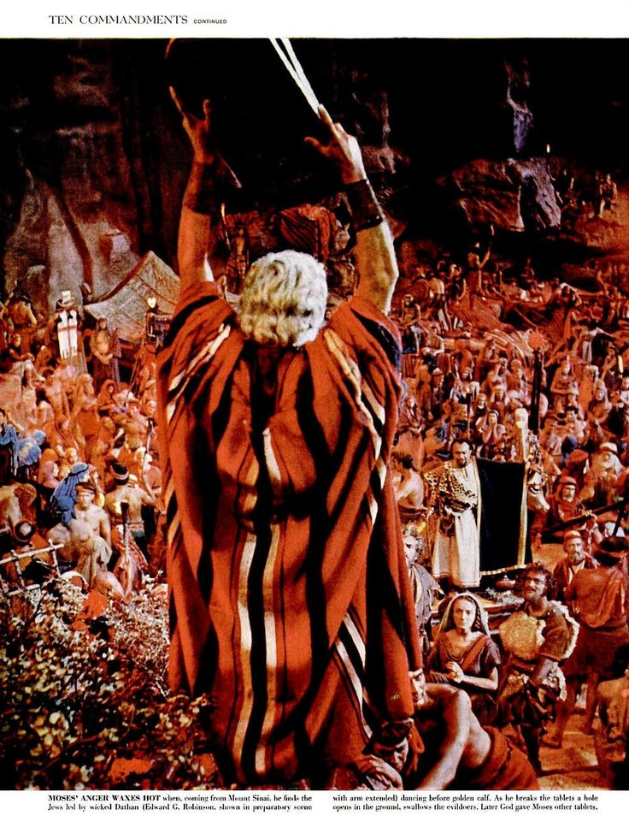
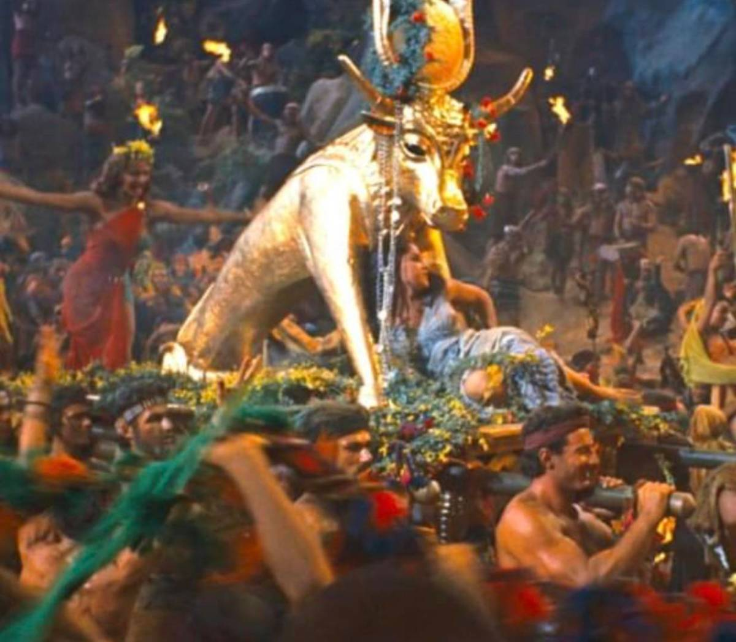
1 Cor. 10:11 “These things happened unto them (Israel) for examples, and they are written for our admonition.”
Corruption
Ex. 32:1-6

Slide 5
1 Cor. 10:11 “These things happened unto them (Israel) for examples, and they are written for our admonition….
20 …and I would not that ye should have
fellowship with devils!”
Ecc. 1:9 “There is nothing new under sun”

Slide 6
1 Cor. 10:20 “…and I would not that ye should have fellowship with devils!”
The Exodus Story (and Israel’s history) teaches us a lot about God’s Nature,
as well as that of our own!
Pr 19:3 “The foolishness of man perverteth his way:
and his heart fretteth (zāʿap’: blames/boils) against the LORD.”

Slide 7
The Exodus reveals God’s Nature as:
1. Pure/Holy Ex 3:5 “put off thy shoes …
for the place whereon thou standest is holy ground.”
A. The first of > 1000 references to holiness.
Lev 19:2 “Speak unto all the children of Israel, and say… Ye shall be holy:
for I the LORD your God
am holy.”
Qādôsh’: sacred

Slide 8
2. Perceptive/Aware Ex 3:7 “I’ve surely seen the
affliction of my people which are in Egypt, and have heard their cry by reason of their taskmasters;
for I know their sorrows;”
A. Jesus Revealed this! Mt 10:29-31 “Are not two sparrows sold for a farthing? and one of them shall not fall on the ground without your Father.
But the very hairs of your head are all numbered.
Fear ye not therefore, ye are of more value
than many sparrows.”

Slide 9
B. Jesus Reflected this. Hebrews 4:15-16
“For we have not an high priest which cannot be touched with the feeling of our infirmities; but was in all points tempted like as we are, yet without sin.
Let us therefore come boldly unto the throne of grace, that we may obtain mercy,
and find grace to help in time of need.”
Heb 7:26 “For such an high priest became us,
who is holy, harmless, undefiled, separate from sinners, and made higher than the heavens;”

Slide 10
3. Preserving/Redemptive Ex 3:8 “I’m come down to deliver them (from) the Egyptians, and to bring them up …unto a land flowing with milk and honey;”
A. The price was the blood of the Passover lamb
Ex 12:13 “the blood shall be to you for a token upon the houses… and when I see the blood,
I will pass over you, and the plague shall not …destroy you, when I smite the land of Egypt.”

Slide 11
A. The Price of their redemption: The Passover lamb.
1) The Passover seder supper illustrates this with the 4 times they drink from the cup. Ex 6:6 “I am the LORD,
I will bring you out from … the burdens of the Egyptians
and I will rid you out of their bondage,
and I will redeem you with a stretched out arm,
and with great judgments:
And I will take you to me for a people,
and I will be to you a God:
and ye shall know that I am the LORD…”

Slide 12
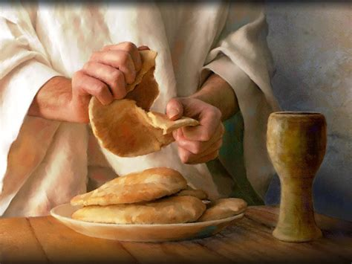
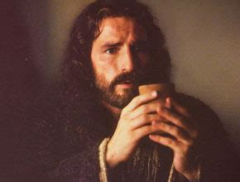
B. This is the price of our redemption as well. 1Pt 1:19
1 Cor 5:7 “For Christ our Passover is sacrificed for us:”
Luke 22:19 “And he took bread, and gave thanks, and brake it, and gave unto them, saying,
This is my body which is given for you: this do in remembrance of me.
20 “This cup is the new testament in my blood, which is shed for you.”

Slide 13
4. Powerful/Almighty. Demonstrated by:
A. How he Delivered them. Ex. 3:19,20:
“And I am sure that the king of Egypt will not let you go, no, not by a mighty hand.
And I will stretch out my hand, and smite Egypt with all my wonders which I will do in the midst thereof:
and after that he will let you go.”
He’s The Most High God אֵ֥ל עֶלְיֹֽון (El Elyon)
Ex 12:12 “against all the gods of Egypt I will execute judgment: I am the LORD.”

Slide 14
4. Powerful/Almighty. Demonstrated by:
B. How he Directed them. Ex 13:21
“the LORD went before them by day in a pillar of a cloud, to lead them the way; and by night in a pillar of fire, to give them light; to go by day and night:”
1) Even into an apparent trap. 14:1-4 “turn and encamp
before Pihahiroth, … shall ye encamp by the sea.
I will harden Pharaoh's heart, that he shall follow them;
and I will be honored upon Pharaoh, and all his host;
that the Egyptians may know that I am the LORD.”

Slide 15
C. How he Protected them. Ex 14:13,14
“Fear ye not, stand still, and see the salvation of the LORD, which he will shew to you to day:
for the Egyptians whom ye have seen to day,
ye shall see them again no more for ever.
14 The LORD shall fight for you…
19 “the angel of God, … removed and went behind them; and the pillar of the cloud went from before their face, and stood behind them:
And it came between the camp of the Egyptians
and the camp of Israel;”

Slide 16
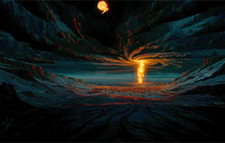
19 “and it was a cloud and darkness to them,
but it gave light by night to these:
so that the one came not near the other all the night.”

Slide 17
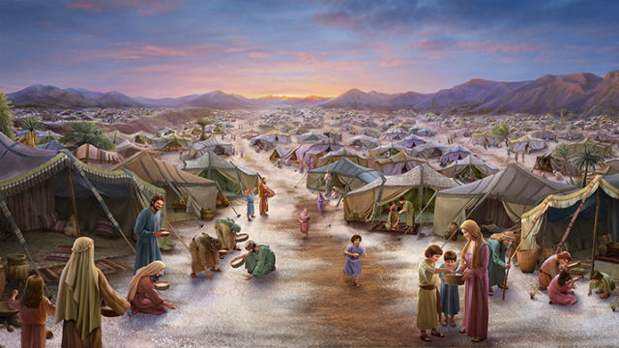
How He Delivered… Directed… Protected D. How He Provided for them. Psalm 78:19
“Can God furnish a table in the wilderness?”
1) Miracle Manna Ex. 16:4 “I will rain bread
from heaven for you…”
Ps 78:24 “rained down manna upon them to eat, and had given them of the corn of heaven.
25 Man did eat angel’s food…”

Slide 18
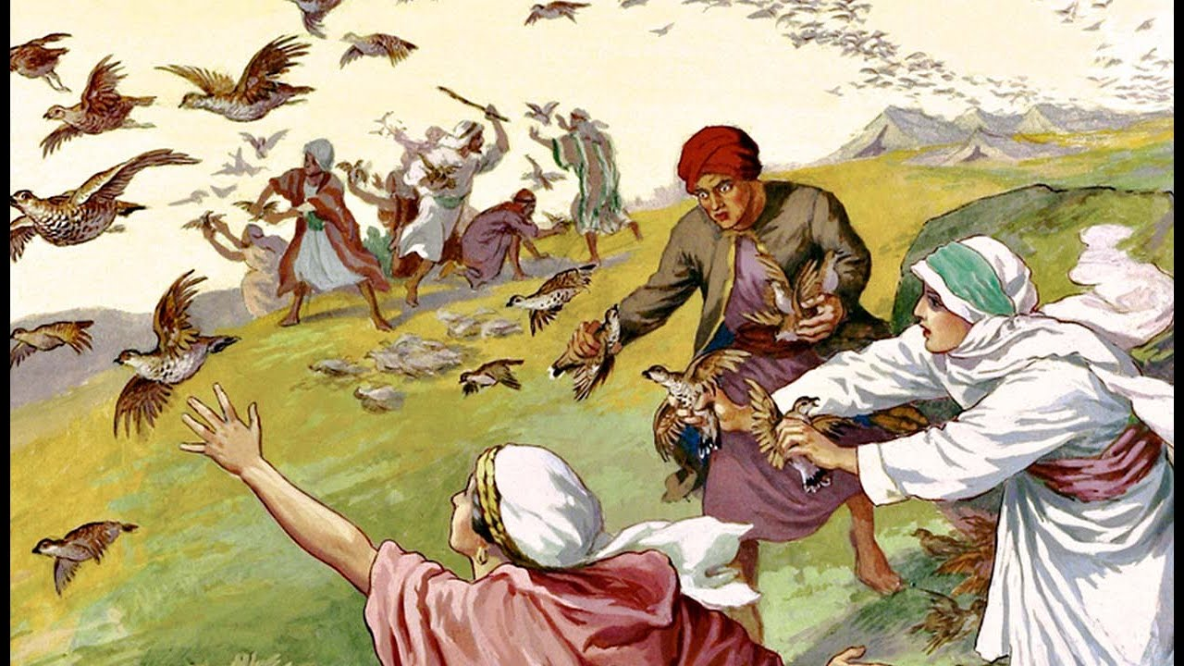
D. How He Provided for them. Psalm 78:19
“Can God furnish a table in the wilderness?”
2) Miracle Meat. Ex. 16:13; Ps 78:27
“He rained flesh also upon them as dust,
and feathered fowls like as the
sand of the sea:”

Slide 19
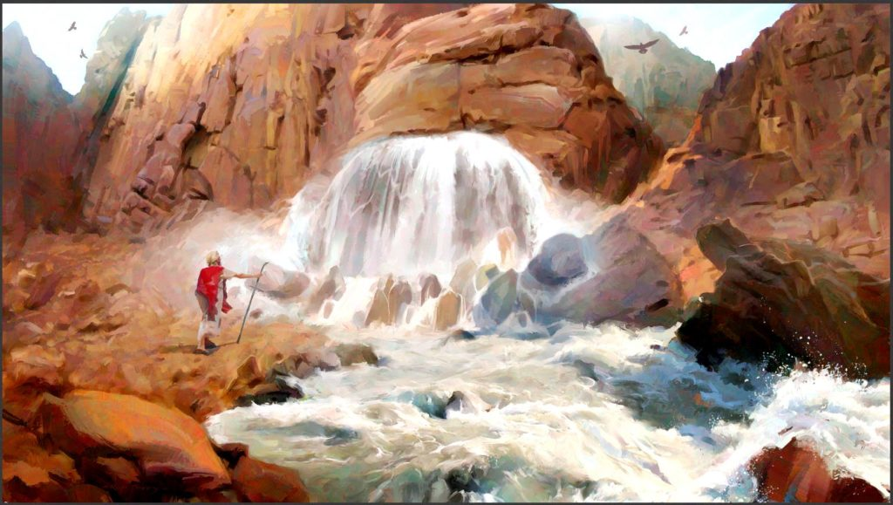
D. How He Provided for them. Psalm 78:19
“Can God furnish a table in the wilderness?”
3) Miracle Moisture (Water in the desert. Ex. 17:6)
6 “I will stand before thee there upon the rock in Horeb;
and thou shalt smite the rock, and there shall
come water out of it….”

Slide 20
The Exodus Revealed God’s Nature as:
5. Personal/Relational. (Desiring a Partnership)
3:10-12 “Come now and I will send thee unto Pharaoh,
that thou mayest bring forth my people …out of Egypt.
Who am I that I should go to Pharaoh…?
Certainly I will be with thee;
and this shall be a token, that I have sent thee:
When thou hast brought forth the people out of Egypt,
ye shall serve God upon this mountain.”

Slide 21
5. Personal/Relational.
A. Validated at Sinai
Ex 19:4 “Ye have seen what I did unto the Egyptians
and how I bare you on eagles' wings,
and brought you unto myself.
5 Now therefore, If you’ll obey my voice indeed…
then ye shall be a peculiar treasure unto me…
6 And ye shall be unto me a kingdom of priests,
and an holy nation.”

Slide 22
Conclusion: God’s Nature is revealed to us through the Exodus to remind us that God is:
Pure/Holy
Perceptive/Aware (Omniscient)
Preserving/Redemptive
Powerful/Almighty (Omnipotent)
Personal/Relational
and Available! (Omnipresent) Ps. 139
As well as Practical /Applicable!

Slide 23
Pr 9:10 “The fear of the LORD is the beginning of wisdom: and the knowledge of the holy
is understanding.”
1 Cor. 10:11 “These things happened to them for examples,
and they are written for our admonition,
upon whom the ends of the world are come.
12 Wherefore let him that thinketh he standeth take heed lest he fall.”

Slide 24
Most seem to avoid God. Ex. 20:19-21
“they said to Moses, speak thou with us and we’ll hear:
but let not God speak with us, lest we die.
And Moses said unto the people, Fear not:
for God is come to prove you,
and that his fear may be before your faces,
that ye sin not.
And the people stood afar off,
and Moses drew near unto the thick darkness
where God was.”

Slide 25
Even After Israel’s apostacy in Ex. 32
Moses pleads for Israel in Ex. 33 and says:
“I beseech thee, show me thy glory” vs 18
God responds by saying in Vs 19
“I will make all my goodness pass before thee,
and I will proclaim the name
(shēm: position, authority, character)
of the LORD before thee;”
God’s Nature is revealed in His Names!

Slide 26
“I beseech thee, show me thy glory” vs 18
20 “And he said, Thou canst not see my face: for there shall no man see me, and live.
21 Behold there is a place by me,
And thou shalt stand upon a rock.
22 …while my glory passeth by, that I will put thee in a clift of the rock, and will cover thee with my hand while I pass by:“

Slide 27
Ex 34:5-8 “The LORD descended in the cloud, and stood with him there, … And the LORD passed by before him, and proclaimed, The LORD, The LORD God, merciful and gracious, longsuffering, and abundant in goodness and truth, Keeping mercy for thousands, forgiving iniquity and transgression and sin,
and that will by no means clear the guilty;
visiting the iniquity of the fathers upon the children, …unto the third and to the fourth generation.
And Moses …bowed his head …and worshipped.”

Slide 28
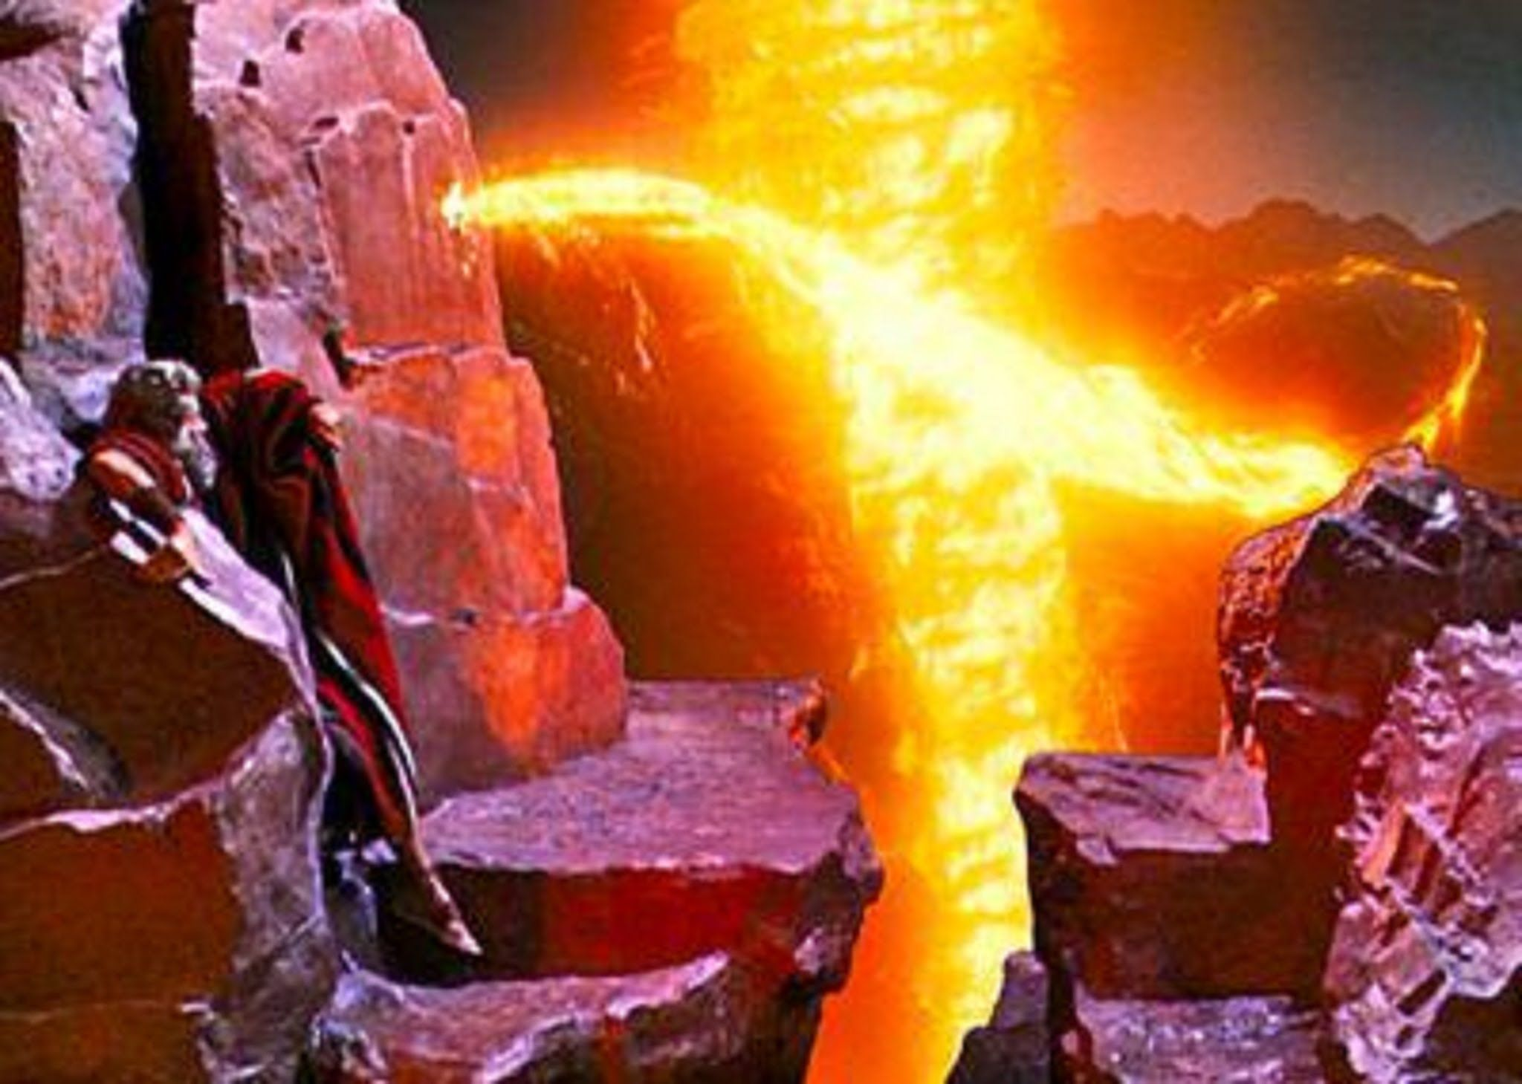
This experience (understanding God’s nature/names) transformed Moses
Ex. 34:29;
and it will change us!
2 Cor 3:13-18 “we all, beholding
as in a glass the glory of the
Lord,
See Ps 91 and James 4:21-27 for a record of this change.
are changed!”

