Slide 2
How is it that truths that were once
“self evident” are now considered
either lies
Because we fail to recognize the nature of the “thief” of Jn 10:10
and/or or the cycle of history.
or simply irrelevant?

Slide 3
Ps. 33:12
Whose God
is the Lord”

Slide 4
Ps 16:4
“Their sorrows shall be multiplied
that hasten after
another god”

Slide 5
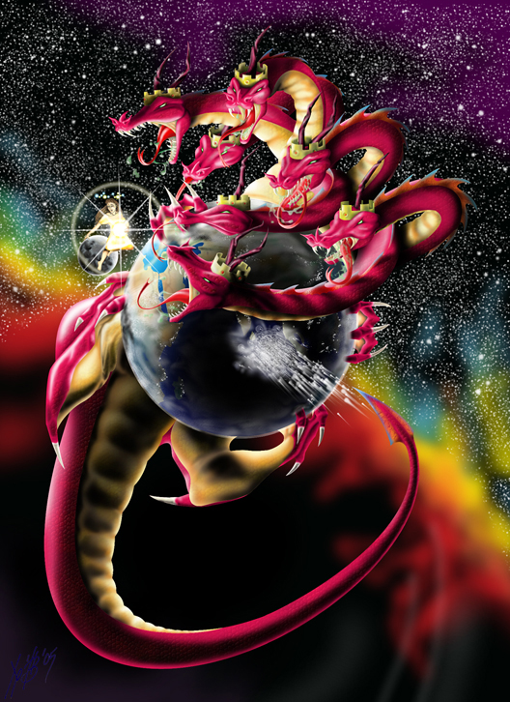
History has a way of repeating itself;
because “behind” human history are forces at work seeking to shape it.
Rev 12:9 “the great dragon was cast out, that old serpent…called Satan,
which deceives the whole world:
he was cast out into the earth, and his angels were cast out with him.”

Slide 6
God chose Israel and uses their history to teach the world about God’s Nature
as well as Satan’s.
1Cor. 10:11,12 “Now all these things happened unto them for ensamples:
they are written for our admonition, …
Wherefore let him that thinketh he standeth take heed lest he fall.”

Slide 7
While not every Jew was a “believer” God grew, guided, and guarded the nation for specific purposes. Ex 19:4-5
“You’ve seen what I did to the Egyptians,
and how I bare you on eagles' wings,
and brought you unto myself.
Now therefore, if ye will obey my voice indeed, and keep my covenant,
then ye shall be a peculiar treasure (segullâ: jewel)
unto me above all people:
for all the earth is mine!”

Slide 8
Ex 19:6 “And ye shall be unto me a kingdom of priests, and an holy nation. “
God’s purposes haven’t changed
and they apply to us! 2 Cor 1:20
“the promises of God in him (Jesus)
are yea and in him Amen,
unto the glory of God
by us. “

Slide 9
God’s purposes haven’t changed!
Compare Ex. 19:5,6 to What we are:
1 Pt 2:9 “ye are a chosen generation, a royal priesthood, an holy nation,
a peculiar people;
peripoi’ēsis: a purchased, precious,
and preserved acquisition

Slide 10
What we are:
1 Pt 2:9 “ye are a chosen generation, a royal priesthood, an holy nation,
a peculiar people;
Why we are:
that ye should shew forth the praises of him who called you out of darkness
into his marvellous light:”

Slide 11
(1Cor 10:11) “these things happened to them for ensamples…written for our admonition”
1. God’s blessings are tied to obedience.
“I set before you a blessing and a curse;
A blessing, (berākâ: prosperity)
if ye obey the commands
of the LORD your God…”
Deut. 11:26-27

Slide 12
God’s blessings are tied to our
obedience.
What’s required for God’s blessing? Dt 10:12-13 “what doth the Lord thy God require of thee, but to:
1) “fear the LORD thy God, (Power)
2) “walk in his ways, (Pursue His Paths)
“The path of life” Ps 16:11

Slide 13
1. God’s blessings are tied to obedience.
What? Dt 10:12-13 “what doth the Lord thy God require of thee, but to:
3) “love him, (Personal Relationship)
4) “serve the LORD (Purpose) with all thy heart and with all thy soul”
5) To keep (shamar: Protect {guard, value})
the commandments of the Lord.”
(Passion)

Slide 14
B. Why? Vs 13
1) The nature of Satan (the beast) is:
a) Deception Rev. 12:9; 2 Cor 4:4; Jn 8:44
b) Division/Rebellion Rev. 12:3-7; 1 Sam 15:23
c) Disease/Corruption Rev 12:9;
Eph 4:22; Gen 6:12
d) Destruction Rev 12:4, 13-17; Rev. 9:11;
Jn 10:10; Mt 7:13
“for thy good” (ṭôb)

Slide 15
B. Why? Vs 13
“for thy good” (ṭôb)
1 Jn 5:23 “Ye are of God, and we know that the whole world lieth in wickedness”
(Poneros: disease, ruin) (2 Cor 4:4)
Satan’s nature has infected the world!
God’s word (commands) are the cure.
(entole: His authoritative prescription)

Slide 16
B. Why? Vs 13 “for thy good” (ṭôb)
Satan: Deception, Division, Disease Destruction.
2) The nature of the Lord (and His law) is:
a) Clarity/Truth. Jn 17:17; Jn 8:32; 14:6
b) Unity/Peace. Jn 17:21; Ps 119:165; Is. 26:3
c) Cleansing/Correcting (Jn 17:17; 15:3; 2 Tim. 3:16)
d) Renewing/Reviving. (2 Ch. 7:14; Ps 23:3; 119:9)
See Psalm 19:7-14

Slide 17
“I set before you a blessing and a curse;…
God’s Blessing is tied to Obedience.
“A blessing if ye obey the commandments of the LORD:
and a curse, (qelālâ’: vilification)
if ye will not obey the commandments
of the LORD your God”
Deut. 11:28

Slide 18
2. God’s curse is tied to disobedience.
“a curse, (qelālâ’: vilification)
God doesn’t directly curse (vilify) us,
Sin causes God to remove the blessings of his word and its effects (peace/protection)
in, on, and through our lives.
We do this by our sin!
(Remember the if/then of Ex. 19:4-6)

Slide 19
2. God’s curse is tied to disobedience.
A. Understand Cause and Effect
1) The Cause (of the curse):
a) We choose to rebel against God
and His word/ways. (1 Sam 15:22,23)
b) We “distance” ourselves from God
and His people. (Gen. 3:8; Heb 10:25)
Disobedience

Slide 20
2) The Effect/Consequences 1 Sam 15
a) Deflection (Blaming others)
15 “the people spared the best …,
to sacrifice unto the LORD thy God…”
21 “But the people took of the spoil, which should have been destroyed”

Slide 21
2) The Effect/Consequences 1 Sam 15
b) Rationalization (justification)
15 “the people spared the best …,
to sacrifice unto the LORD thy God…”
21 “…to sacrifice to the Lord”
24 “I have transgressed…
because I feared the people,
and obeyed their voice.”

Slide 22
A. Understand Cause and Effect
2) The Effect/Consequences
a) Deflection (Blaming others)
b) Rationalization (Self justification)
c) Rebellion (Demonic influence)
1 Sam 15:23 “rebellion is as the sin
of witchcraft!”

Slide 23
2) The Effect/Consequences
a) Deflection b) Rationalization c) Rebellion
d) Reprobation (Stinking Thinking)
20 “I have obeyed the voice of the LORD”
Ro. 1:28 “as they did not like to retain God in their knowledge, God gave them over to a Reprobate mind” (adokimos nous)
Gen.3:1 “Yea hath God said?”

Slide 24
d) Reprobation is a biproduct of:
(1) Incomplete (surface) Repentance!
Sorrow for the consequences,
but not the cause of the sin!
30 “I have sinned:
before the elders of my people, and Israel,
and turn again with me,
that I may worship the LORD thy God.”
yet honor me now,

Slide 25
2) The Effect/Consequences 1 Sam. 15
d) Reprobation is a bi-product of:
(1) Incomplete (surface) Repentance!
(2) Satanic deception. 2 Tim. 2:24-26
“oppose themselves…snare of the devil”
Luke 15:17 “when he came to himself…”
Ro 1:18 “For the wrath of God is revealed… against all ungodliness …
who hold the truth in unrighteousness”

Slide 26
2) The Effect/Consequences 1 Sam 15:23 “rebellion is as the sin of witchcraft!”
Eph. 4:26,27 “Be angry and sin not…
Neither give place (topos: opportunity)
To the devil!”
(diabolos: slanderer, false accuser)

Slide 27
B. Example of cause/effect from Mt. 18.
After telling about the lost sheep (11-14)
Jesus gives clear instructions on how to resolve offenses/personal conflicts. (13-17)
“How often should I forgive?, til 7x?” (21)
“Jesus answers...until 70 x 7!” (22)
Then he tells the story of an incredible debt
(offense) that was forgiven Vs 23-27
10,000 talents!

Slide 28
This servant refused to forgive a much lesser debt (100 pence)
imprisoning the one who owed him. (28-30)
When the King discovered this injustice he:
Confronted the ungracious servant. 32,33
“Then his lord, …said unto him, O thou wicked servant, I forgave thee all that debt…
Shouldest not thou also have had compassion on thy fellow servant, even as I had pity on thee? “

Slide 29
When the King discovered this injustice he:
Confronted the ungracious servant. V 32,33
Condemned the ungracious servant. V 34 “And his lord was wroth,
and delivered him to the tormentors,
till he should pay all that was due unto him.”
See Mt 7:1-2

Slide 30
Then Jesus Clearly applied this to us! Vs 35 “ So likewise shall my heavenly Father
do also unto you,
if ye from your hearts forgive not
every one his brother their trespasses.“
(parap’tōma: errors, faults)

Slide 31
Conclusion:
Who/what are these Tormentors?
The spiritual/emotional/relational effects caused by our disobedience
and rebellion!
1 Sam. 15:23; Eph. 4:27; Heb 12:15
“bitterness springing up trouble you”

Slide 32
Why does God allow this? Pr 6:23-24
“For the commandment is a lamp;
and the law is light;
and reproofs of instruction
are the way of life:
To keep thee from the evil …”

Slide 33
Pr 1:23-25 ”Turn you at my reproof:
behold, I will pour out my spirit unto you,
I will make known my words unto you.
Because I have called, and ye refused;
I have stretched out my hand,
and no man regarded;
But ye have set at nought all my counsel, and would none of my reproof:

Slide 34
Pr 1:29-32
“For that they hated knowledge,
and did not choose the fear of the LORD:
They would none of my counsel:
they despised all my reproof.
Therefore shall they eat of the fruit
of their own way,
and be filled with their own devices.”

Slide 35
Pr 1:32 “For the turning away
of the simple shall slay them,
(Turning away from what/who?)
And the prosperity of fools
(shalwâ: false security)
shall destroy them.”

Slide 36
Notice how this chapter ends!
³³ ”But whoso hearkeneth unto me
shall dwell safely,
(beṭaḥ: have refuge, confidence, hope)
and shall be quiet (shāʾan: peaceful)
from fear of evil.” (Ra: wicked, distress)
(also the King of Egyptian gods)

Slide 37
Why does God allow this?
Natural Consequences can bring us to supernatural repentance,
Which will produce renewal.
2 Cor 7:10 “For godly sorrow worketh repentance to salvation ….”

Slide 38
Dt 11:26-28 “I set before you this day
a blessing and a curse;
A blessing, if ye obey the commandments of the LORD your God,
And a curse, if ye will not obey the commandments of the LORD your God,
but turn aside
…to go after other gods.”

Slide 39
Application: Cause and Effect
Ps 33:12 “Blessed is the nation (people)
whose God is the LORD”
Ps 16:4 “Their sorrows shall be multiplied that hasten after
another god”
Which will you choose?

