Slide 1
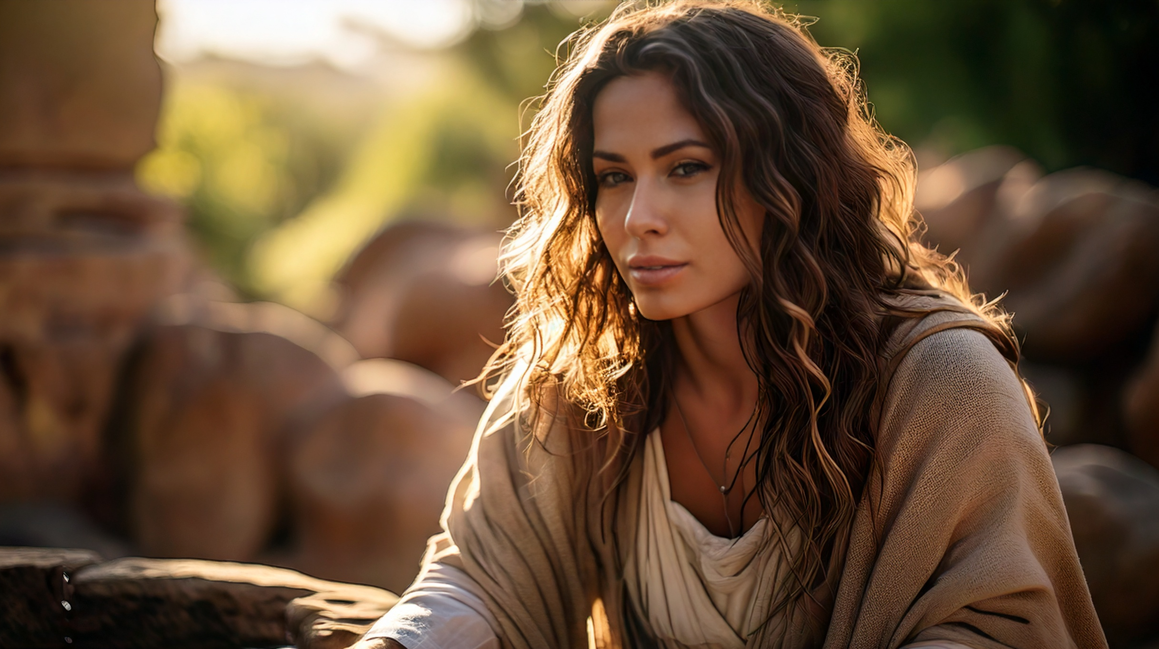
Acceptance From the Unexpected
By Joseph Peters

Slide 2

Goal
Every Christian should understand that even the unlikely are given opportunities from God
For these three reasons

Slide 3
Reasons
Samaria Was Despised by God’s Chosen People
Samaria Was Given an Opportunity
Samaria Accepted the Opportunity

Slide 4
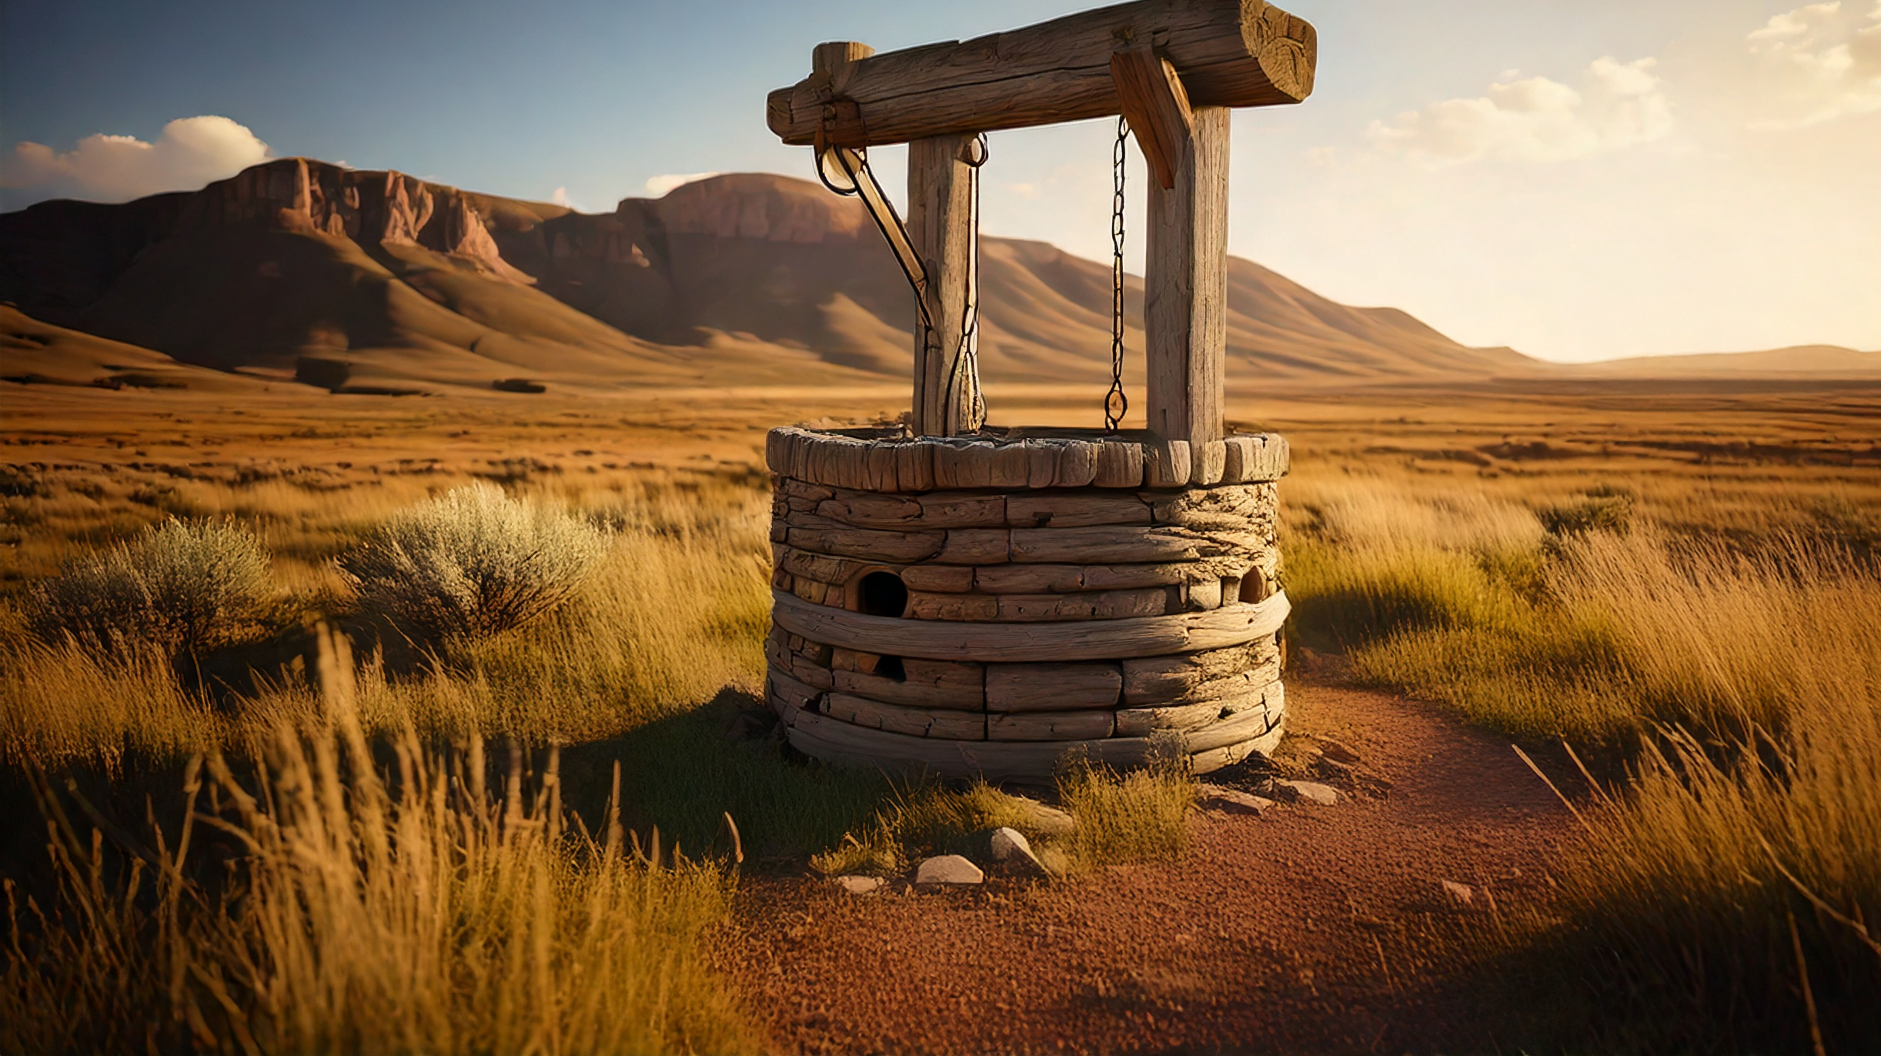
Samaria Was Despised by God’s Chosen People

Slide 5
Samaritans Origin Story
Then the king of Assyria came up throughout all the land, and went up to Samaria, and besieged it three years. In the ninth year of Hoshea the king of Assyria took Samaria, and carried Israel away into Assyria, and placed them in Halah and in Habor by the river of Gozan, and in the cities of the Medes (2 Kings 17:5–6).
But it came to pass, that when Sanballat heard that we builded the wall, he was wroth, and took great indignation, and mocked the Jews. And he spake before his brethren and the army of Samaria, and said, What do these feeble Jews? will they fortify themselves? will they sacrifice? will they make an end in a day? will they revive the stones out of the heaps of the rubbish which are burned (Neh 4:1–2).

Slide 6
Jesus’ Journey to Samaria
When therefore the Lord knew how the Pharisees had heard that Jesus made and baptized more disciples than John, (Though Jesus himself baptized not, but his disciples,) He left Judaea, and departed again into Galilee. And he must needs go through Samaria. Then cometh he to a city of Samaria, which is called Sychar, near to the parcel of ground that Jacob gave to his son Joseph. Now Jacob’s well was there. Jesus therefore, being wearied with his journey, sat thus on the well: and it was about the sixth hour (John 4:1–6).

Slide 7
The Woman’s Confusion
There cometh a woman of Samaria to draw water: Jesus saith unto her, Give me to drink. (For his disciples were gone away unto the city to buy meat.) Then saith the woman of Samaria unto him, How is it that thou, being a Jew, askest drink of me, which am a woman of Samaria? for the Jews have no dealings with the Samaritans (John 4:7–9).

Slide 8
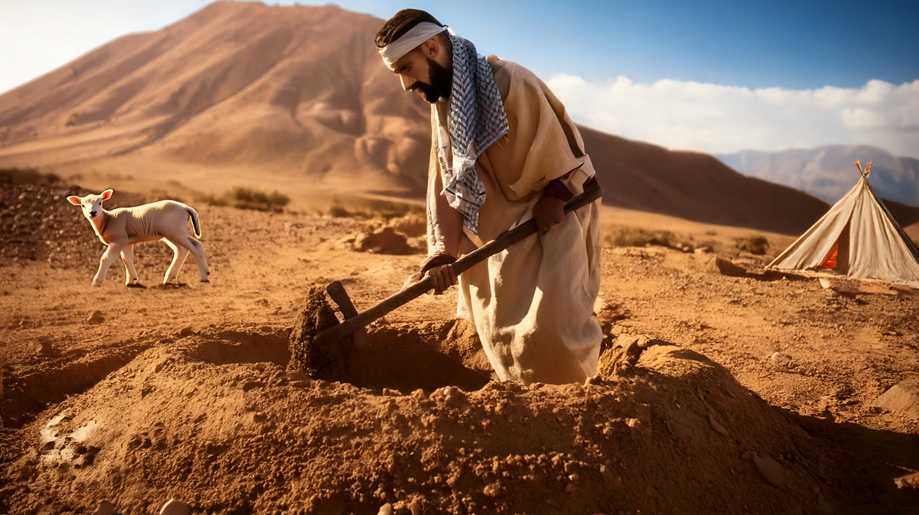
Samaria Was Given an Opportunity

Slide 9
Jesus’ Invitation
Jesus answered and said unto her, If thou knewest the gift of God, and who it is that saith to thee, Give me to drink; thou wouldest have asked of him, and he would have given thee living water. The woman saith unto him, Sir, thou hast nothing to draw with, and the well is deep: from whence then hast thou that living water? Art thou greater than our father Jacob, which gave us the well, and drank thereof himself, and his children, and his cattle (John 4:10–12)?

Slide 10
The Woman’s Continual Misunderstanding
Jesus answered and said unto her, Whosoever drinketh of this water shall thirst again: But whosoever drinketh of the water that I shall give him shall never thirst; but the water that I shall give him shall be in him a well of water springing up into everlasting life. The woman saith unto him, Sir, give me this water, that I thirst not, neither come hither to draw (John 4:13–15).

Slide 11
Jesus Changes Tactics
Jesus saith unto her, Go, call thy husband, and come hither. The woman answered and said, I have no husband. Jesus said unto her, Thou hast well said, I have no husband: For thou hast had five husbands; and he whom thou now hast is not thy husband: in that saidst thou truly (John 4:16–18).

Slide 12
The Woman Changes the Subject
The woman saith unto him, Sir, I perceive that thou art a prophet. Our fathers worshipped in this mountain; and ye say, that in Jerusalem is the place where men ought to worship (John 4:19–20).
But unto the place which the LORD your God shall choose [has chosen] (Deut. 12:5).

Slide 13
Jesus Redirects Back to Spiritual Matters
Jesus saith unto her, Woman, believe me, the hour cometh, when ye shall neither in this mountain, nor yet at Jerusalem, worship the Father. Ye worship ye know not what: we know what we worship: for salvation is of the Jews. But the hour cometh, and now is, when the true worshippers shall worship the Father in spirit and in truth: for the Father seeketh such to worship him. God is a Spirit: and they that worship him must worship him in spirit and in truth (John 4:21–24).

Slide 14
Jesus, the Messiah
The woman saith unto him, I know that Messias cometh, which is called Christ: when he is come, he will tell us all things. Jesus saith unto her, I that speak unto thee am he (John 4:25–26).

Slide 15
The Samaritans and the Disciples
And upon this came his disciples, and marvelled that he talked with the woman: yet no man said, What seekest thou? or, Why talkest thou with her? The woman then left her waterpot, and went her way into the city, and saith to the men, Come, see a man, which told me all things that ever I did: is not this the Christ? Then they went out of the city, and came unto him. In the mean while his disciples prayed him, saying, Master, neat. But he said unto them, I have meat to eat that ye know not of. Therefore said the disciples one to another, Hath any man brought him ought to eat (John 4:27–33).

Slide 16
Jesus redirects back to spiritual matters
Jesus saith unto them, My meat is to do the will of him that sent me, and to finish his work. Say not ye, There are yet four months, and then cometh harvest? behold, I say unto you, Lift up your eyes, and look on the fields; for they are white already to harvest. And he that reapeth receiveth wages, and gathereth fruit unto life eternal: that both he that soweth and he that reapeth may rejoice together. And herein is that saying true, One soweth, and another reapeth. I sent you to reap that whereon ye bestowed no labour: other men laboured, and ye are entered into their labours (John 4:34–38).

Slide 17
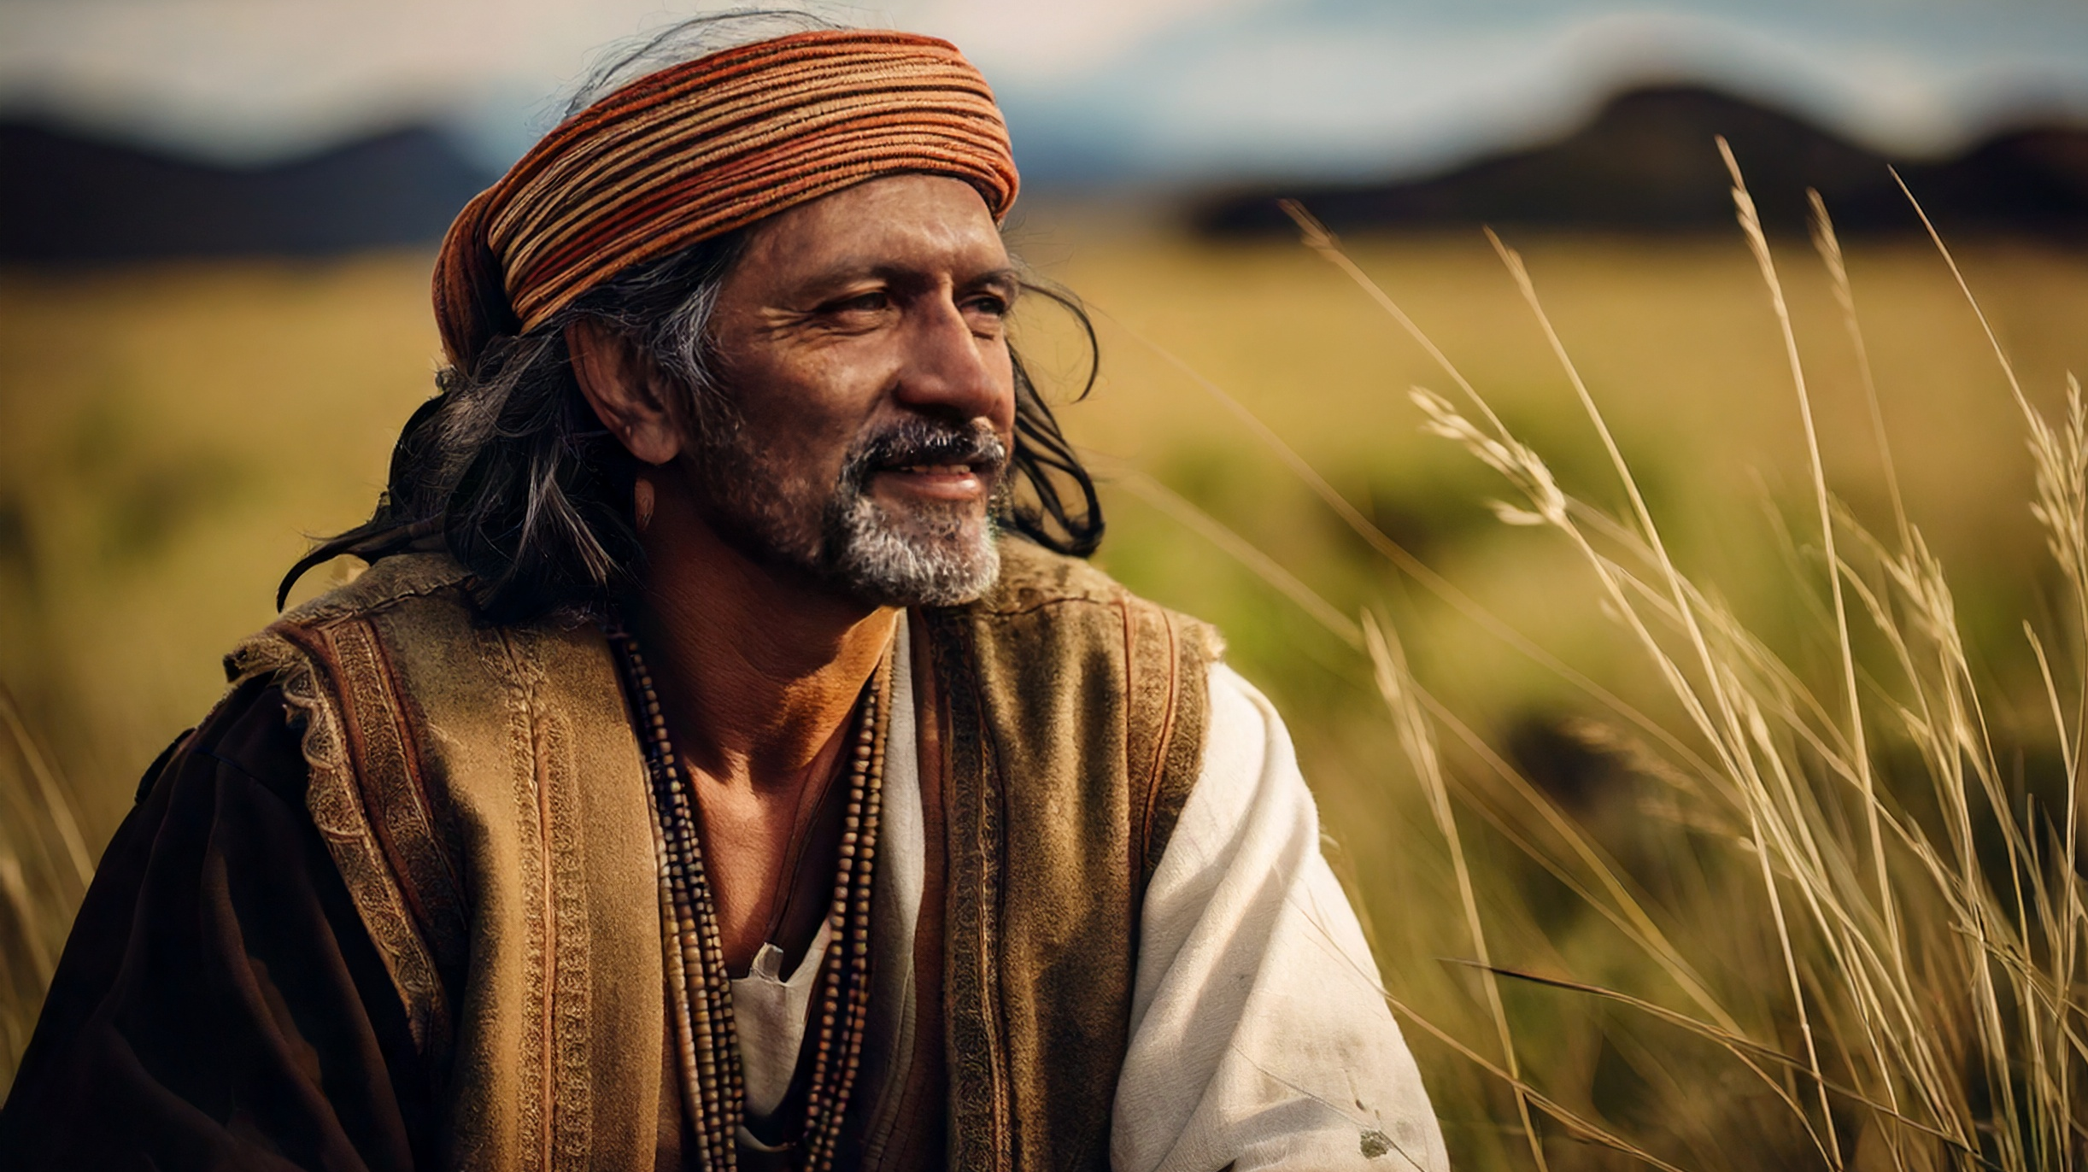
Samaria Accepted the Opportunity

Slide 18
The Samaritans Accept Jesus
And many of the Samaritans of that city believed on him for the saying of the woman, which testified, He told me all that ever I did. So when the Samaritans were come unto him, they besought him that he would tarry with them: and he abode there two days. And many more believed because of his own word; And said unto the woman, Now we believe, not because of thy saying: for we have heard him ourselves, and know that this is indeed the Christ, the Saviour of the world (John 4:39–42).

Slide 19
Jesus’ own people rejected him
Now after two days he departed thence, and went into Galilee. For Jesus himself testified, that a prophet hath no honour in his own country…
Then said Jesus unto him, Except ye see signs and wonders, ye will not believe (John 4:43–44, 48).

Slide 20
Conclusion
Every Christian should understand that even the unlikely are given opportunities from God
For these three reasons

Slide 21
Reasons
Samaria Was Despised by God’s Chosen People
Samaria Was Given an Opportunity
Samaria Accepted the Opportunity

