Slide 1
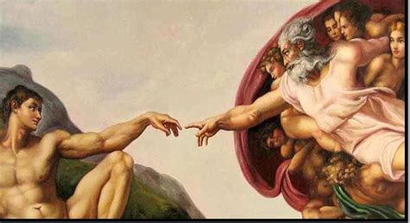
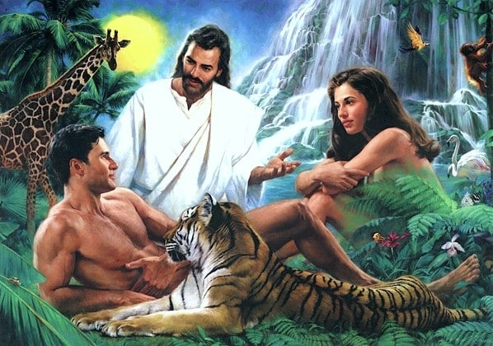
God is relational!
He created us for relationships,
And relationships for us!
Gen 2:18
(Gen. 1:26
1 Jn. 4:16)
We tend to think others in our relationships “owe us”. (Happiness, respect, love, affection, appreciation, etc)
The truth is that God brings us into relationships in order to “GROW US!”

Slide 2
God actively seeks relationships with us (Jn 4:23)
John 14:18,21 “I will not leave you comfortless:
I will come to you…
21 He that hath my commandments, (entole’: prescription)
and keeps them, He it is that loveth me:
and he that loveth me shall be loved of my Father,
and I will love him,
and will manifest myself to him.”
Satan seeks to rob us of this relationship
(through deception, distraction, infection & rebellion.)
(Jn 10:10; 1 Jn 5:19)

Slide 3
God gives us His Word and His Spirit to help us recognize God’s divine destiny for us;
1 Tim 1:5 “Now the end (telos: goal) of the commandment is:
To Love Purely
To See Clearly
To Trust Sincerely
As well as Satan’s determined “devices” (2 Cor 2:11)
that attack us in each of these areas.
(Our Love, Perception, and Faith)
“charity out of a pure heart,
“and of a good conscience, (co-perception)
and of faith unfeigned”

Slide 4
God wants to so work in us to be able us to:
“To reach out with Your hands,
To see through Your eyes,
To love with the love of a Savior!
To feel with Your heart,
and to think with Your mind;
I'd give my last breath for Your glory!”
John Mark Hall (Casting Crowns)
So He can work through us through us to bring
His light and love to others! (Phil 2:13)

Slide 5
To accomplish this He brings into our lives:
Ministry Partners (Pastors, Preachers, Teachers)
(1 Cor 3:9; Heb. 12:7,17; Eph. 4:10-16)
This also includes Each other! Heb 3:12-15 “Take heed, brethren, lest there be in any of you an evil heart ... in departing from the living God.
But exhort one another daily, …
lest any of you be hardened through the deceitfulness of sin.
For we are made partakers (met’ochos: partners) of Christ…
While it is said, To day if ye will hear His voice,
harden not your hearts, as in the provocation.”
(See Isaiah 30:20,21)

Slide 6
He intentionally brings into our lives:
Marriage Partners Eph. 5:21-32; 1 Peter 3:1-8
Mal 2:14 “the LORD hath been witness between thee and the wife of thy youth, against whom thou hast dealt treacherously (bāgad’: deceitfully, unfaithfully)
yet is she thy companion,
(ḥaberet: knit together)
and the wife of thy covenant.”
(berît: from bārâ meaning to select, feed, render clear)

Slide 7
What’s God looking for in a Man?
Men Partners (Father figures)
“Father” is used 352 times in the New Testament.
266 times it is used to describe God!

Slide 8
Acts 13:18-22 Paul records that God led Israel to Canaan:
“And when he had destroyed seven nations in the land of Chanaan, he divided their land to them by lot.
And after that he gave them judges about the space of 450 years, until Samuel the prophet.
And afterward they desired a king: and God gave unto them Saul …by the space of forty years.
And when he had removed him, he raised up unto them David to be their king; to whom also he gave testimony, and said,
I have found David the son of Jesse,
a man after mine own heart,
which shall fulfil all my will.”

Slide 9
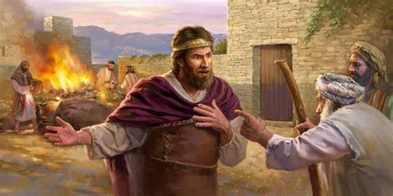
When Israel demanded a King, God gave them Saul,
who “looked” the part (1 Sam. 9:2).
His true nature (pride, impatience, insecurity) was first revealed under pressure in 1 Sam. 13.
Vs 14 Samuel revealed: “thy kingdom shall not continue:
the LORD hath sought him a man after his own heart,
and …commanded him to be captain over his people,
because thou hast not kept
(shamar: guarded, hedged, protected)
that which the LORD commanded thee.”
(Ṣāwâ’: appointed)

Slide 10
Israel were God’s people, not just Saul’s.
His authority came from his relationship to God.
Since he wasn’t willing to be “a man under authority”
he could be trusted to be “a man of authority”. (Mt 8:9)
God gave him multiple opportunities to obey,
and sent Samuel to confront him
and challenge him to genuinely repent,
but his behavior continued to reveal his
Pride and Bitterness. (1 Sam 14&15)

Slide 11
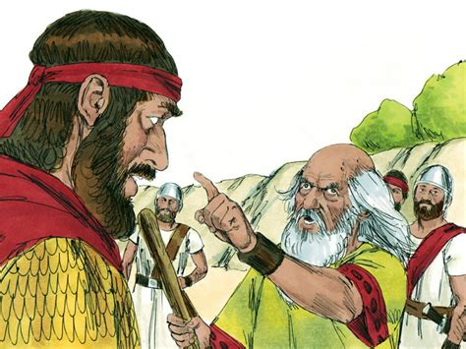
After his third (recorded) failure God told him
“Hath the LORD as great delight in burnt offerings and sacrifices, as in obeying the voice of the LORD?
to obey is better than sacrifice, …
For rebellion (merî’ from mara: bitterness)
is as the sin of witchcraft, (qesem’: divination)
and stubbornness is as iniquity and idolatry.
Because thou hast rejected the word of the LORD, he hath also rejected thee from being king.”
1 Sam 15:22-23

Slide 12
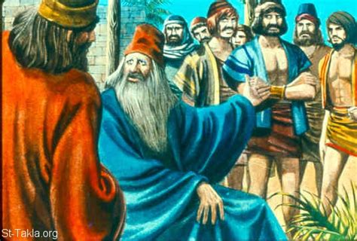
In 1 Sam. 16 God sends Samuel to anoint the next King.
6 “it came to pass, when they were come, that he looked on Eliab, and said, Surely the LORD'S anointed is before him.
7 But the LORD said unto Samuel, Look not on his countenance, …; because I have refused him:
for the LORD seeth not as man;
for man looks on the outward appearance,
but the LORD looks on the heart.”

Slide 13
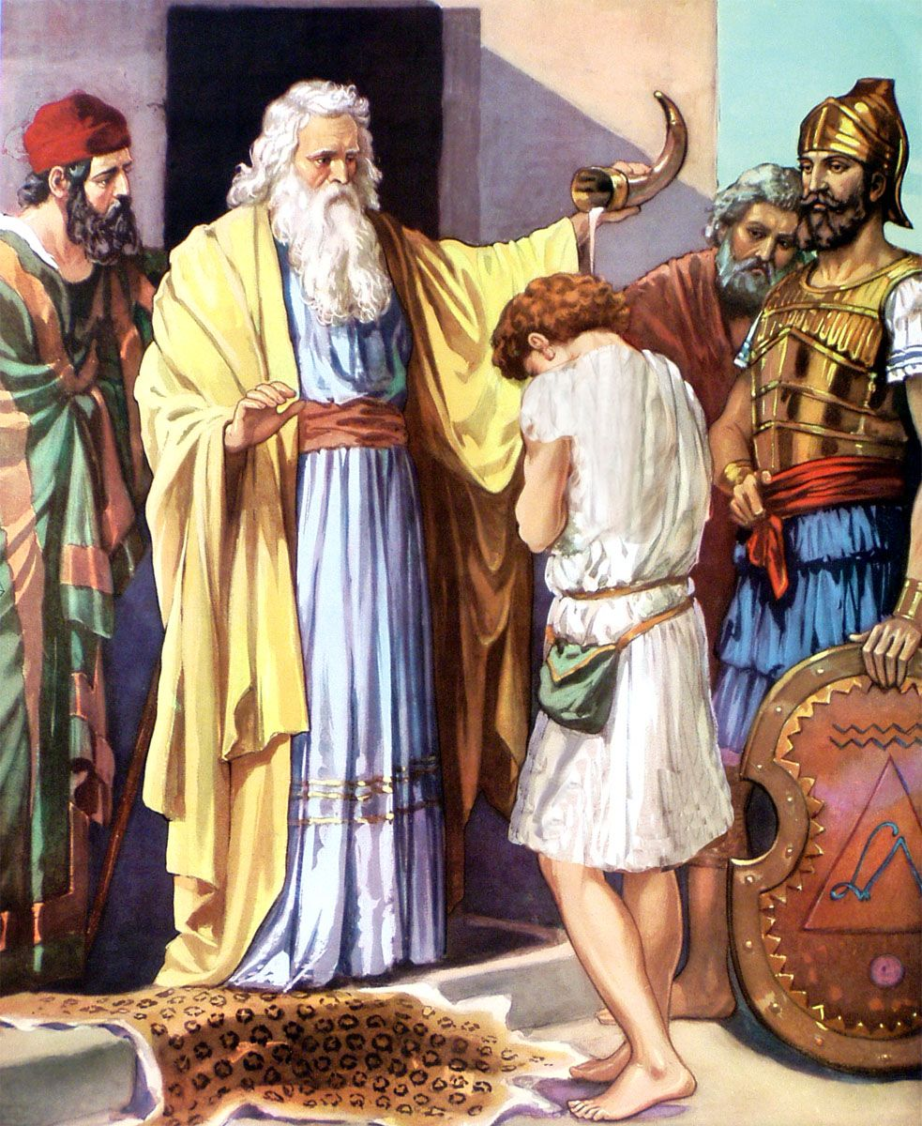
In 1 Sam. 16 God sends Samuel to anoint the next King.
11 “Are here all thy children? …
There remains yet the youngest, and…he keepeth the sheep.
…Send and fetch him: for we will not sit down till he come.
12 And he sent, and brought him in. … the LORD said, Arise, anoint him:
for this is he.
13 Then Samuel …anointed him in the midst of his brethren:
and the Spirit of the LORD came upon David from that day forward.”

Slide 14
David was chosen to lead God’s People,
Not because He couldn’t or didn’t sin,
But because he couldn’t get comfortable in sin. Ps 32
2 “Blessed is the man unto whom the LORD imputeth not iniquity, and in whose spirit there is no guile. (deceit)
3 When I kept silence, my bones waxed old
through my roaring all the day long.
4 For day and night thy hand was heavy upon me: …Selah.
5 I acknowledged my sin unto thee, ..mine iniquity have I not hid. I said, I will confess my transgressions unto the LORD;
and thou forgavest the iniquity of my sin. Selah.

Slide 15
6 “For this (vs 5) shall every one that is godly pray unto thee in a time when thou mayest be found: …
7 Thou art my hiding place; thou shalt preserve me from trouble; thou shalt compass me about with songs of deliverance. Selah.
8 I will instruct thee and teach thee in the way which thou shalt go: I will guide thee with mine eye..
11 Be glad in the LORD, and rejoice, ye righteous: and shout for joy, all ye that are upright in heart.”
(Yāshār’: straight!)

Slide 16
1Sam 13:14 “The LORD hath sought a man after his own heart”
What does a man after God’s heart look (act) like?
Ps 78:70-72 “He chose David also his servant, and took him from the sheepfolds..he brought him to feed (rāʿâ: shepherd) Jacob his people, and Israel his inheritance.
So he fed them according to the integrity of his heart;
(tom: innocence; From tāmam’: consumed to be complete, upright)
What “consumes you?
and guided (nāḥâ: govern, guide, straighten) them by the skilfulness (tâbûwn: understanding, wisdom) of his hands.”

Slide 17
Integrity was important to God and David. Ps 15:1-5
“LORD, who shall abide in thy tabernacle?...dwell in thy holy hill?
He that walketh uprightly, (From tāmam’) and works righteousness,
and speaketh the truth in his heart.
He that backbiteth not with his tongue, nor doeth evil to his neighbor, nor taketh up a reproach against his neighbor.
In whose eyes a vile person is contemned;
but he honoreth them that fear the LORD.
He that sweareth to his own hurt,
He that putteth not out his money to usury,
nor taketh reward against the innocent.
He that doeth these things shall never be moved.”
and changeth not.

Slide 18
Integrity was important to God and David.
Ps 7:8 “judge me, O LORD, according to my righteousness,
and according to mine integrity that is in me.”
Ps 25:21 “Let integrity and uprightness preserve me…”
Ps 26:11 “I will walk in mine integrity: redeem me…”
Ps 41:12 “And as for me, thou upholdest me in mine integrity”
David passed this passion on to Solomon!
Pr 11:3 “The integrity of the upright shall guide them…”
Pr 19:1 “Better is the poor that walketh in his integrity,
than he that is perverse in his lips, and is a fool.
Pr 20:7 “The just man walketh in his integrity:
his children are blessed after him.”

Slide 19
1Sam 13:14 “The LORD hath sought a man after his own heart
And commanded him to be captain over his people.”
God is still seeking men “after his heart”,
Who He can trust to
1) Follow him “in paths of righteousness” (Ps. 23:3)
2) Focus on (“consumed” with) personal integrity.
3) Feed / Lead (shepherd) others with integrity/skill. ➔Their family. Ps 127:3 “children are an heritage of the LORD”
Pr 22:7 “Train up a child in the way he should go,
and when he’s old, he’ll not depart from it.”

Slide 20
God’s still seeking men He can trust to:
3) Shepherd (feed/lead) others with integrity/skill.
Their Friends: Pr 27:17 “Iron sharpens iron; so a man
sharpens the countenance of his friend. “ (rēaʿ: companion)
{Rea comes from “raa”: meaning to shepherd!}
Pr 17:17 “A friend loveth at all times,
and a brother is born for adversity.”
Pr 18:24 “A man that hath friends must shew himself friendly:
and there is a friend that sticketh closer than a brother.”
Jn 15:13 “Greater love hath no man than this,
that a man lay down his life for his friends.”

Slide 21
3) Shepherd (feed/lead) others with integrity/skill.
God’s Flock: Others God wants to love through you.
Paul modeled this to Timothy “my own son in the faith” 1Tim 1:2 (See also Phil. 2:19-22)
And the Thessalonian church 1 Th 2:10-12
“Ye are witnesses…how holily and justly and unblameably we behaved ourselves among you that believe:
As ye know how we exhorted and comforted and charged every one of you, as a father doth his children,
That ye would walk worthy of God,
who hath called you unto his kingdom and glory.”

Slide 22
1Sam 13:14 “The LORD hath sought a man after his own heart
And commanded him to be captain over his people.”
God is still seeking men (and women) “after his heart”
who will value / pursue integrity and skill (wisdom);
Who He can trust to partner with him in the shepherding (cultivation) of His people.
God reveals in Ezekiel 22 the condition of His people and the reasons for his impending judgment.
Ez 22:30 “I sought for a man among them, that should make up the hedge, and stand in the gap before me for the land,
that I should not destroy it:
but I found none.”

Slide 23
1Sam 13:14 “The LORD hath sought a man after his own heart
And commanded him to be captain over his people.”
God is still seeking men (and women) “after his heart”
who will value / pursue integrity and skill (wisdom);
Who He can trust to partner with him in the shepherding (cultivation) of His people.
God reveals in Ezekiel 22 the condition of His people and the reasons for his impending judgment.
Ez 22:30 “I sought for a man among them, that should make up the hedge, and stand in the gap before me for the land,
that I should not destroy it:
but I found none.”

Slide 24
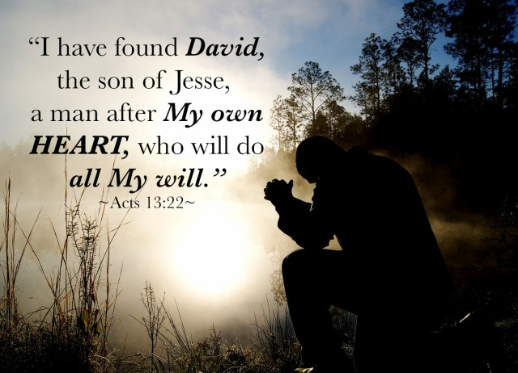
Will He Find One in You?
“I sought for a man among them that would stand…”

