Slide 1
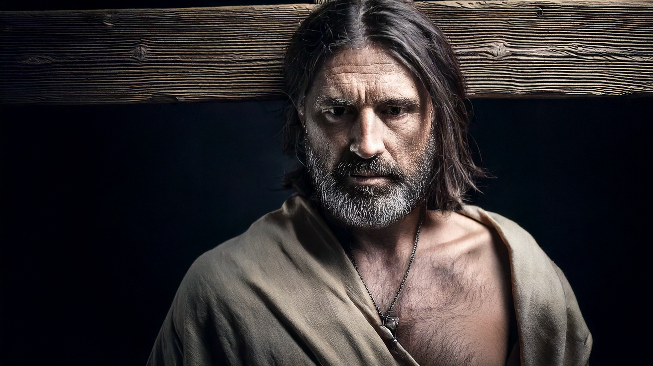
A Hopeful Request
By Joseph Peters

Slide 2

Goal
Every Christian should make requests in humility
For these three reasons

Slide 3
Reasons
The Thief Defended Jesus and Acknowledged His Own Guilt
The Thief Made a Hopeful Request to Jesus
The Thief’s Request Was Accepted by Jesus

Slide 4
Matthew
Then were there two thieves crucified with him, one on the right hand, and another on the left.
(1) And they that passed by reviled him, wagging their heads, And saying, Thou that destroyest the temple, and buildest it in three days, save thyself. If thou be the Son of God, come down from the cross. (2) Likewise also the chief priests mocking him, with the scribes and elders, said, He saved others; himself he cannot save. If he be the King of Israel, let him now come down from the cross, and we will believe him. He trusted in God; let him deliver him now, if he will have him: for he said, I am the Son of God. (3) The thieves also, which were crucified with him, cast the same in his teeth (Matt 27:38–44).

Slide 5
Mark
And with him they crucify two thieves [λῃστής]; the one on his right hand, and the other on his left. And the scripture was fulfilled, which saith, And he was numbered with the transgressors.
(1)And they that passed by railed on him, wagging their heads, and saying, Ah, thou that destroyest the temple, and buildest it in three days, Save thyself, and come down from the cross. (2) Likewise also the chief priests mocking said among themselves with the scribes, He saved others; himself he cannot save. Let Christ the King of Israel descend now from the cross, that we may see and believe. (3) And they that were crucified with him reviled him (Mark 15:27–32).

Slide 6
Luke
And when they were come to the place, which is called Calvary, there they crucified him, and the malefactors, one on the right hand, and the other on the left. Then said Jesus, Father, forgive them; for they know not what they do. And they parted his raiment, and cast lots. (1) And the people stood beholding. (2) And the rulers also with them derided him, saying, He saved others; let him save himself, if he be Christ, the chosen of God. (4) And the soldiers also mocked him, coming to him, and offering him vinegar, And saying, If thou be the king of the Jews, save thyself (Luke 23:33–37).

Slide 7
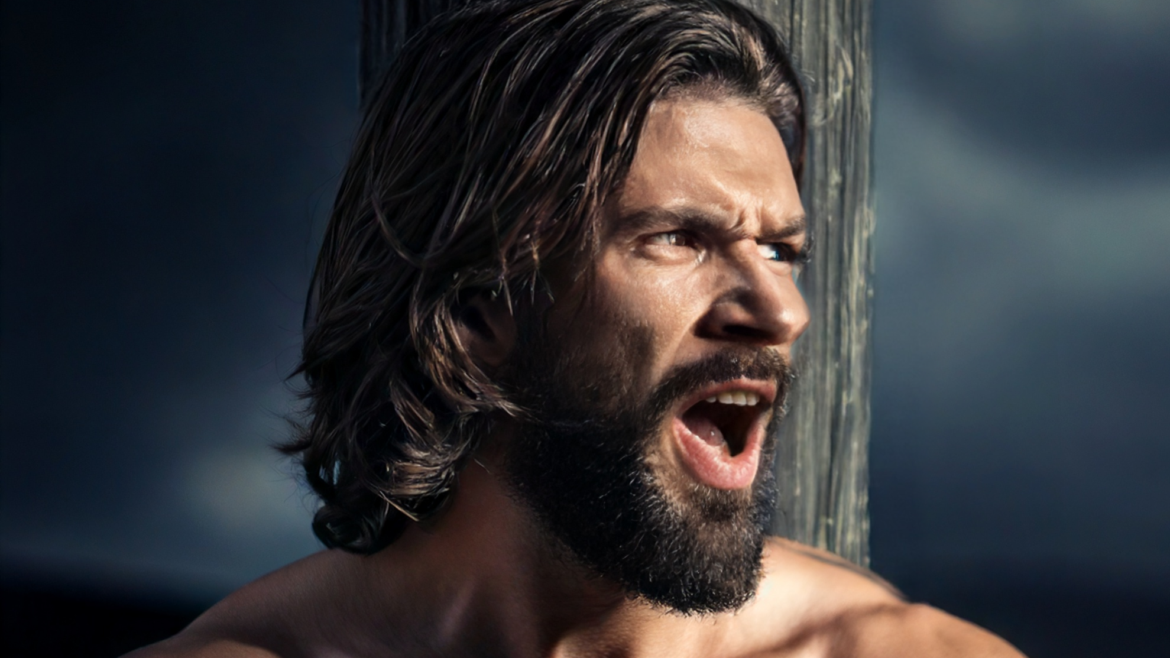
The Thief Defended Jesus and Acknowledged His Own Guilt

Slide 8
A Request Through Mockery
And one of the malefactors which were hanged railed on him, saying, If thou be Christ, save thyself and us (Luke 23:39).

Slide 9
A defense of Jesus
But the other answering rebuked him, saying, Dost not thou fear God, seeing thou art in the same condemnation? And we indeed justly; for we receive the due reward of our deeds: but this man hath done nothing amiss (Luke 23:40–41.

Slide 10

The Thief Made a Hopeful Request to Jesus

Slide 11
A humble Appeal
And he said unto Jesus, Lord, remember me when thou comest into thy kingdom (Luke 23:42–43).

Slide 12

The Thief’s Request Was Accepted by Jesus

Slide 13
With Jesus in Paradise
And Jesus said unto him, Verily I say unto thee, To day shalt thou be with me in paradise (Luke 23:43).

Slide 14
Goal
Every Christian should make requests in humility
For these three reasons

Slide 15
Reasons
The Thief Defended Jesus and Acknowledged His Own Guilt
The Thief Made a Hopeful Request to Jesus
The Thief’s Request Was Accepted by Jesus

