Slide 1
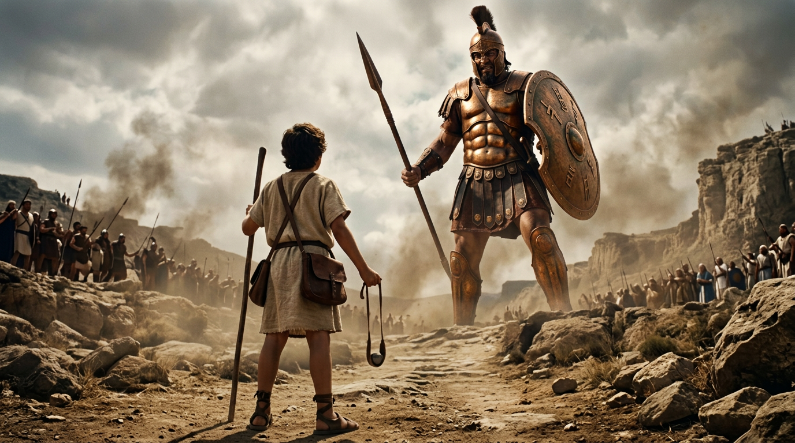
A Faith that Inspires
By Joseph Peters

Slide 2

Goal
Everyone of God’s people should have a faith that God can use to inspire others
For these three reasons

Slide 3
Reasons
Joshua and Caleb’s faith inspired Israel to defeat giants
David’s faith led him to face a giant alone
David’s faith inspired others to fight the giants after he could not

Slide 4
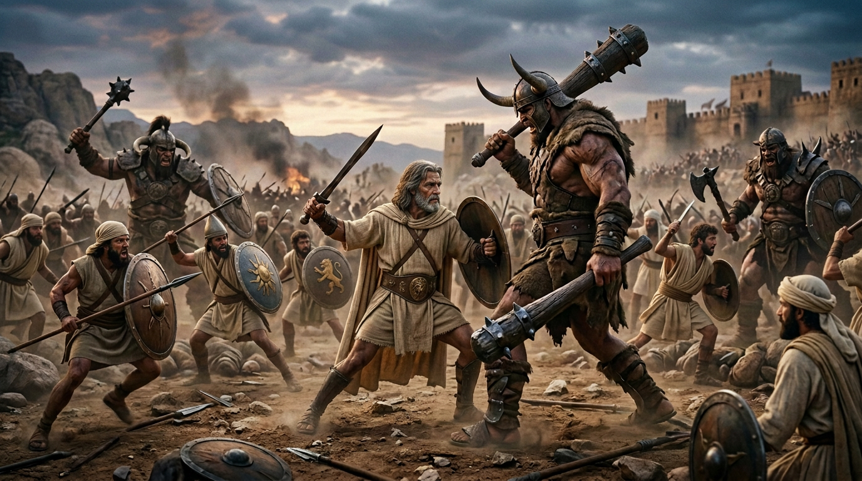
Joshua’s Faith Inspired Israel to Defeat Giants

Slide 5
Fear of the Giants in the Land
Nevertheless the people be strong that dwell in the land, and the cities are walled, and very great: and moreover we saw the children of Anak there… And Caleb stilled the people before Moses, and said, Let us go up at once, and possess it; for we are well able to overcome it. But the men that went up with him said, We be not able to go up against the people; for they are stronger than we. And there we saw the giants, the sons of Anak, which come of the giants: and we were in our own sight as grasshoppers, and so we were in their sight (Num 13:28, 30-31, 33).

Slide 6
Joshua and Caleb’s Courage
And Joshua the son of Nun, and Caleb the son of Jephunneh, which were of them that searched the land, rent their clothes: And they spake unto all the company of the children of Israel, saying, The land, which we passed through to search it, is an exceeding good land. If the LORD delight in us, then he will bring us into this land, and give it us… Only rebel not ye against the LORD, neither fear ye the people of the land; for they are bread for us: their defence is departed from them, and the LORD is with us: fear them not (Num 14:6–8a, 9).

Slide 7
Joshua and Calebs Victory
And at that time came Joshua, and cut off the Anakims from the mountains, from Hebron, from Debir, from Anab, and from all the mountains of Judah, and from all the mountains of Israel: Joshua destroyed them utterly with their cities. There was none of the Anakims left in the land of the children of Israel: only in Gaza, in Gath, and in Ashdod, there remained… And Caleb drove thence the three sons of Anak, Sheshai, and Ahiman, and Talmai, the children of Anak (Josh 11:21–22; 15:14).

Slide 8
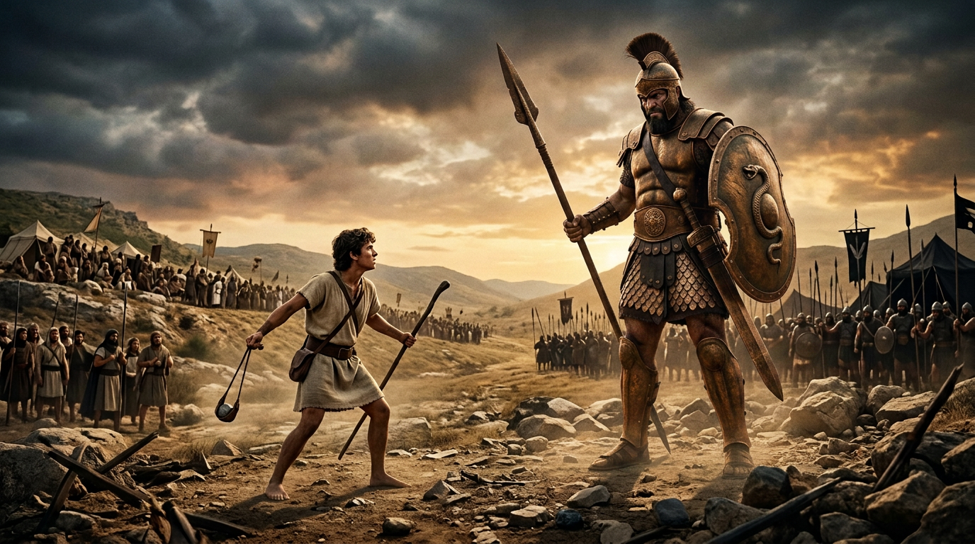
David’s Faith Led Him to Face a Giant Alone

Slide 9
The People Fear the Giant
And there came out from the camp of the Philistines a champion named Goliath of Gath, whose height was six cubits and a span. He had a helmet of bronze on his head, and he was armed with a coat of mail, and the weight of the coat was five thousand shekels of bronze. And he had bronze armor on his legs, and a javelin of bronze slung between his shoulders. The shaft of his spear was like a weaver’s beam, and his spear’s head weighed six hundred shekels of iron… All the men of Israel, when they saw the man, fled from him and were much afraid (1 Sam 17:4–7a, 24).

Slide 10
David’s Courage
for who is this uncircumcised Philistine, that he should defy the armies of the living God..? And David said to Saul, Let no man’s heart fail because of him; thy servant will go and fight with this Philistine… And all this assembly shall know that the LORD saveth not with sword and spear: for the battle is the LORD’s, and he will give you into our hands (1 Sam 17:26b, 32, 47).

Slide 11
David’s Victory
And it came to pass, when the Philistine arose, and came and drew nigh to meet David, that David hasted, and ran toward the army to meet the Philistine. And David put his hand in his bag, and took thence a stone, and slang it, and smote the Philistine in his forehead, that the stone sunk into his forehead; and he fell upon his face to the earth. So David prevailed over the Philistine with a sling and with a stone, and smote the Philistine, and slew him (1 Sam 17:48-50).

Slide 12
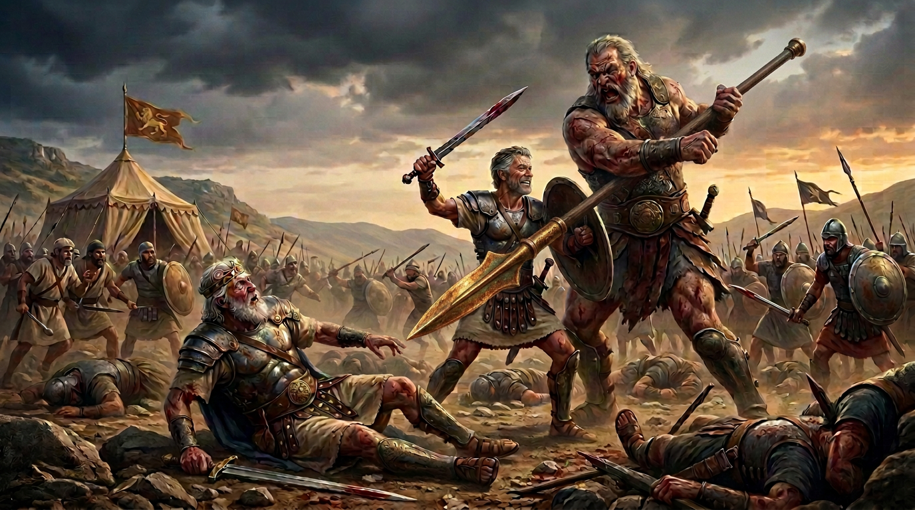
David’s Faith Inspired Others

Slide 13
David’s Battle Days are Over
Moreover the Philistines had yet war again with Israel; and David went down, and his servants with him, and fought against the Philistines: and David waxed faint. And Ishbi-benob, which was of the sons of the giant, the weight of whose spear weighed three hundred shekels of brass in weight, he being girded with a new sword, thought to have slain David. But Abishai the son of Zeruiah succoured him, and smote the Philistine, and killed him. Then the men of David sware unto him, saying, Thou shalt go no more out with us to battle, that thou quench not the light of Israel (2 Sam 21:15–17).

Slide 14
Slaying and Saph and Goliath?
And it came to pass after this, that there was again a battle with the Philistines at Gob: then Sibbechai the Hushathite slew Saph, which was of the sons of the giant. And there was again a battle in Gob with the Philistines, where Elhanan the son of Jaare-oregim, a Beth-lehemite, slew the brother of Goliath the Gittite, the staff of whose spear was like a weaver’s beam (2 Sam 21:18–19).

Slide 15
Goliath’s Brother Rather Than Goliath
And there was war again with the Philistines; and Elhanan the son of Jair slew Lahmi the brother of Goliath the Gittite, whose spear staff was like a weaver’s beam (1 Chron 20:5).

Slide 16
Slaying More Giants
And there was yet a battle in Gath, where was a man of great stature, that had on every hand six fingers, and on every foot six toes, four and twenty in number; and he also was born to the giant. And when he defied Israel, Jonathan the son of Shimea the brother of David slew him. These four were born to the giant in Gath, and fell by the hand of David, and by the hand of his servants (2 Sam 21:20–22).

Slide 17
Conclusion
Everyone of God’s people should have a faith that God can use to inspire others
For these three reasons

Slide 18
Reasons
Joshua and Caleb’s faith inspired Israel to defeat giants
David’s faith led him to face a giant alone
David’s faith inspired others to fight the giants after he could not

