Slide 1
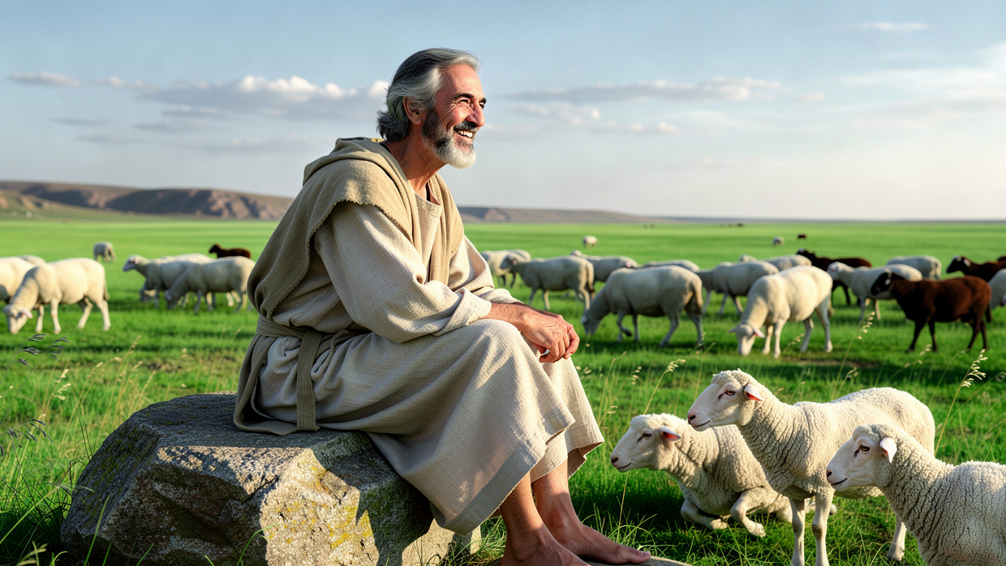
A Balanced Wisdom
By Joseph Peters

Slide 2

Goal
Everyone Should Use Wisdom to Please God Rather Than for Good Results
For These Reasons

Slide 3
Reasons
Proverbs: Wisdom and Righteousness Honors God
Ecclesiastes: Wisdom and Righteousness Does Not Always Lead to Good Results
Job: God’s Will Can be Confusing to Us

Slide 4
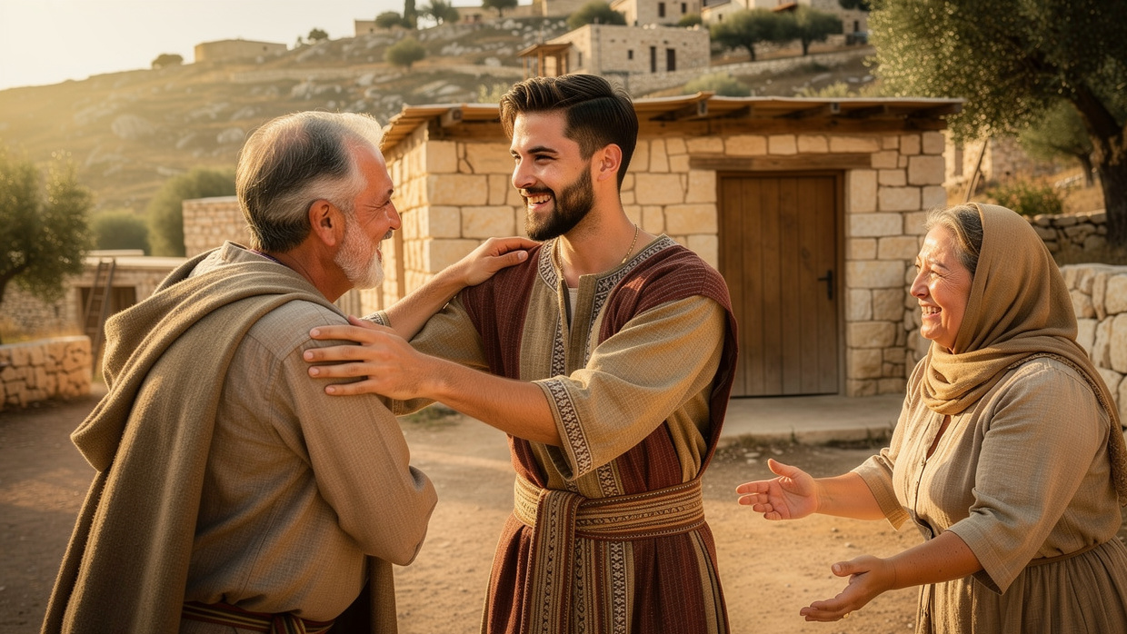
Proverbs: Wisdom and Righteousness Honors God

Slide 5
Comparison to Fools
A wise son maketh a glad father: But a foolish man despiseth his mother. Folly is joy to him that is destitute of wisdom: But a man of understanding walketh uprightly (Prov 15:20–21).
The foolishness of man perverteth his way: And his heart fretteth against the LORD (Prov 19:3).

Slide 6
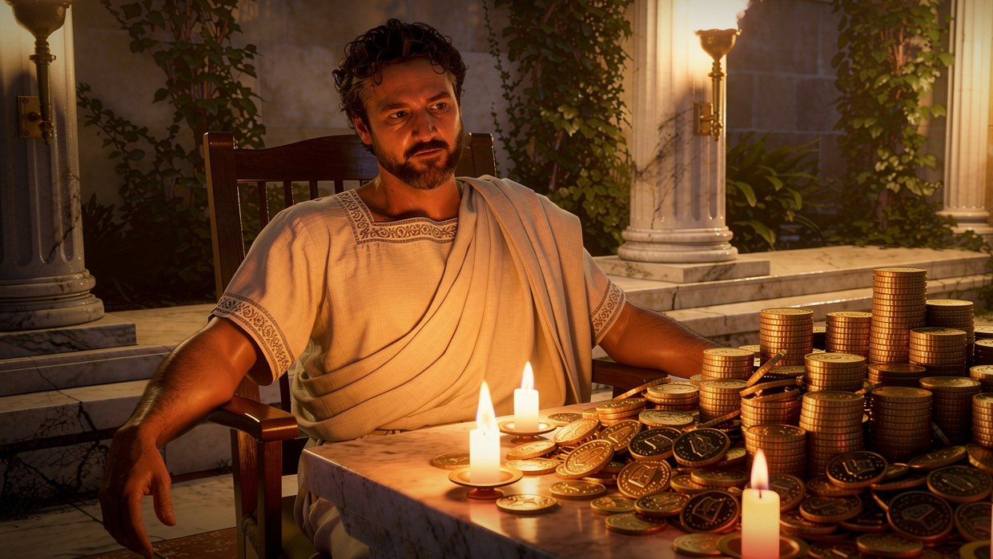
Ecclesiastes: Wisdom and Righteousness Does Not Always Lead to Good Results

Slide 7
The Frustration of Injustice
All things have I seen in the days of my vanity: there is a just man that perisheth in his righteousness, and there is a wicked man that prolongeth his life in his wickedness (Eccl 7:15).

Slide 8
Unfortunate Equity of Outcome
All things come alike to all: there is one event to the righteous, and to the wicked; to the good and to the clean, and to the unclean; to him that sacrificeth, and to him that sacrificeth not: as is the good, so is the sinner; and he that sweareth, as he that feareth an oath (Eccl 9:2).
Then said I in my heart, As it happeneth to the fool, so it happeneth even to me; and why was I then more wise? Then I said in my heart, that this also is vanity (Eccl 2:15).

Slide 9
The Point
Let us hear the conclusion of the whole matter: Fear God, and keep his commandments: for this is the whole duty of man. For God shall bring every work into judgment, with every secret thing, whether it be good, or whether it be evil (Eccl 12:13–14).

Slide 10
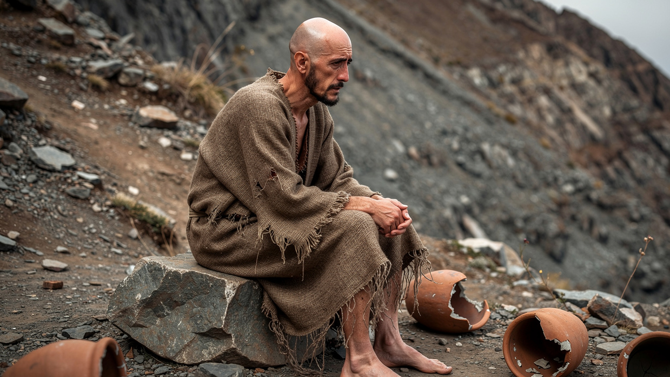
Job: God’s Will Can be Confusing to Us

Slide 11
God’s Commendation of Job
And the LORD said unto Satan, Hast thou considered my servant Job, that there is none like him in the earth, a perfect and an upright man, one that feareth God, and escheweth evil (Job 1:8)?

Slide 12
Job Does Not Turn Against God
Then Job arose, and rent his mantle, and shaved his head, and fell down upon the ground, and worshipped, And said, Naked came I out of my mother’s womb, And naked shall I return thither: The LORD gave, and the LORD hath taken away; Blessed be the name of the LORD. In all this Job sinned not, nor charged God foolishly (Job 1:20–22).

Slide 13
Satan’s Second Attempt
And the LORD said unto Satan, Hast thou considered my servant Job… and still he holdeth fast his integrity, although thou movedst me against him, to destroy him without cause. And Satan answered the LORD, and said, Skin for skin, yea, all that a man hath will he give for his life. But put forth thine hand now, and touch his bone and his flesh, and he will curse thee to thy face (Job 2:3ac, 4-5).

Slide 14
Job Wants God to Hear Him and Answer Him
Then call thou, and I will answer: Or let me speak, and answer thou me. How many are mine iniquities and sins? Make me to know my transgression and my sin. Wherefore hidest thou thy face, And holdest me for thine enemy (Job 13:22–24).
Oh that one would hear me! Behold, my desire is, that the Almighty would answer me… (Job 31:35a).

Slide 15
Job Wants God to Hear Him and Answer Him
Then the LORD answered Job out of the whirlwind, and said, Who is this that darkeneth counsel By words without knowledge? Gird up now thy loins like a man; For I will demand of thee, and answer thou me. Where wast thou when I laid the foundations of the earth? Declare, if thou hast understanding (Job 38:1–4).

Slide 16
Job Recognizes His Own Lack of Understanding
Then Job answered the LORD, and said, I know that thou canst do every thing, And that no thought can be withholden from thee. Who is he that hideth counsel Without knowledge? Therefore have I uttered that I understood not; Things too wonderful for me, which I knew not (Job 42:1–3).

Slide 17
Conclusion
Everyone Should Use Wisdom to Please God Rather Than for Good Results
For These Reasons

Slide 18
Reasons
Proverbs: Wisdom and Righteousness Honors God
Ecclesiastes: Wisdom and Righteousness Does Not Always Lead to Good Results
Job: God’s Will Can be Confusing to Us

