Slide 1
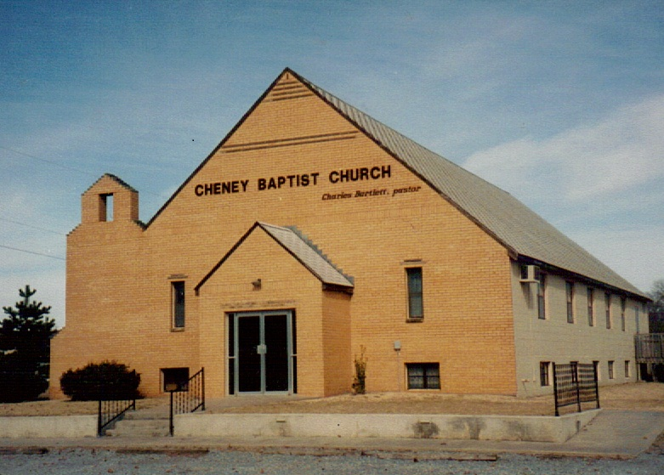
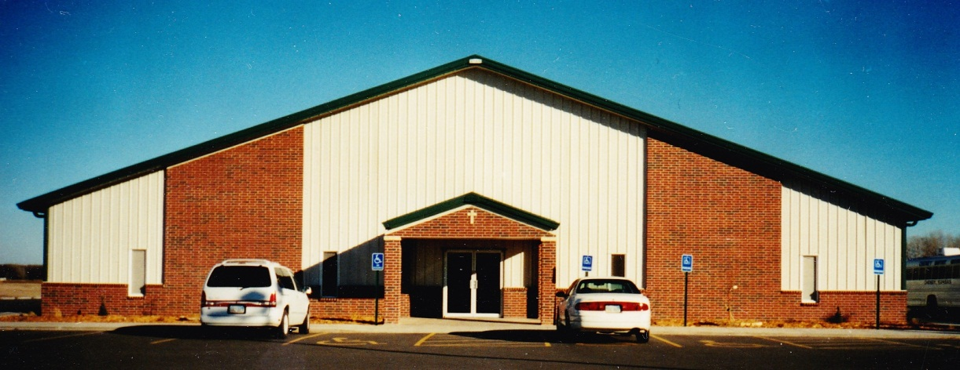
Cheney Baptist Church
70th Anniversary
June 21, 1953 -June 11, 2023
“What hath God wrought!”
(Nu 23:23)

Slide 2
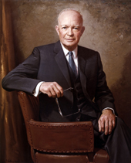
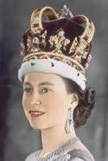
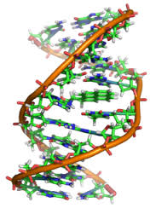
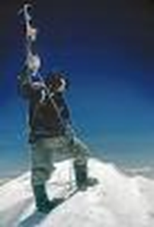
What’s Special about 1953?
The Korean War Ended.
Eisenhower became President.
Elizabeth II crowned Queen.
Discovery of the double-helix DNA
Sir Edmund Hillary climbs Mt. Everest
The Corvette goes on sale.
New York adopts three color traffic lights.

Slide 3
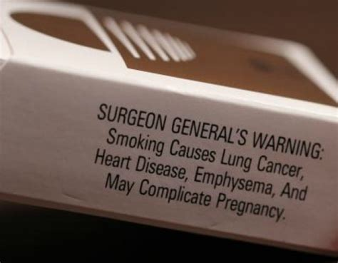
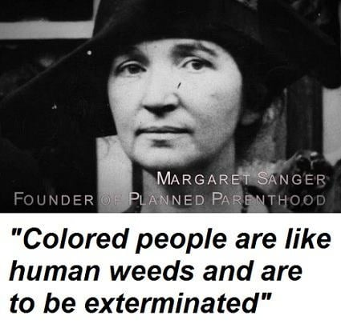
What happened in 1953?
Ian Fleming publishes his first James Bond novel,
Casino Royale.
Cigarette Smoking reported to cause Cancer.
Playboy Magazine publishes 1st issue.
Margaret Sanger funds birth control
pill research.

Slide 4
In a New York Times article Margaret Sanger wrote:
“Birth Control is not contraception indiscriminately and thoughtlessly practiced.
It means the release and cultivation of the better racial elements in our society,
and the gradual suppression, elimination and eventual extirpation of defective stocks —
those human weeds which threaten the blooming of the finest flowers of American civilization.“
April 8, 1923, Section X, Page 11

Slide 5
Cost of Living in 1953?
Average annual Wages: $4,000.00
Cost of new house:
A gallon of Gas:
A new car:
New Dress:
New Shoes:
Bathing Suit:
$9,550
20 cents
$1,650.00
$5.00
$3.00
$4.00

Slide 6
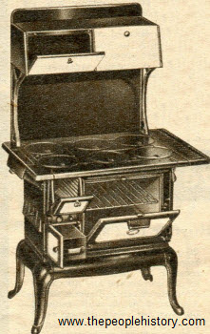
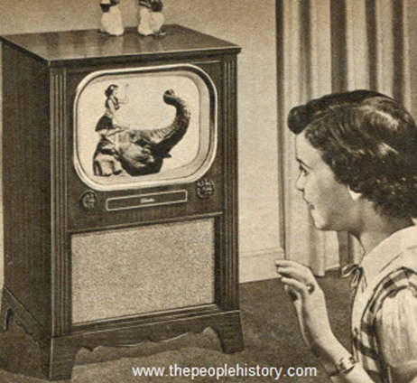
Gas: $185
$329
Wood Stove
$50
First Color TV:
$1,275
$350

Slide 7
What happened in 1953?
June 21, 18 believers covenanted together to form the Cheney Baptist Church.
Born in a tent revival, they soon moved into the American Legion Hall.
August: CBC began a Missions Program.
October: Groundbreaking for Building.

Slide 8
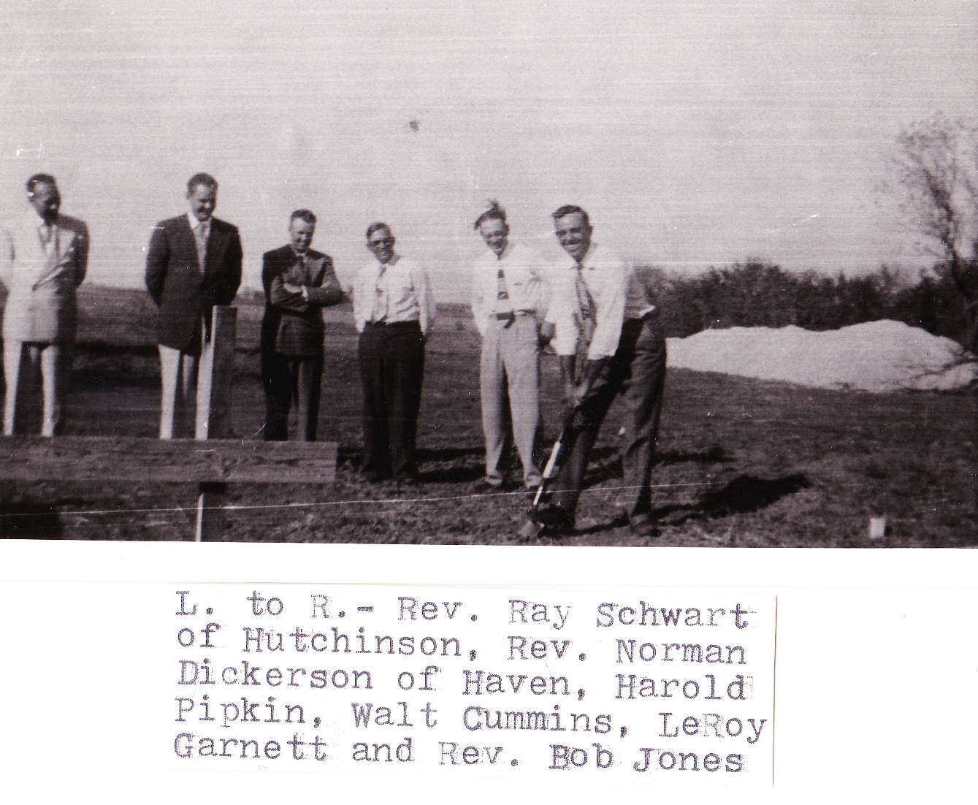
“What hath God wrought!” (Nu 23:23)

Slide 9
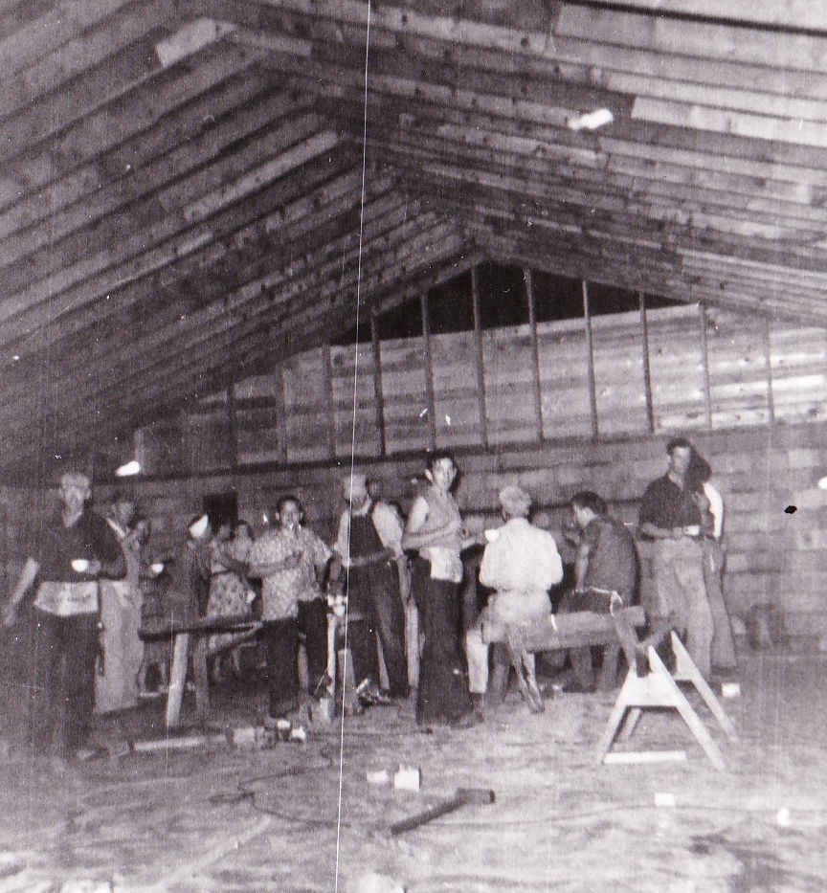
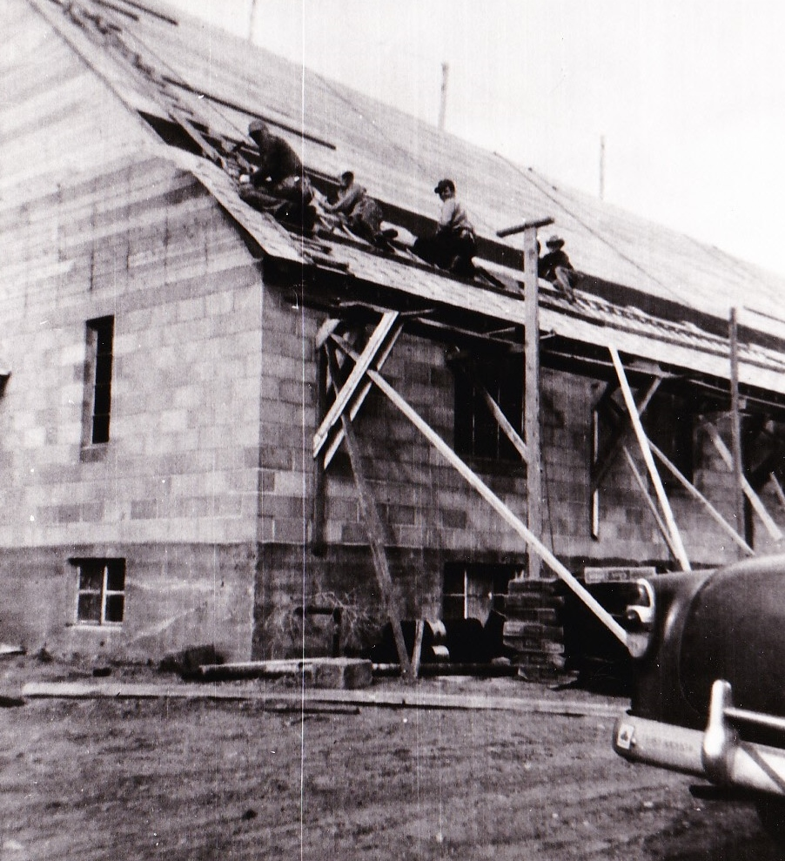
Held services in basement during building.

Slide 10
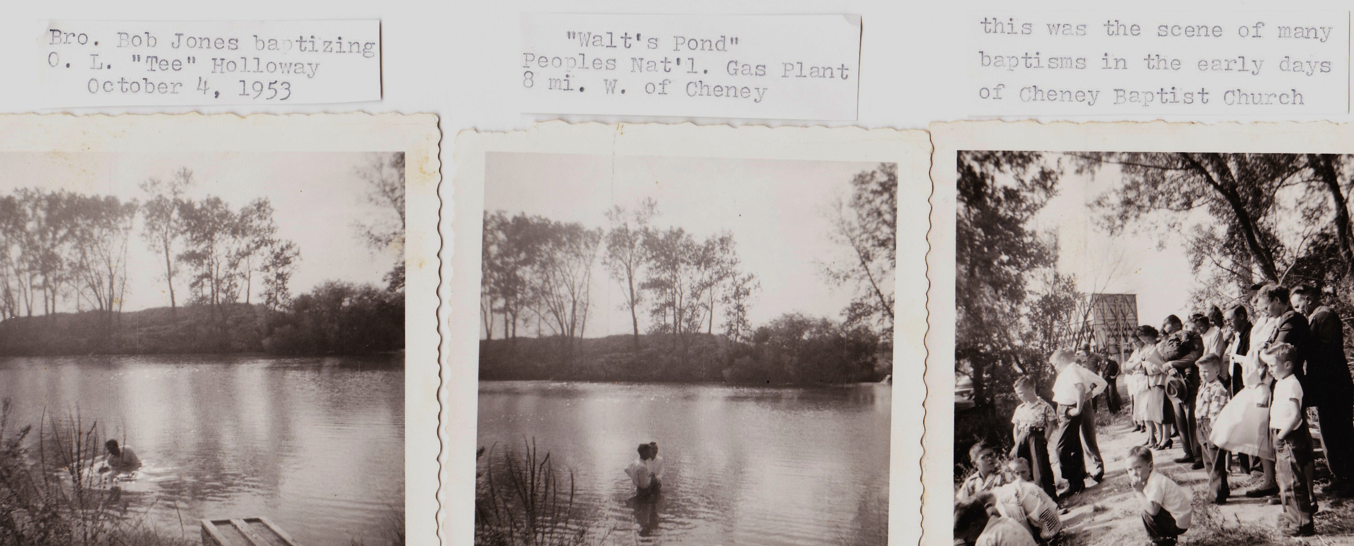
Early Baptisms
Pastor Bob Jones baptizing at Walt’s Pond Oct. 4th 1953

Slide 11
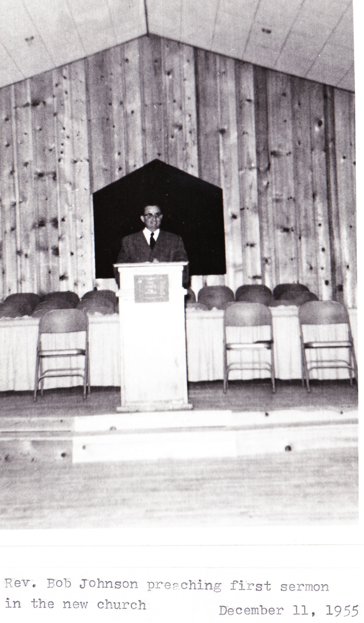
Pastor Bob Johnson preaching first sermon in new church
Dec. 11, 1955

Slide 12
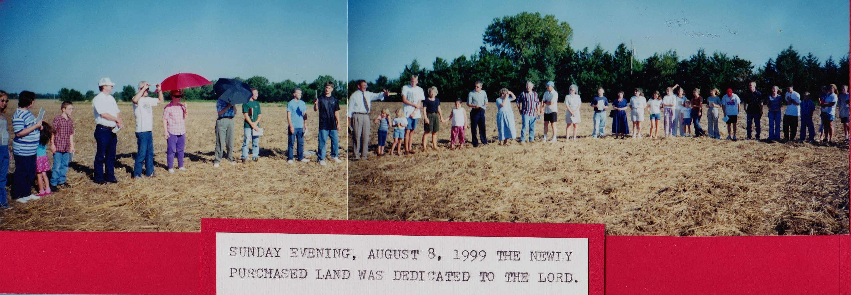
“What hath God wrought!” (Nu 23:23)

Slide 13
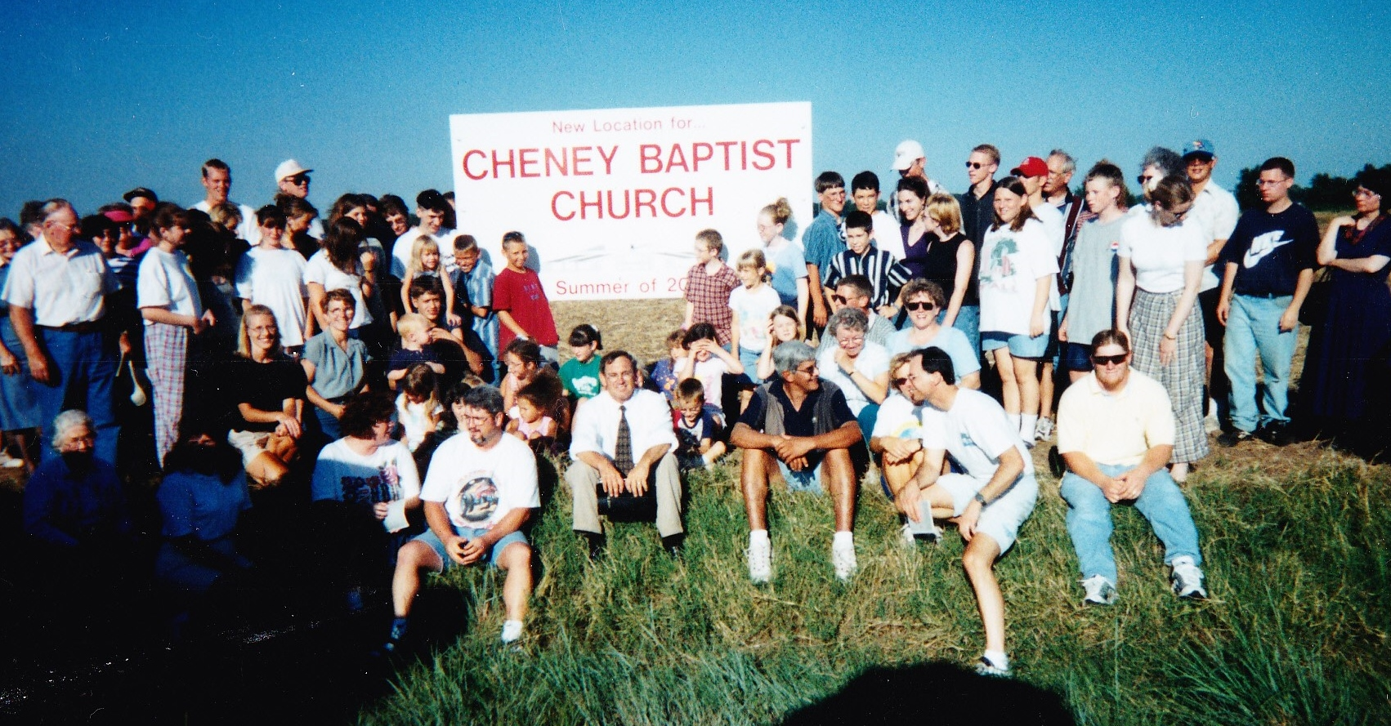
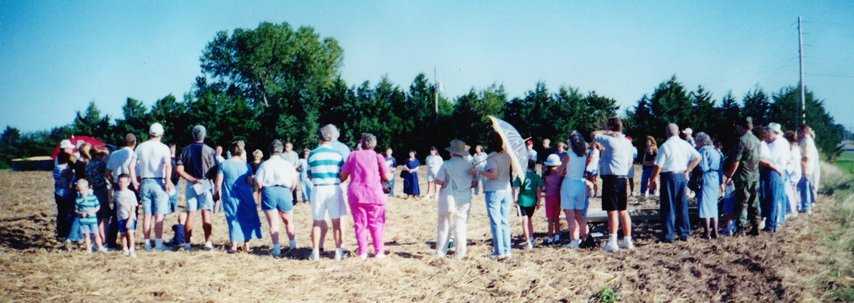
The Devices of the Devil!

Slide 14
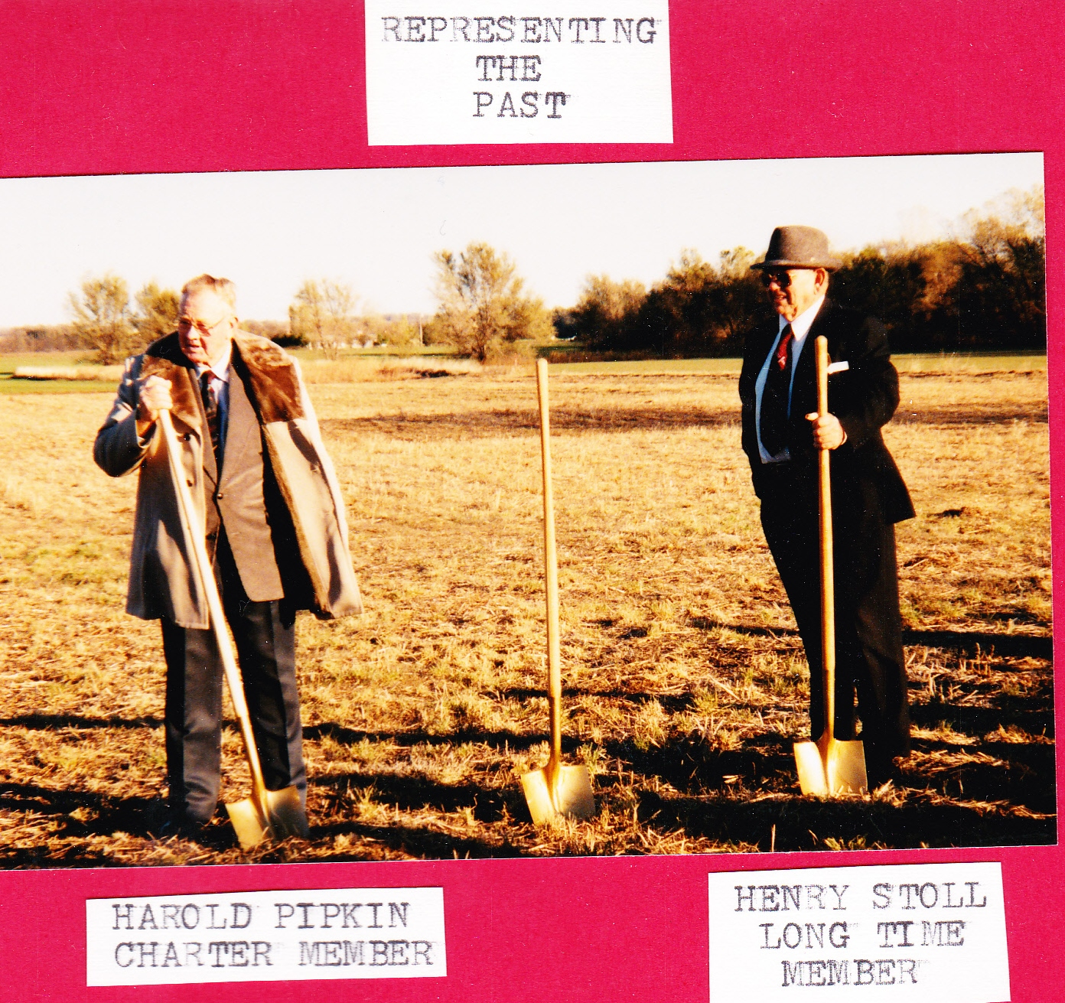
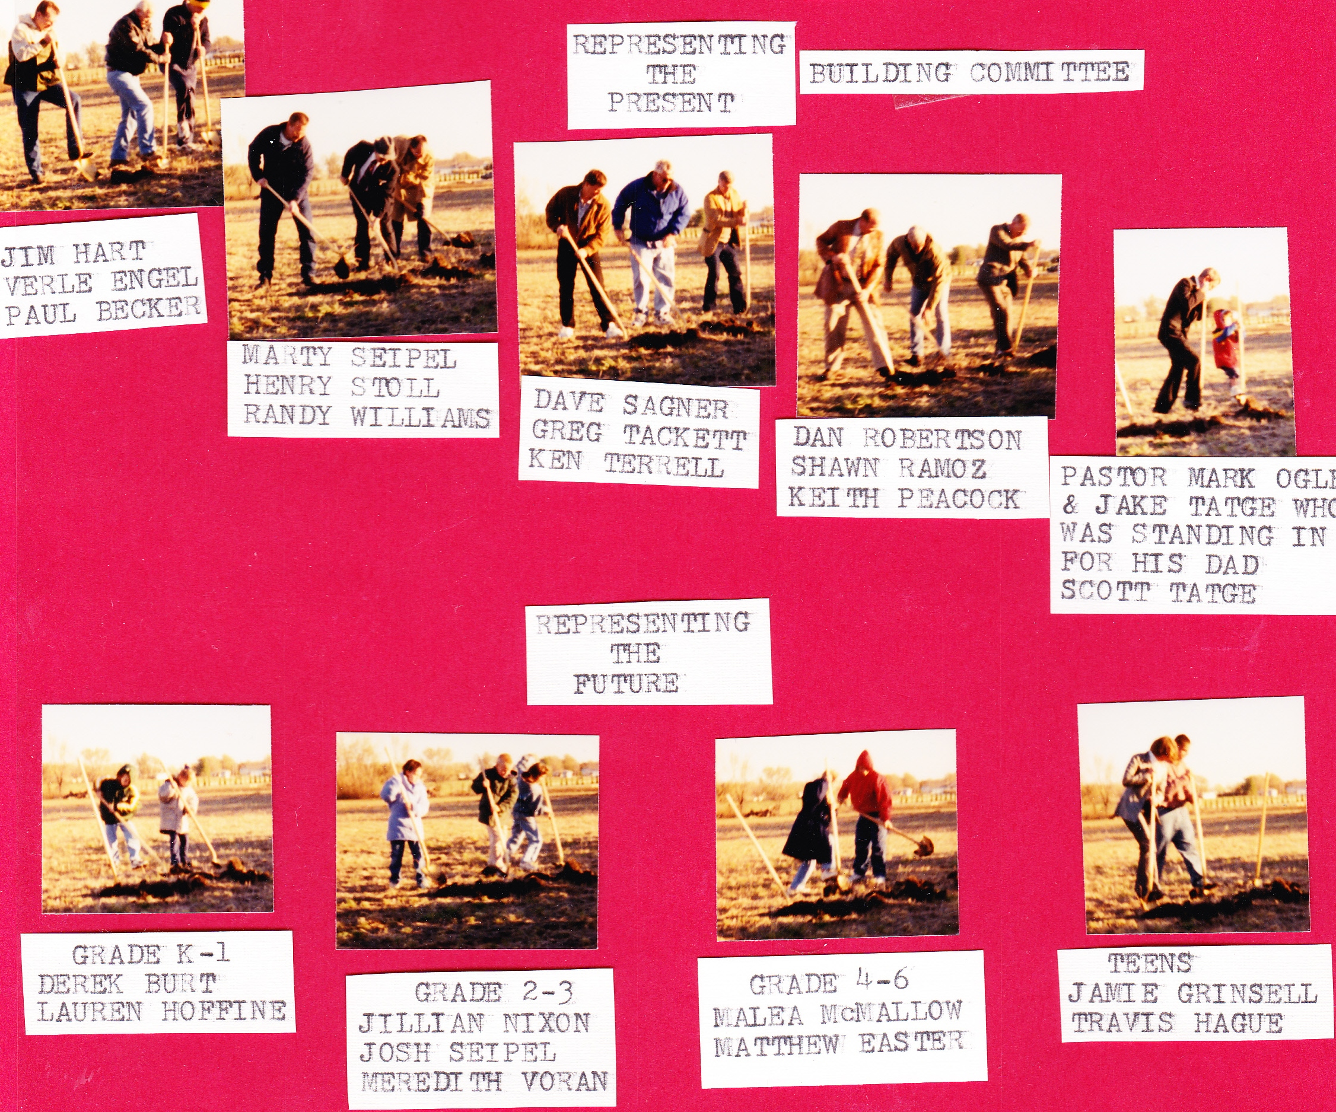

Slide 15
“What hath God wrought” (Nu 23:23)
Was Balaam’s observation to King Balak
who was seeking to find a way to curse Israel.
Whoever & whatever God seeks to bless (Ph. 2:13),
Satan will seek to curse! (Jn 10:10a)
He does this by cultivating Separation,
Deception, Seduction
against the very source of our Blessings.
(Gen. 3: 1 Sam 15:23)
and ultimately Rebellion

Slide 16
As well as America.
This was true of Israel,
Lincoln’s call for fasting and prayer Mar. 1863
“… it is the duty of nations as well as of men to own their dependence upon the overruling power of God, to confess their sins …in humble sorrow, yet with assured hope that genuine repentance will lead to mercy and pardon, and to recognize the sublime truth,
announced in the Holy Scriptures
and proven by all history, that those nations only
are blessed whose God is the Lord…”

Slide 17
This is true, not just of nations, but also of individual people and Churches! Deut. 30:19
At our 60th anniversary I spoke on 2 Cor 2:11 and discussed how Satan was behind many of the societal changes we were seeing then.
“Lest Satan should get an advantage of us:
for we are not ignorant of his devices.”
noēma; purpose, intellect, resolve.
Satan has a purpose (Jn 10:10)
and the intellect and resolved to pursue it!

Slide 18
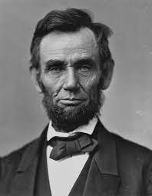
At our 60th Anniversary I shared how Satan had infiltrated various institutions of our Nation in an attempt to seduce us away from our Biblical Foundations. Some of those successes include:
Removing school Prayer (June 62) and Bible (June 63)
Removing the 10 Commandments from Schools. 11/80
Why all this focus on the classroom?
“The philosophy of the school room in one generation,
Will be the philosophy of the government
in the next.” A. Lincoln

Slide 19
What has Satan Wrought?
Removing any reference to God and/or the Bible.
Legalizing murder of the unborn. Jan 1973
Redefining Homosexuality Dec. 1973
This classification (as a mental disorder) was challenged by gay rights activists following the 1969 Stonewall riots, and in December 1973, the APA board of trustees voted to declassify homosexuality as a mental disorder.
(without any scientific basis)

Slide 20
What has Satan Wrought?
Removing any reference to God and/or the Bible.
Legalizing murder of the unborn. Jan 1973
Redefining Homosexuality Dec. 1973
This classification (as a mental disorder) was challenged by gay rights activists following the 1969 Stonewall riots, and in December 1973, the APA board of trustees voted to declassify homosexuality as a mental disorder.
(without any scientific basis)

Slide 21
Satan is still pursuing his “devices” with increased resolve and intensity. 2 Tim 3:1,13 “in the last days, perilous times shall come…
But evil men and seducers shall wax worse and worse, deceiving, and being deceived.”
Rev. 12:12“Woe to the inhabiters of the earth… for the devil is come down unto you, having great wrath,
because he knoweth that he hath but a short time.”
“What has Satan Wrought?”

Slide 22
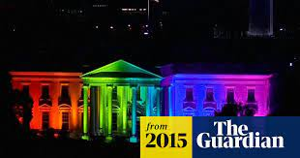
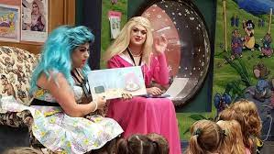
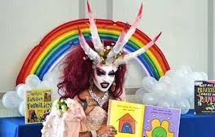
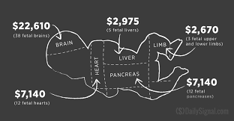
Look at what he’s accomplished in the
just the last 10 years!
Redefined Marriage (June 2015)
Drag Queen Story Hour (2015)
Selling aborted baby parts. 2016
https://thebridgehead.ca/2020/04/16/new-documents-reveal-that-
planned-parenthood-charged-for-usable-baby-body-parts/
Biden Administration Removes Limits
on Use of Fetal Tissue for Research 2021

Slide 23
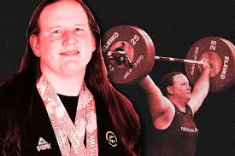
“What has Satan Wrought?” since 2013
Gender insanity! (Redefining Biology)
There’s 107 genders according to sexualdiversity.org
Males competing as women.
2020 Olympics

Slide 24
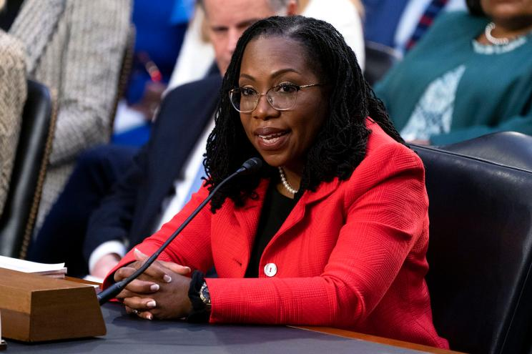
Ketanji Brown Jackson is the first black woman to be nominated to the Supreme Court.
When asked if she “could provide a definition for the word ’woman.’” Eventually Responded by saying:
“No, I can’t,” …
“Not in this context.
I’m not a biologist.”
March 22

Slide 25
“What has Satan Wrought?” since 2013
Kim Petras (biological male) on cover of Sports Illustrated Swimsuit issue (May 15, 2023)
Earlier this year, Kim made history as the first transgender woman to win a Grammy Award for best pop duo/group performance, for her track “Unholy” with Sam Smith.

Slide 26
“What has Satan Wrought?” since 2013
Increasing Abuse of Government Power
Closing Churches in the name of Heath Safety
While leaving massage parlors, bars and casinos open
ESG insanity
Political hypocrisy and Corruption
Weaponizing Government agencies
(FBI, Justice Dept., IRS, Homeland Security)

Slide 27
These battles are setting the stage for the final war!
Rev. 12:7-10: “There was war in heaven…
9 And the great dragon was cast out, that old serpent, called the Devil, and Satan, which deceiveth the whole world: he was cast out into the earth,
and his angels (messengers) were cast out with him.
(He’s not working alone! 2 Cor 12; 2 Tim 3,4)
10 …Now is come salvation, and strength, and the kingdom of our God, and the power of his Christ:
for the accuser of our brethren is cast down,
which accused them before our God day and night.”

Slide 28
11 “And they overcame him by the blood of the Lamb,
and by the word of their testimony;
and they loved not their lives unto the death.
12 Therefore rejoice, ye heavens, and ye that dwell in them.
Woe to the inhabiters of the earth and of the sea!
for the devil is come down unto you, having great wrath,
because he knoweth that he hath but a short time…
17 And the dragon was wroth …and went to make war with the remnant of her seed,
which keep the commandments of God,
and have the testimony of Jesus Christ.”

Slide 29
This war is now being fought on Earth! (Eph 6)
The Dragon (Devil) of Rev 12 will give his power to the “Beast” introduced in Rev. 13, who controls the world through fear and finance! (Rev. 13:16-17)
I find it interesting that President Biden signed Executive order 14067 March 22 ordering all US Govt. agencies to find a way to fast track the transition to digital dollars.
Digital Currencies have the ability to make the control prophesied in Rev. 13:16,17 a reality.

Slide 30
Central Bank Digital Currency Tracker
114 countries, representing over 95 percent of global GDP, are exploring/developing a CBDC.
A new high of 60 countries are in an advanced phase of exploration (development, pilot, or launch).
Rev. 12:12 “the Devil is come down …having great wrath, because he knoweth that he hath but a short time…”

Slide 31
2 Cor 2:11 “Lest Satan should get an advantage of us:
for we are not ignorant of his devices.”
noēma; purpose, intellect, resolve.
He’s not the only one with a purpose and resolve!
70 years ago 18 believers came together with a purpose and resolve to stand in the gap for Cheney and the surrounding communities.
We here have come to honor their commitment
And to recommit ourselves to this task
Of partnering with God’s purposes/resolve.

Slide 32
In Acts 13:36 Paul records that “David, after he served his own generation by the will of God, fell on sleep…”
Those 18 CBC Charter members sacrificed and
“served their generation”
during a time of spiritual/moral transition.
Can it be said of us that we’re serving our
generation “By the will of God”
During these turbulent transitional times?
How will future generations judge us?
“Will those who come behind us find us faithful?”

Slide 33
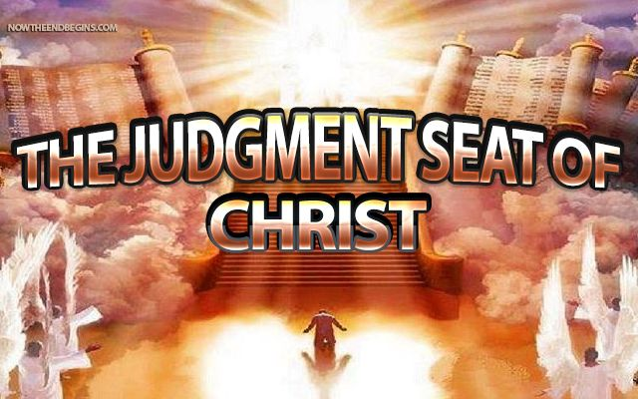
More importantly, how will Jesus?
Will we hear:
1 Cor 3:10-15
2 Cor 5:9-11
“Well done good and faithful servants” (Mt. 25:21)
or “wicked and slothful servants” Vs 26

Slide 34
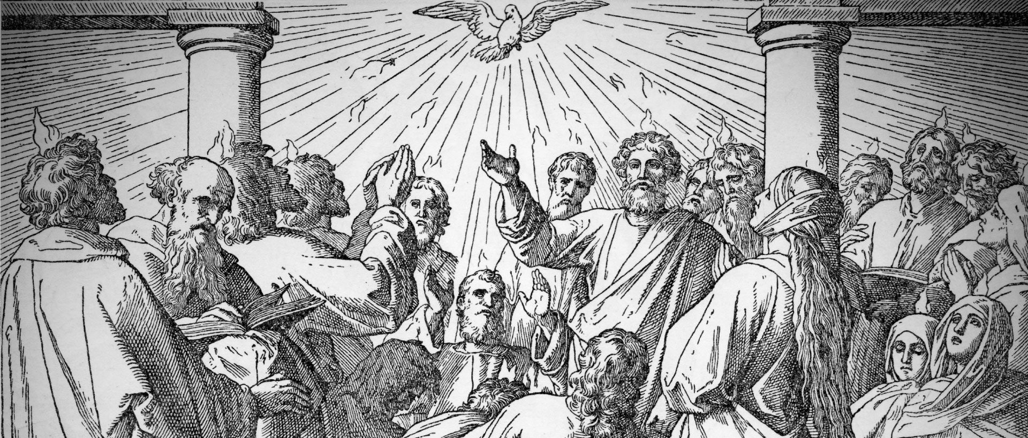
The Holy Spirit came at Pentecost
He came in mighty fullness then.
His witness through believers won the lost
and multitudes were born again.

Slide 35
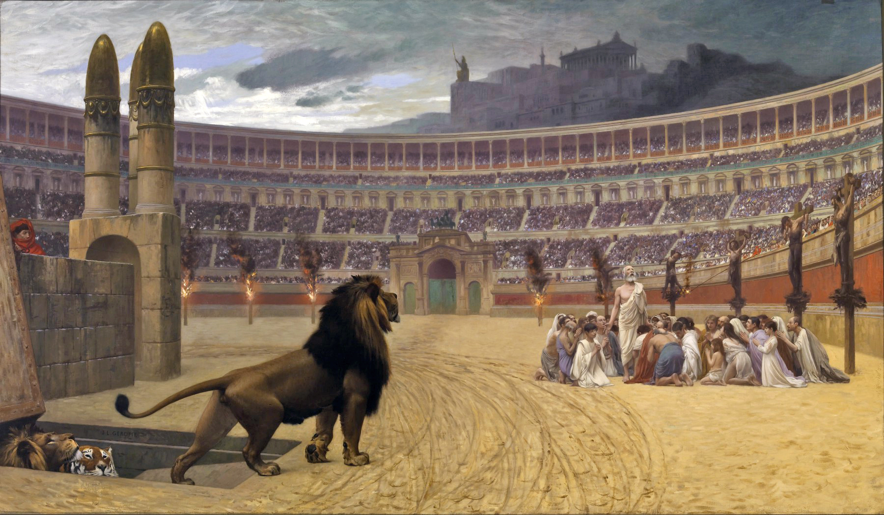
The early Christians scattered o’er the world
they preached the gospel fearlessly.
Though some were martyred and to lions hurled,
they marched along in victory.

Slide 36
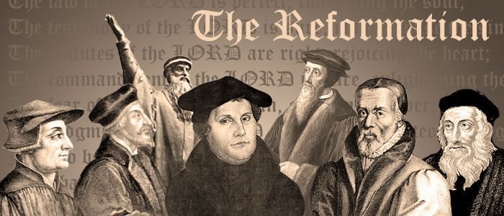
Then in an age when darkness gripped the earth
the just shall live by faith was learned.
The Holy Spirit gave the Church new birth
As reformation fires burned.

Slide 37
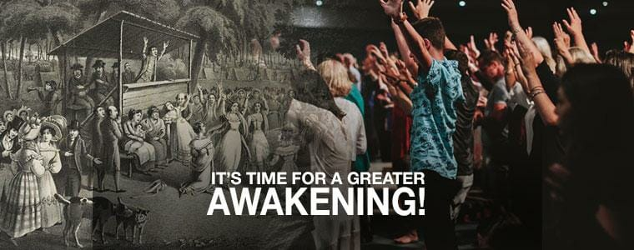
In later years the great revivals came
when saints would seek the Lord and pray.
O once again we need that Holy Flame
to meet the challenge of today.

Slide 38
Come Holy Spirit, Dark is the hour
we need your filling
your love and your mighty power
move now among us
stir us we pray; come Holy Spirit
Revive you church today!
John W. Peterson

